Slide 1
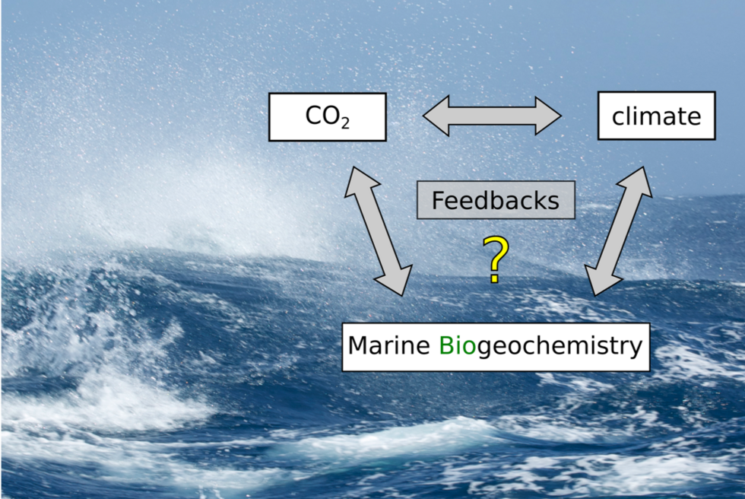
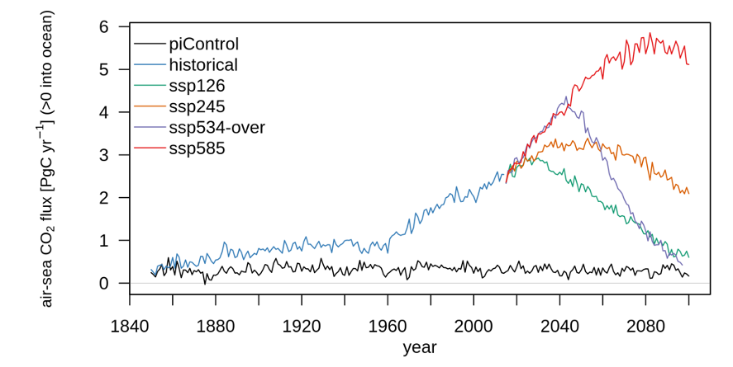
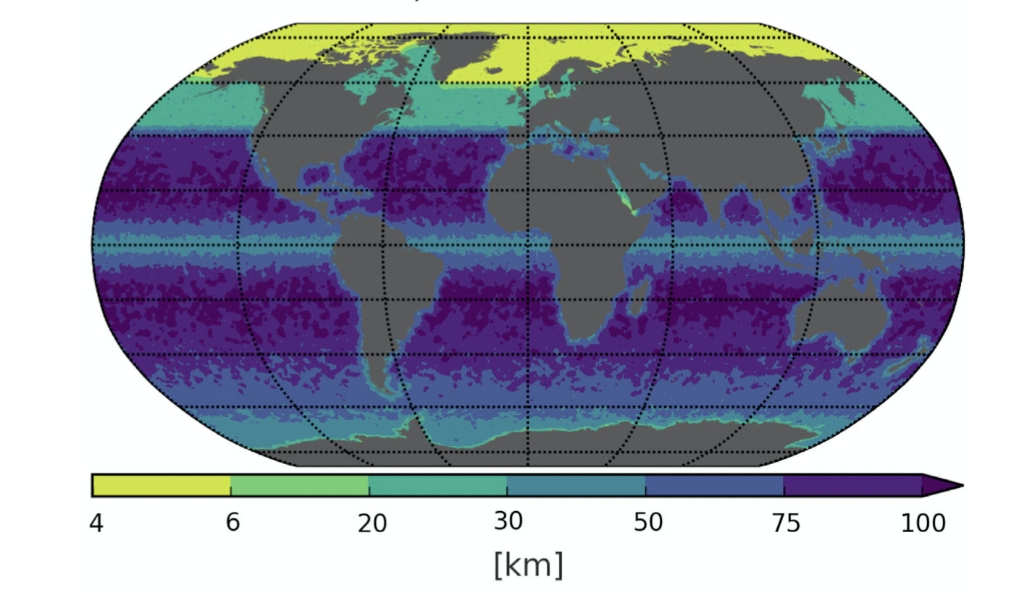

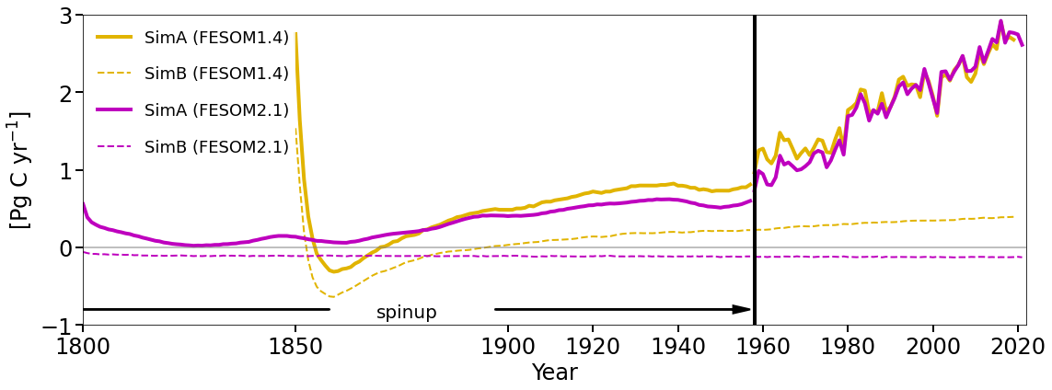
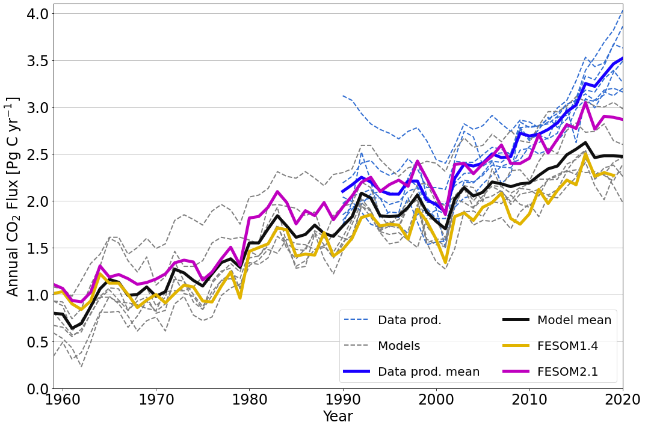

DKRZ User Workshop 2022
Ö. Gürses, L. Oziel, O. Karakuṣ, D. Sidorenko, C. Völker, Y. Ye, M. Zeising, and J. Hauck
FESOM2.1-REcoM3 – an updated ocean biogeochemical model
The effects of climate change, caused by increasing greenhouse gas emissions, are strongly impacting us. In particular the ocean plays a key role in the global carbon cycle. We thus need to improve our understanding of the ocean and biogeochemical state.
Here we present an ocean general circulation biogeochemical model with an active ocean carbon cycle, based on the Finite VolumE Sea ice-Ocean Model (FESOM2.1) and the Regulated Ecosystem Model (REcoM3), which will be used for climate change scenarios in the future. Its improved dynamical core resulted in a higher computational efficiency compared to the previous model version based on FESOM1.4.
CMIP6-type simulations with fully coupled Earth System Model AWI-ESM1
On-going analyses: variability of air-sea CO2 fluxes, ocean carbon uptake in future scenarios, extreme events (daily model output, from C. Danek)
model-REcoM3
Ocean model-FESOM2.1
supports an unstructured mesh
higher resolution in domains of interest
lower computing cost compared to preceding version FESOM1.4
Biogeochemical
water column biogeochemistry and ecosystem model
incorporates cycles of carbon and nutrients (nitrogen, iron, and silicon)
varying intracellular stoichiometry in phytoplankton and zooplankton
slow-sinking/fast-sinking detritus
polar macrozooplankton (Karakus et al., 2021)
Horizontal resolution of the mesh used in this study
Surface ocean carbon flux
Nutrients
Sketch of REcoM3
Ocean productivity
FESOM2.1- REcoM3
has lower bias in control simulation (simB)
is in better aggrement with the observation-based estimates (pCO₂ product , IPCC 1990 and others)
FESOM2.1- REcoM3 successfully reproduces the global patterns of simulated concentrations compared to the observed fields
positive DIN bias in the subtropical Pacific Ocean (can be cured with third zooplankton, Karakus et al., 2022-accepted)
overestimated (underestimated) DSi in the Southern Ocean (northern Pacific)
simulated global net primary production (NPP) is at the lower end of the satellite-based estimate range
the modeled export production (EP) and opal export is within the range of the observations
 | FESOM1.4 (Sim. A) | FESOM2.1 (Sim. A) | Range (Literature)
NPP global (PgC yr ⁻¹) | 32.5 | 35.8 | 50.5 (VGPM, this study)
 |  |  | 68.9 (CBPM, this study)
 |  |  | 47.3 (Behrenfeld and Falkowski, 1997)
 |  |  | 52 (Westberry et al., 2008)
 |  |  | 23.7-30.7 (Schneider et al., 2008)
 |  |  | 48.7-52.7 (Kulk et al., 2020)
EP global (PgC yr ⁻¹) | 6.1 | 5.9 | 9.6 (Schlitzer, 2004)
 |  |  | 5.8-13 (Dunne et al., 2007)
 |  |  | 5 (Henson et al., 2011)
 |  |  | 6 (Siegel et al., 2014)
Opal export global (Tmol Si yr ⁻¹) | 74.5 | 115 | 69-185 (review in Dunne et al., 2007)
NPP SO (PgC yr ⁻¹) | 3.1 | 3.24 | 3.48 (VGPM, this study)
 |  |  | 3.92 (CBPM, this study)
 |  |  | 1.1-4.9 (Carr et al., 2006)
 |  |  | 5.7 (Behrenfeld and Falkowski, 1997)
EP SO (PgC yr ⁻¹) | 1.1 | 1.1 | 1.0 (Schlitzer 2002; Nevinson et al., 2012)
Opal export SO (Tmol Si yr ⁻¹) | 21.5 | 38 | 21-54 (Dunne et al., 2007)
Simulated annual mean global air-sea CO₂ flux in PgC yr−1
simA: ⬀ CO₂ + climatology (after 1958, JRA55-do-1.5.0)
simB: ⇨ CO₂ (278 ppm) + climatology (control simulation)
Global net primary and export production in our simulations and estimates from literature. Southern Ocean (SO) is considered as the region South of 50°S.
2.2
IPCC 1990 *
Where to next?
Simulated surface concentration of dissolved inorganic nitrogen (A), dissolved inorganic silicon (D) and corresponding differences (C and F) between FESOM2.1-REcoM3 averaged over the time period 2012-2021 and WOA2018 climatology (B and E, Garcia et al., 2019b)
Coupling FESOM2.1-REcoM3 to atmosphere model (or CMIP* forcing) we can investigate:
changes in biogeochemical cycles and ecosystems in response to modification in ocean circulation
the impact of mesh resolution on nutrients through turbulent mixing, advection, etc.
micro/meso/macrozooplankton
CO₂ sensitivity and multiple driver effects (CO₂, T, light, nutrients) on phytoplankton growth
* Denman et al., 2007
Outcome
FESOM2.1-REcoM3 is one out of three 'high-CO2 sink' models in the Global Carbon Budget, which agree better with multiple observational constraints (Friedlingstein et al., 2022)
Current developments in REcoM3 are at the forefront of modelling the biological carbon pump
Globally integrated annual air-sea CO₂ flux from Global Ocean Biogeochemistry Models and data-products used in the Global Carbon Budget 2020, after applying bias correction to the models and area-corrections and river flux adjustment of of 0.65 PgC yr−1 (Regnier et al., 2022) to the data-products
References
Garcia, H. E., Weathers, K. W., Paver, C. R., Smolyar, I., Boyer, T. P., Locarnini, R. A., Zweng, M. M., Mishonov, A. V., Baranova,O. K., Seidov, D., and Reagan, J. R.:
World Ocean Atlas 2018, Volume 4: Dissolved Inorganic Nutrients (phosphate, nitrate, silicate). A. Mishonov Technical Editor, Tech. rep., NOAA Atlas NESDIS 84, 2019b
Regnier, P., Resplandy, L., Najjar, R. G., and Ciais, P.: The land-to-ocean loops of the global carbon cycle, Nature, 603, 401–410,1040, https://doi.org/10.1038/s41586-021-04339-9, 2022
Karakus, O., Völker, C., Iversen, M., Hagen, W., Wolf-Gladrow, D., Fach, B., and Hauck, J.: Modeling the Impact of Macrozooplankton on Carbon Export Production in the Southern Ocean, Journal of Geophysical Research: Oceans, 126, https://doi.org/10.1029/2021JC017315, 2021
Friedlingstein, P., Jones, M. W., O’Sullivan, M., Andrew, R. M., Bakker, D. C. E., Hauck, J., Le Quéré, C., Peters, G. P., Peters, W., Pongratz, J., Sitch, S., Canadell, J. G., Ciais, P., Jackson, R. B., Alin, S. R., Anthoni, P., Bates, N. R., Becker, M., Bellouin, N., Bopp, L., Chau, T. T. T., Chevallier, F., Chini, L. P., Cronin, M., Currie, K. I., Decharme, B., Djeutchouang, L. M., Dou, X., Evans, W., Feely, R. A., Feng, L., Gasser, T., Gilfillan, D., Gkritzalis, T., Grassi, G., Gregor, L., Gruber, N., Gürses, Ö., Harris, I., Houghton, R. A., Hurtt, G. C., Iida,895 Y., Ilyina, T., Luijkx, I. T., Jain, A., Jones, S. D., Kato, E., Kennedy, D., Klein Goldewijk, K., Knauer, J., Korsbakken, J. I., Körtzinger, A., Landschützer, P., Lauvset, S. K., Lefèvre, N., Lienert, S., Liu, J., Marland, G., McGuire, P. C., Melton, J. R., Munro, D. R., Nabel, J. E. M. S., Nakaoka, S.-I., Niwa, Y., Ono, T., Pierrot, D., Poulter, B., Rehder, G., Resplandy, L., Robertson, E., Rödenbeck, C., Rosan, T. M., Schwinger, J., Schwingshackl, C., Séférian, R., Sutton, A. J., Sweeney, C., Tanhua, T., Tans, P. P., Tian, H., Tilbrook, B., Tubiello, F., van der Werf, G. R., Vuichard, N., Wada, C., Wanninkhof, R., Watson, A. J., Willis, D., Wiltshire, A. J., Yuan, W., Yue, C., Yue, X.,900 Zaehle, S., and Zeng, J.: Global Carbon Budget 2021, Earth System Science Data, 14, 1917–2005, https://doi.org/10.5194/essd-14-1917-2022, 2022
Denman, K. L., Brasseur, G., Chidthaisong, A., Ciais, P., Cox, P. M., Dickinson, R. E., Hauglustaine, D., Heinze, C., Holland, E., Jacob, D., Lohmann, U., Ramachandran, S., Leite da Silva Dias, P., Wofsy, S. C., and Zhang, X.: Couplings Between Changes in the Climate System and Biogeochemistry, in: Climate Change 2007: The Physical Science Basis.
Contribution of Working Group I to the Fourth Assessment Report of the Intergovernmental Panel on Climate Change, edited by: Solomon, S., Qin, D., Manning, M., Marquis, M., Averyt, K., Tignor, M. M. B., Miller, H. L., and Chen, Z. L., Cambridge University Press, Cambridge, UK and New York, USA, 499–587, 2007.
Acknowledgements: This project has received funding from the Helmholtz Junior Research Group, Marine Carbon and Ecosystem Feedbacks in the Earth System (MarESys)
BREMERHAVEN
Am Handelshafen 12
27570 Bremerhaven
Telefon 0471 4831-0
www.awi.de

