Slide 1


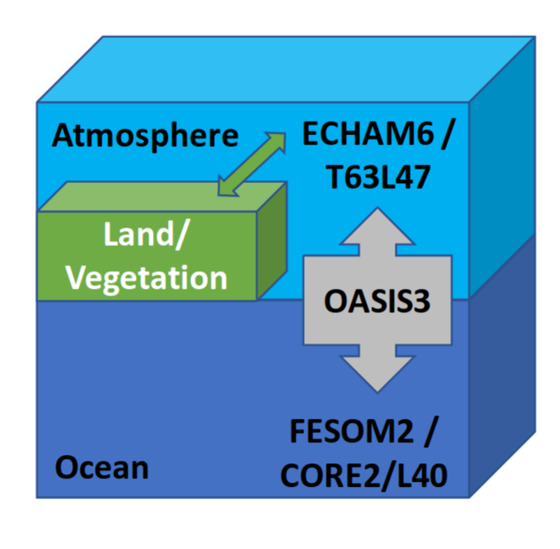
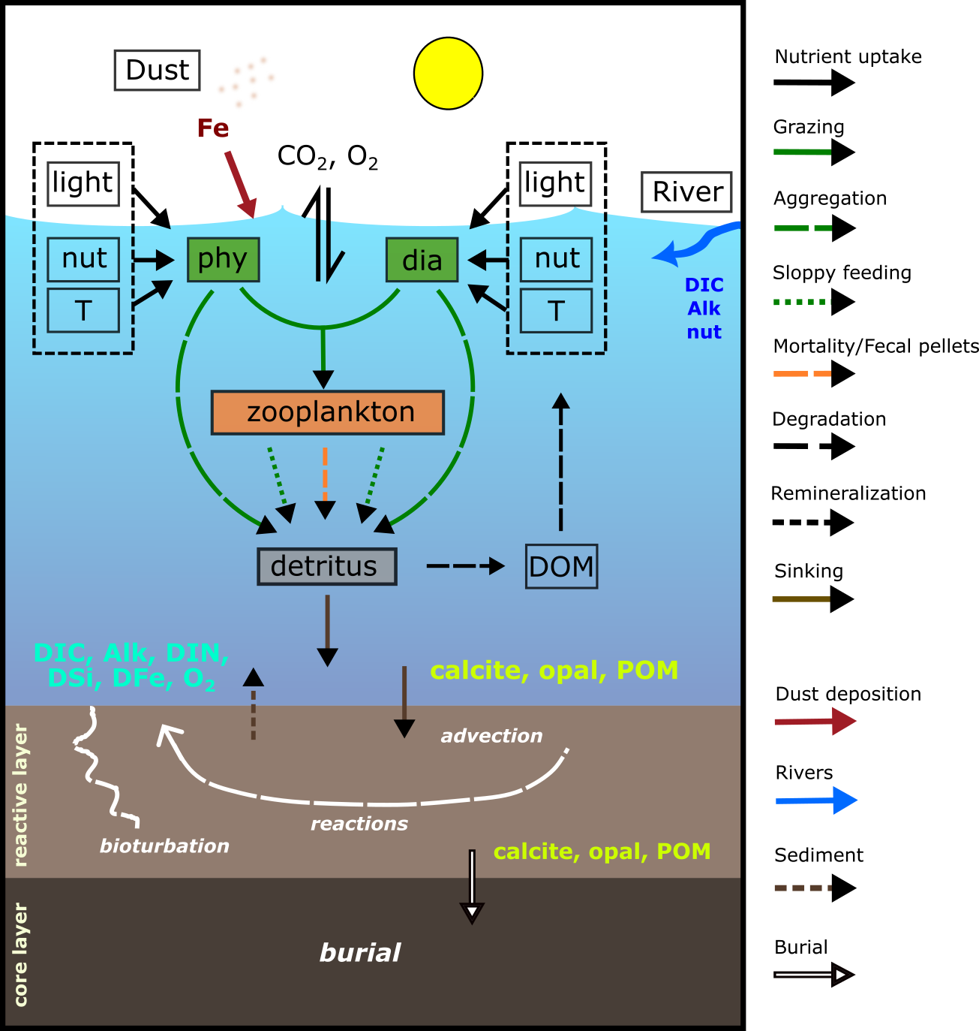
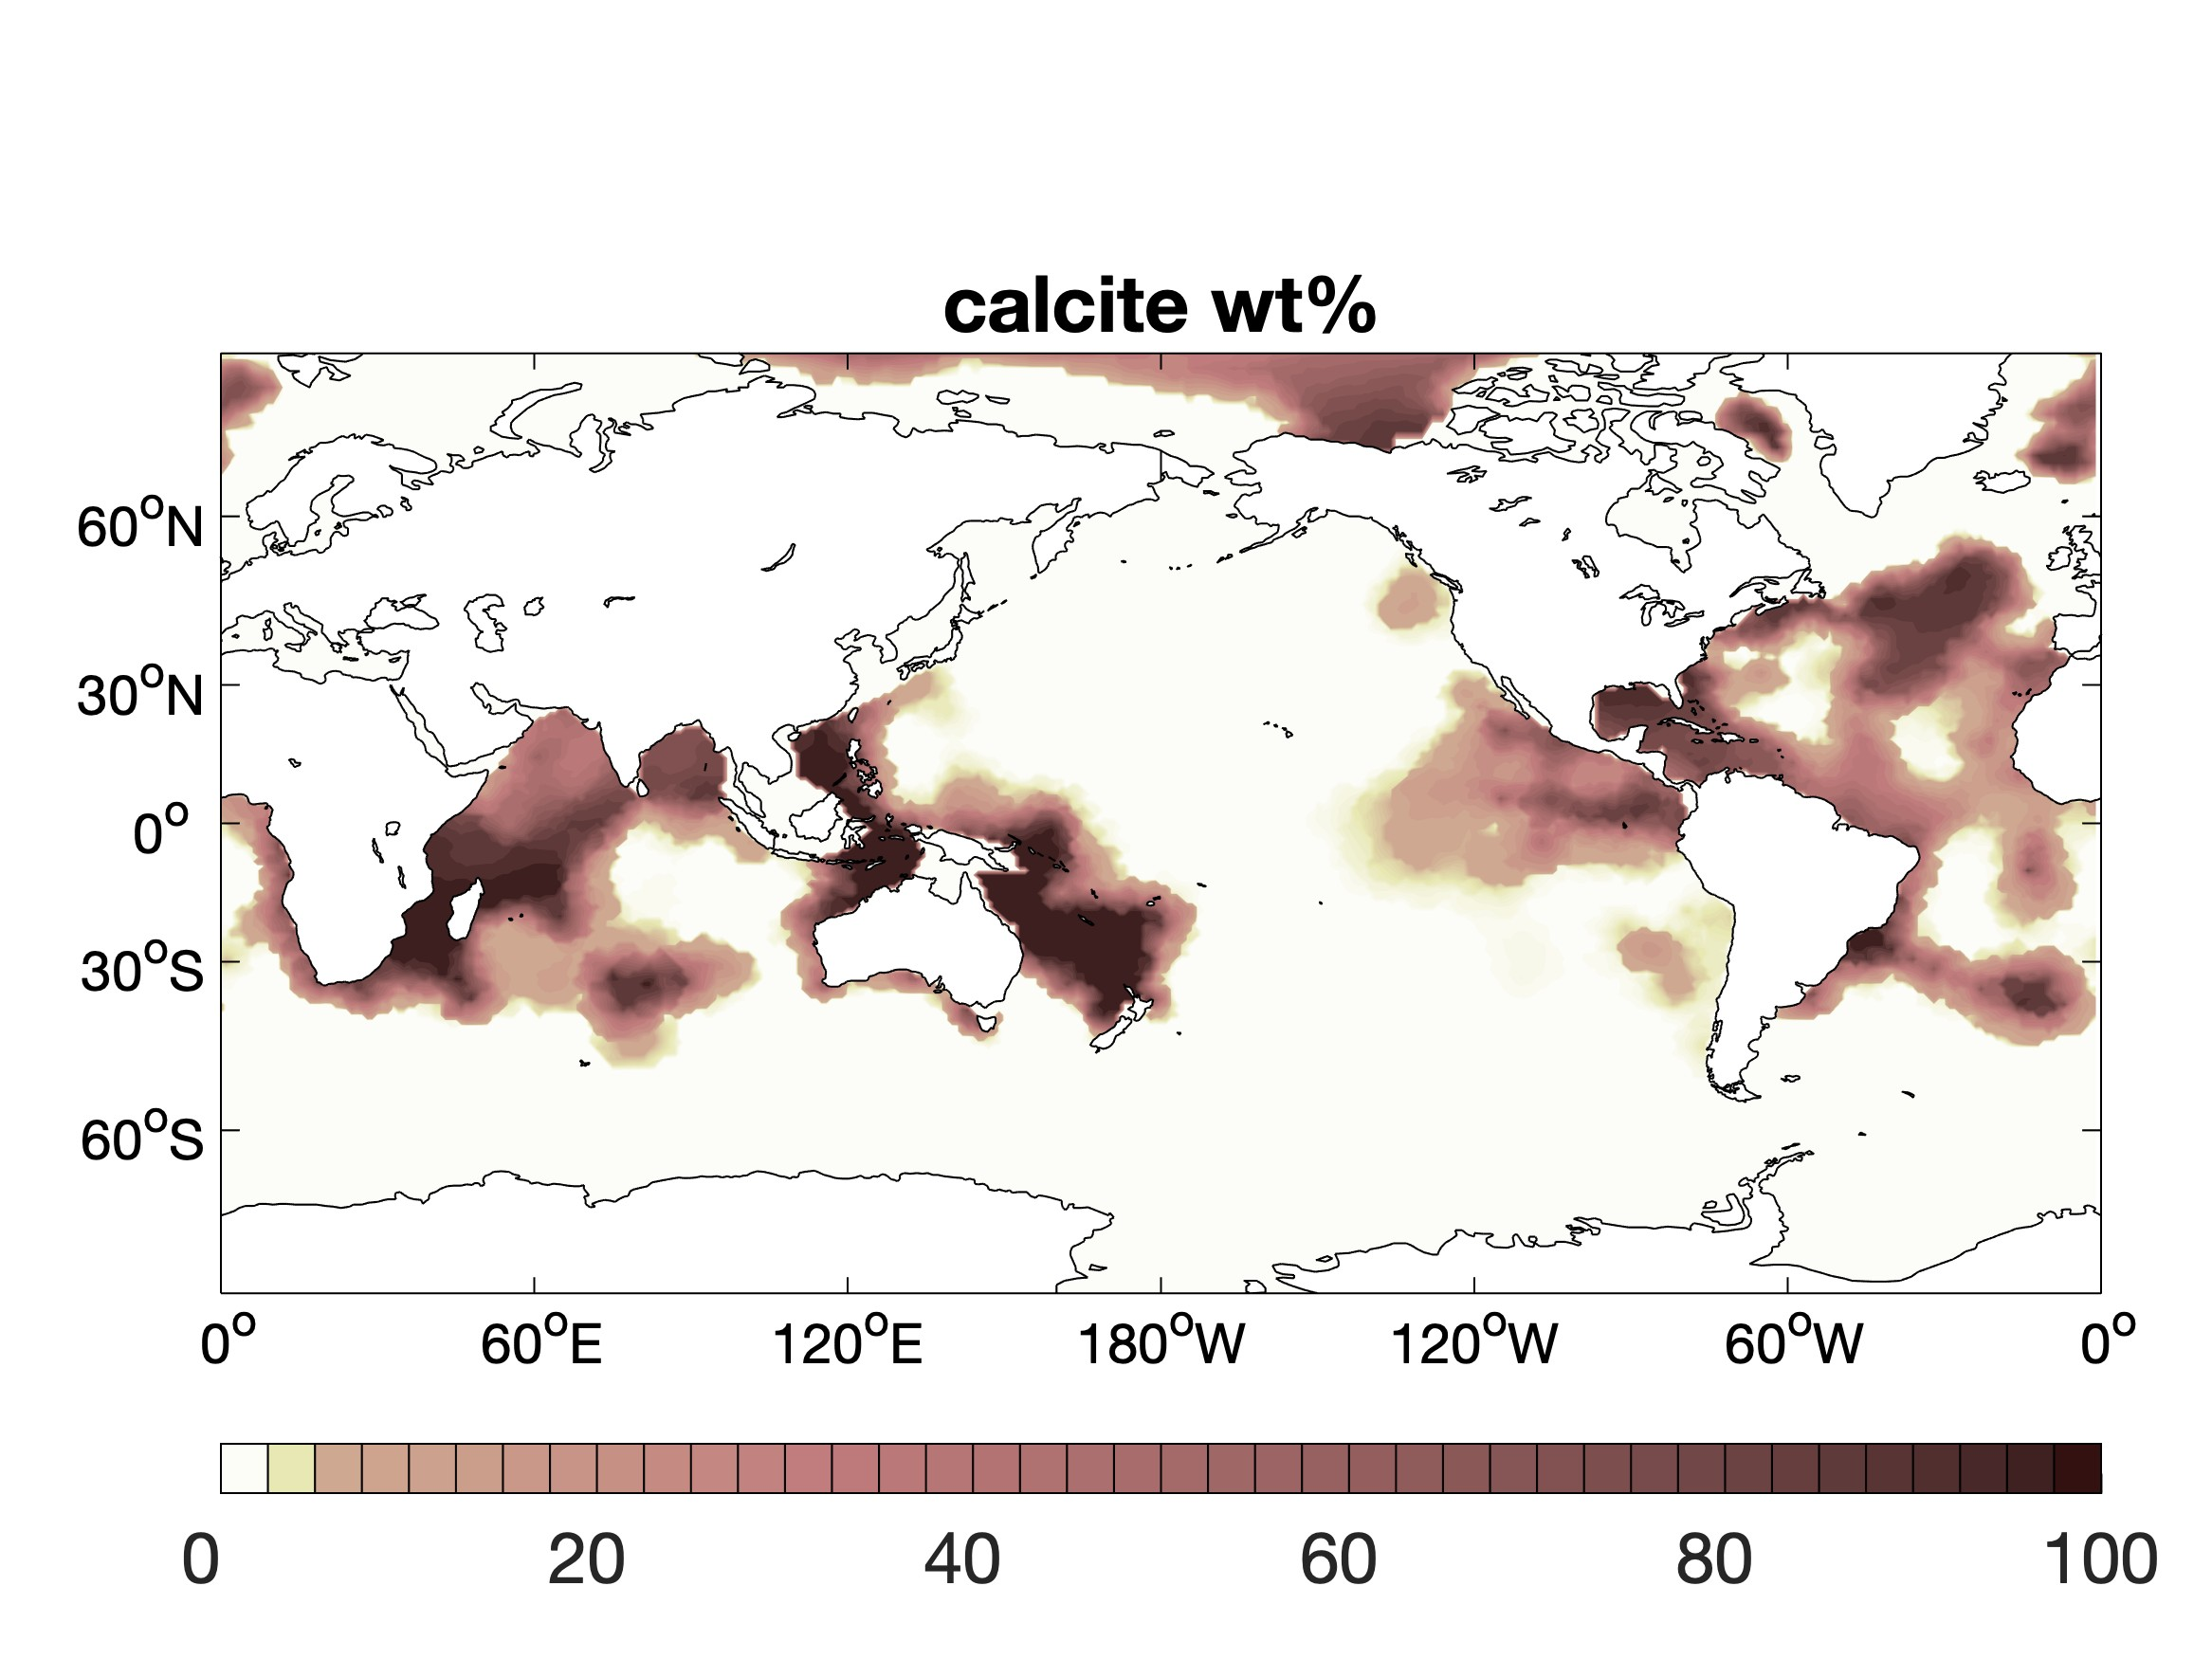
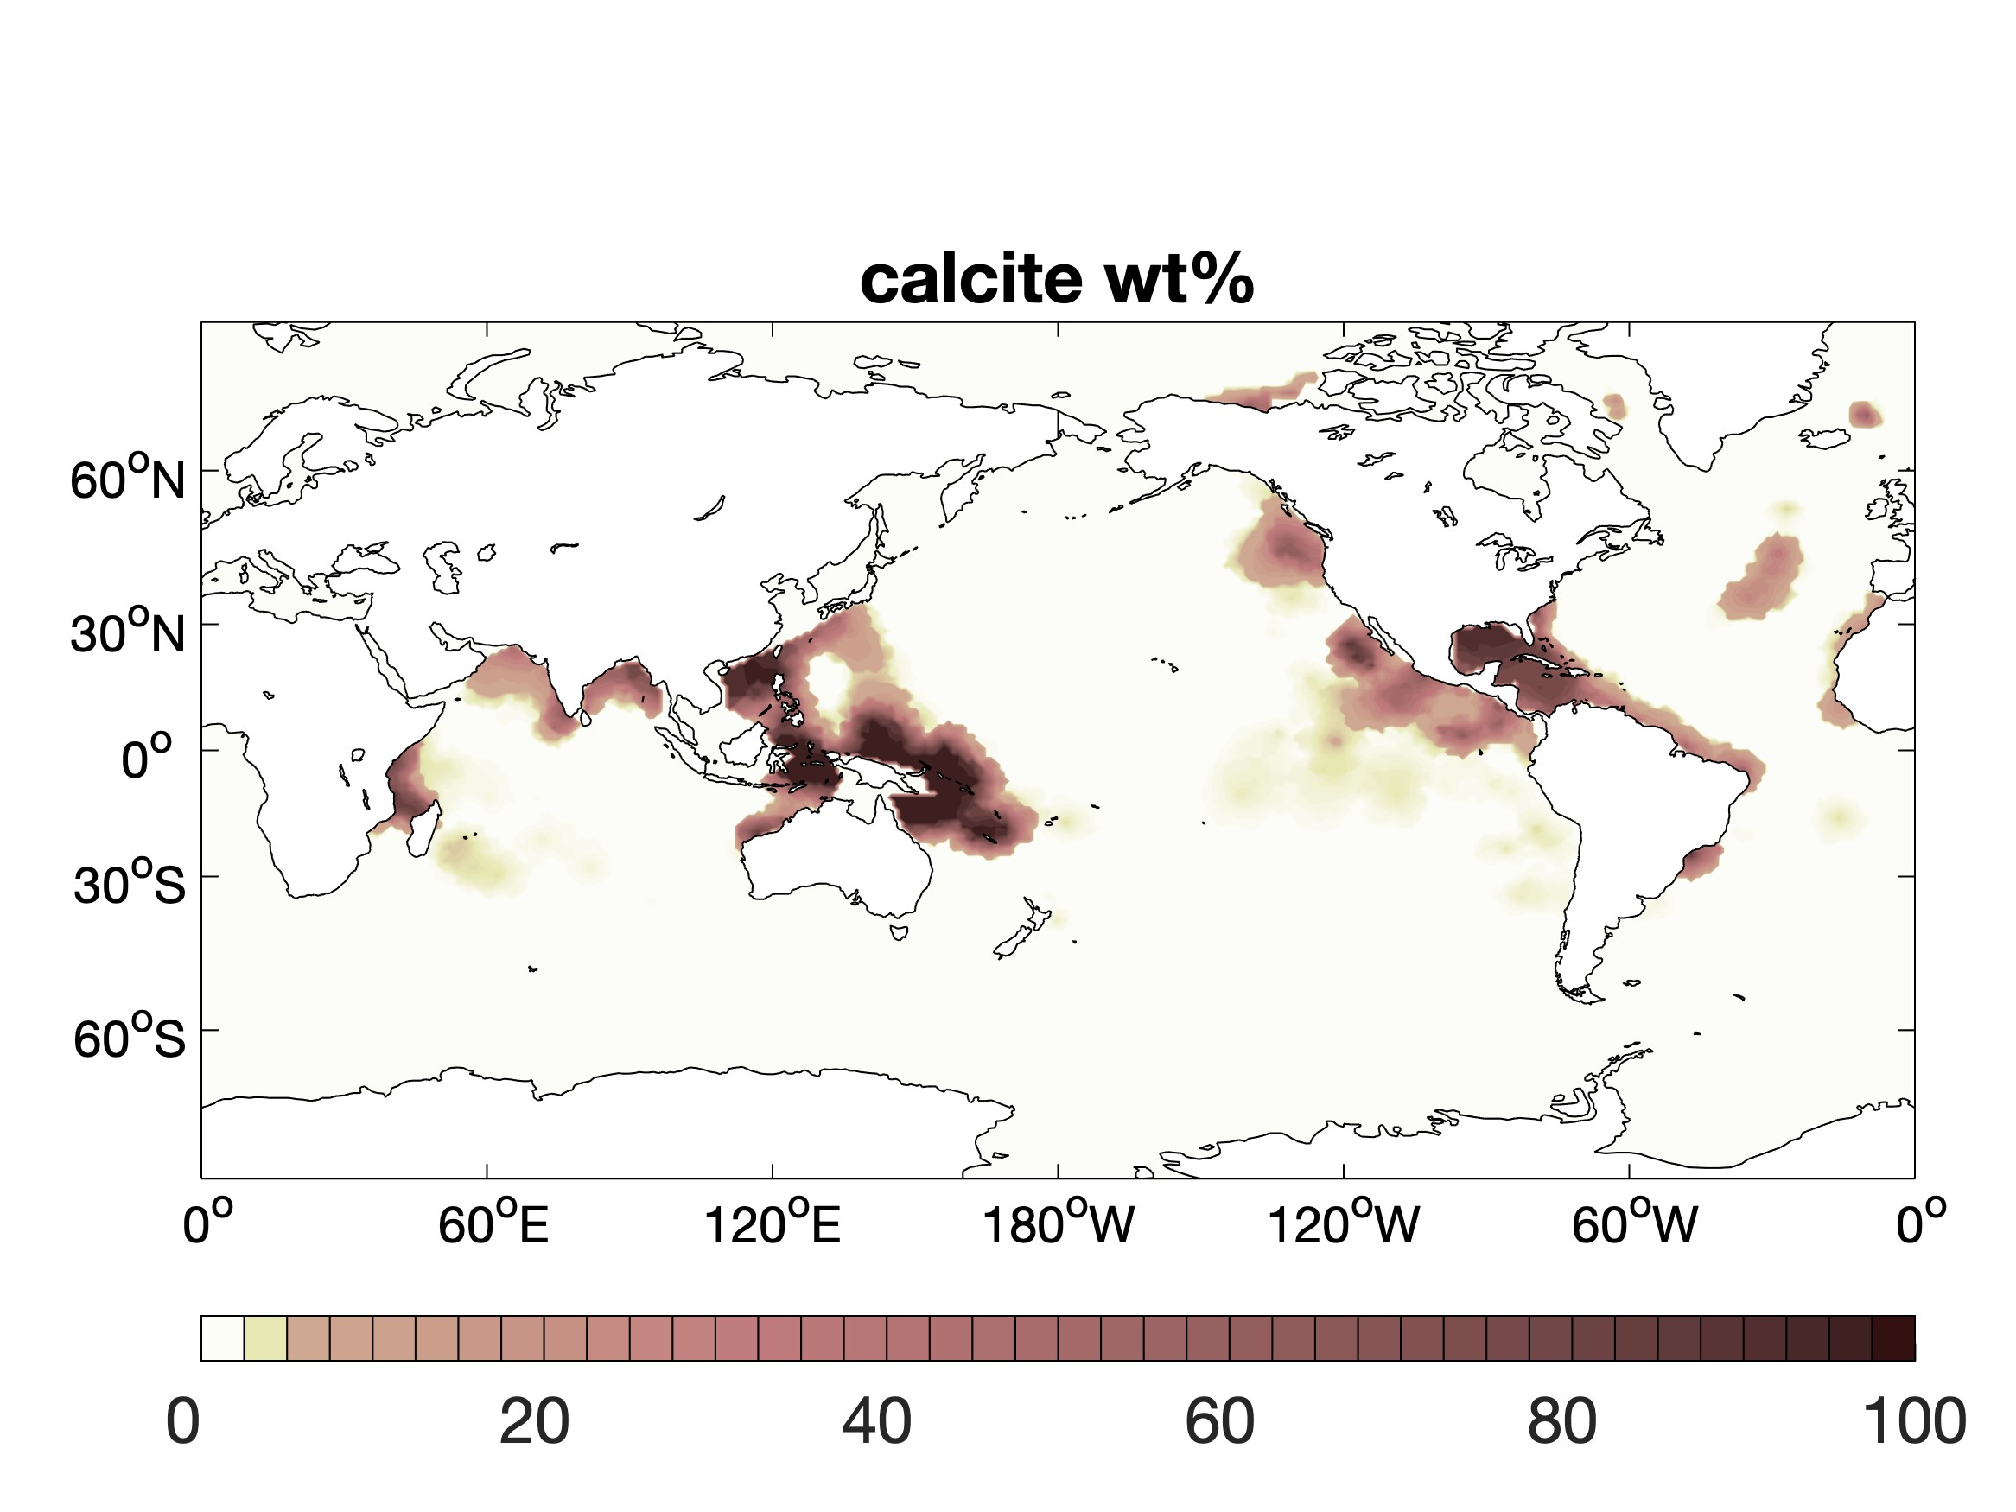
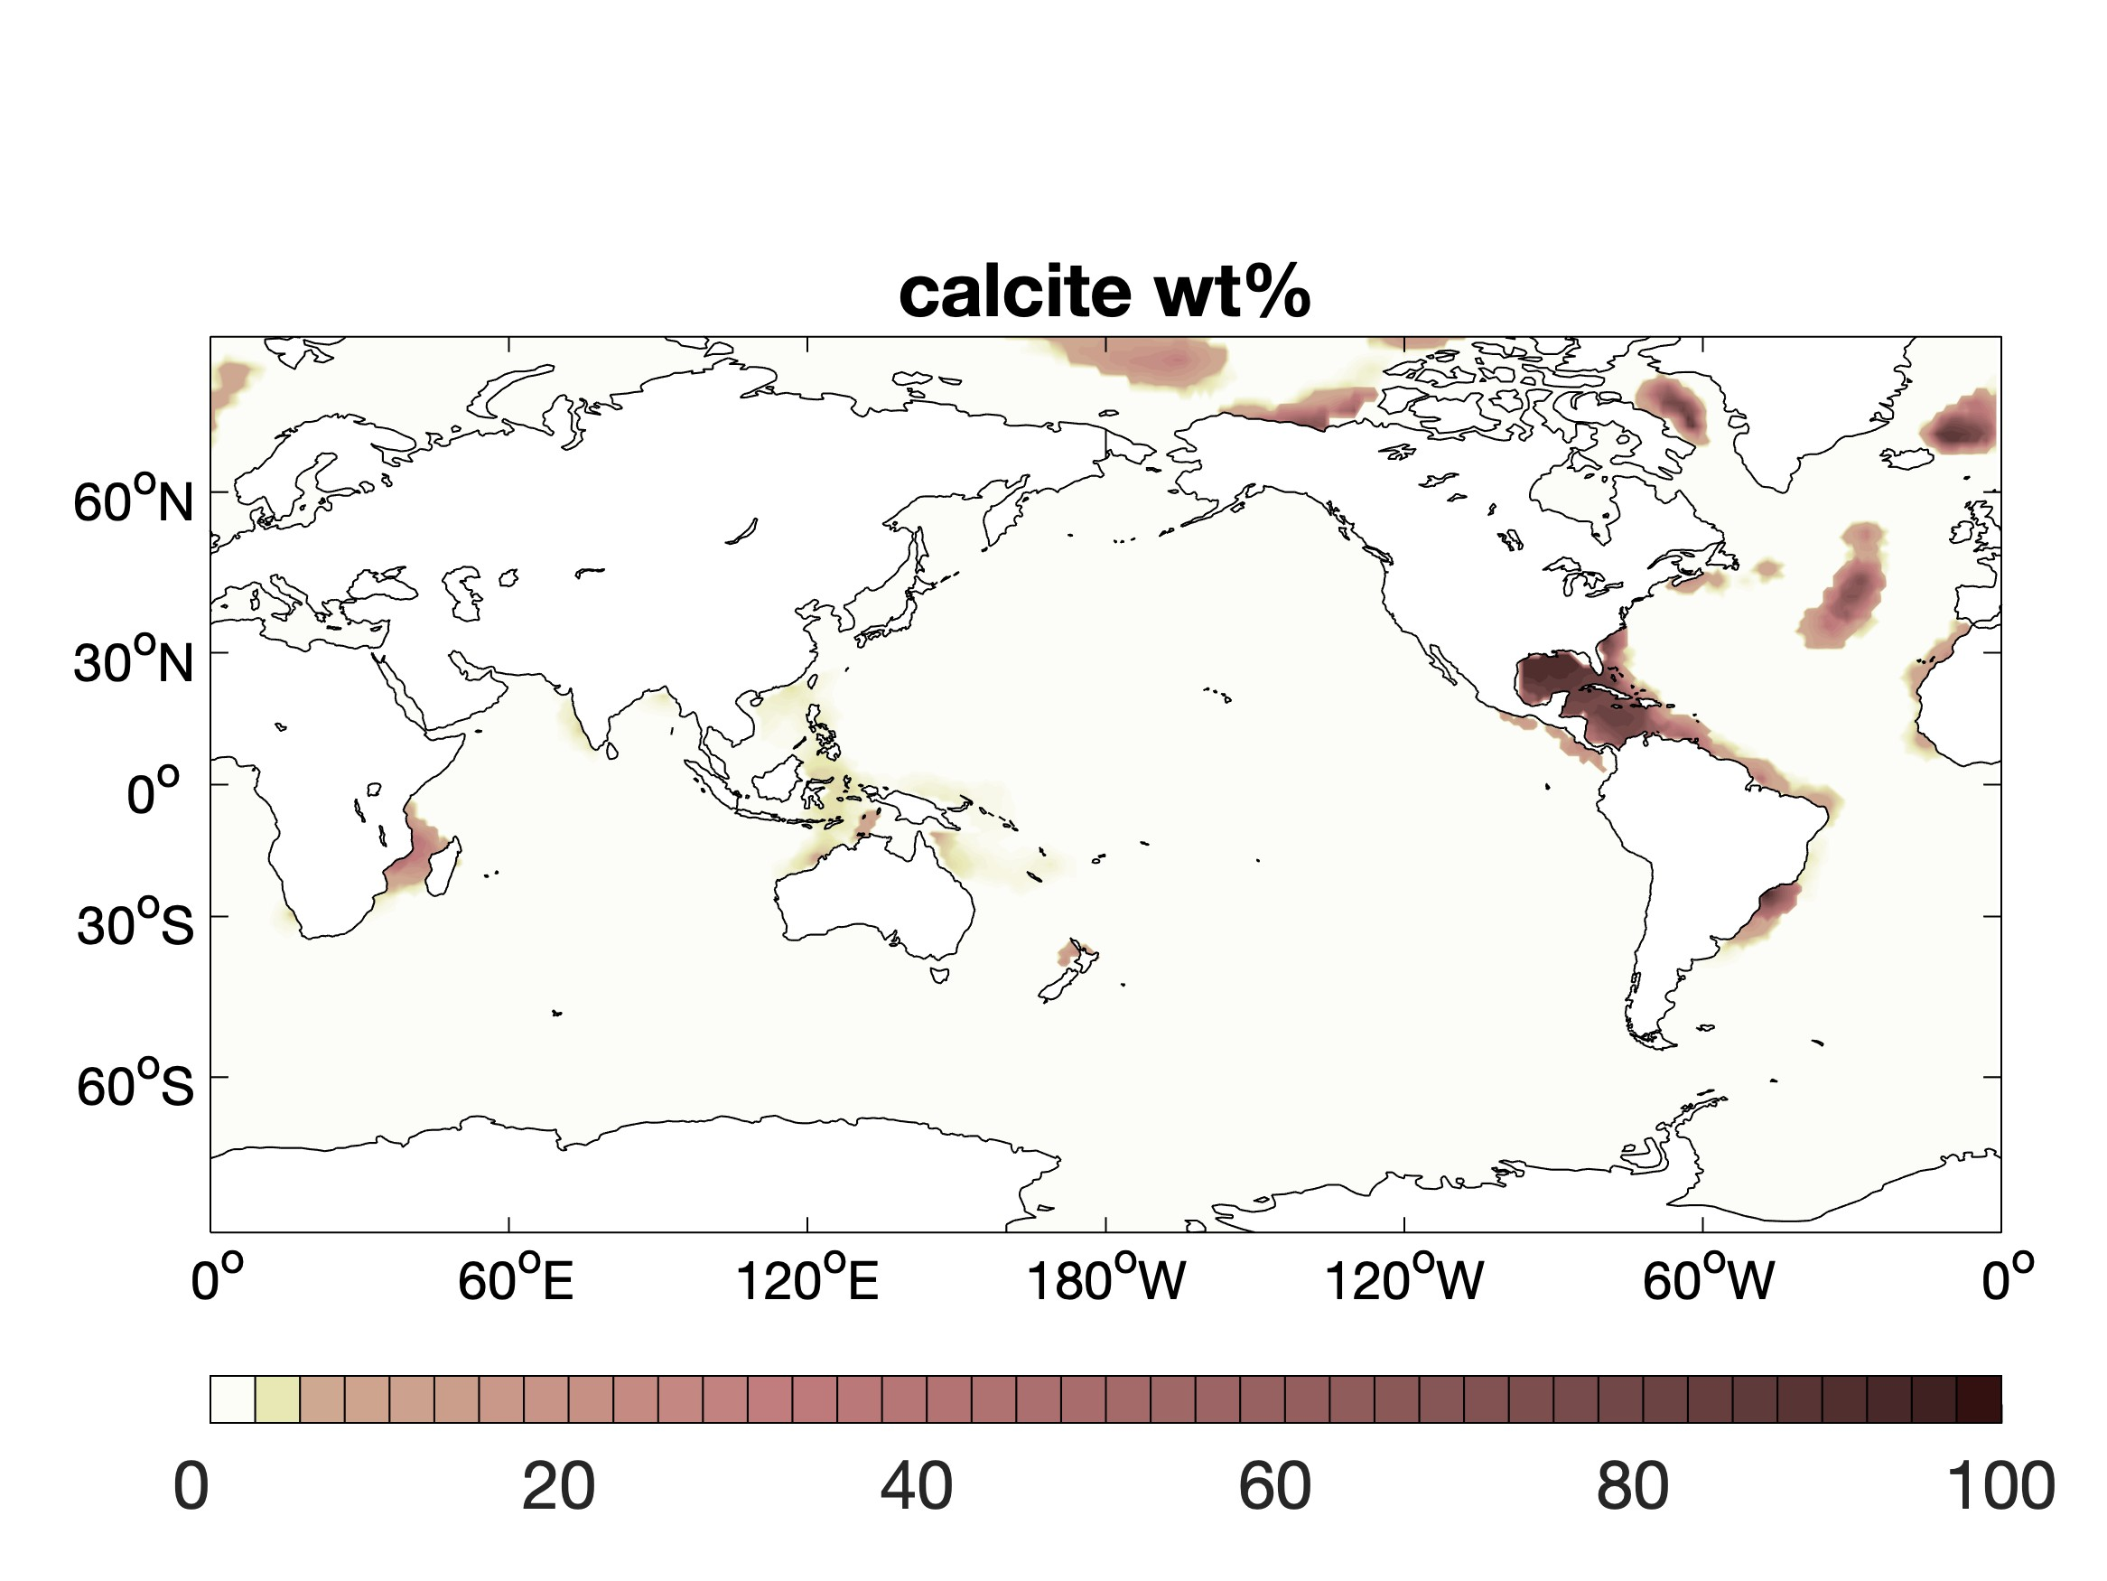
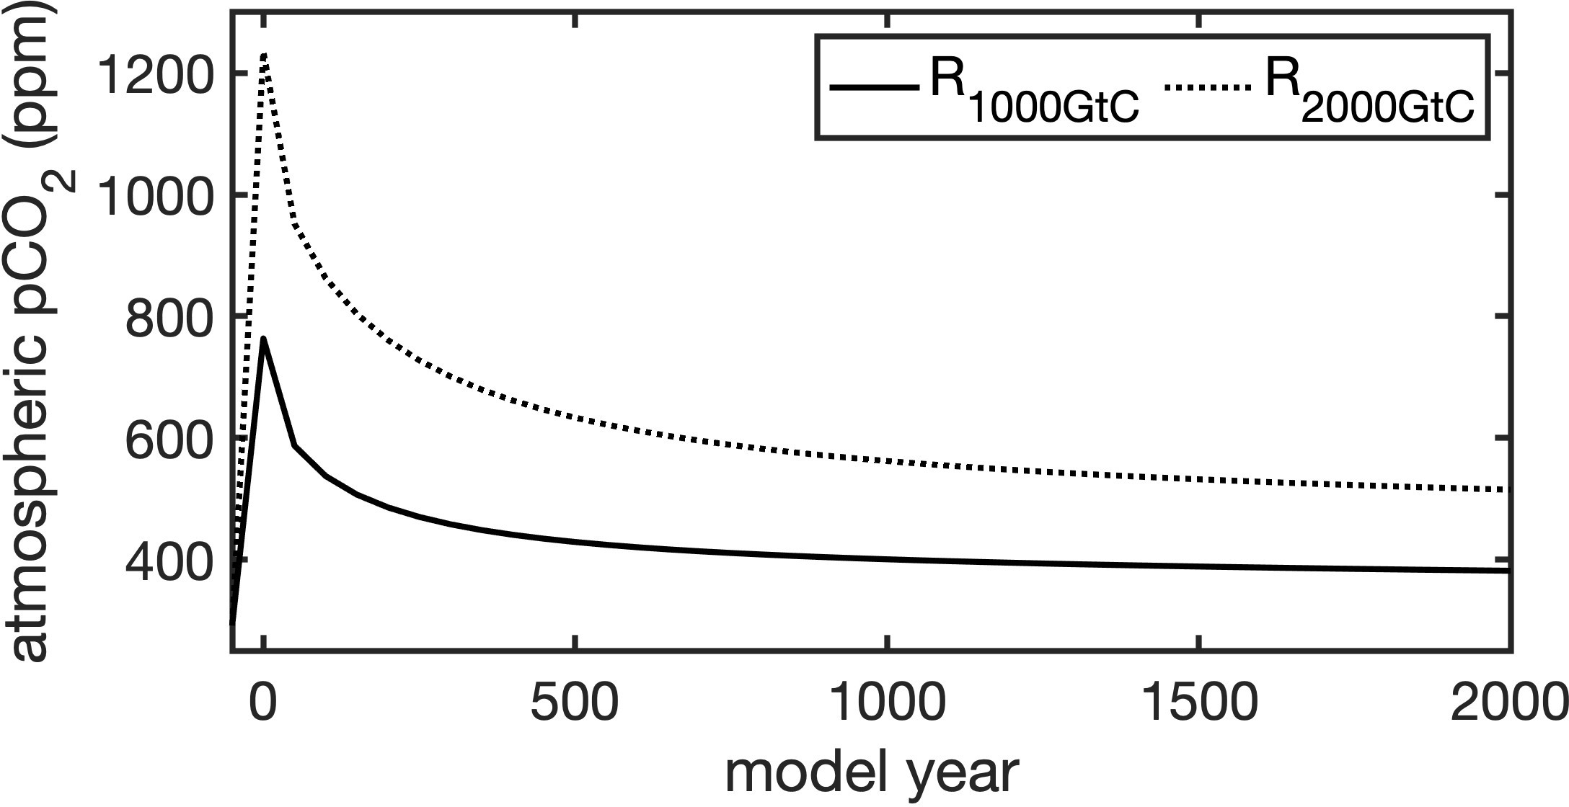
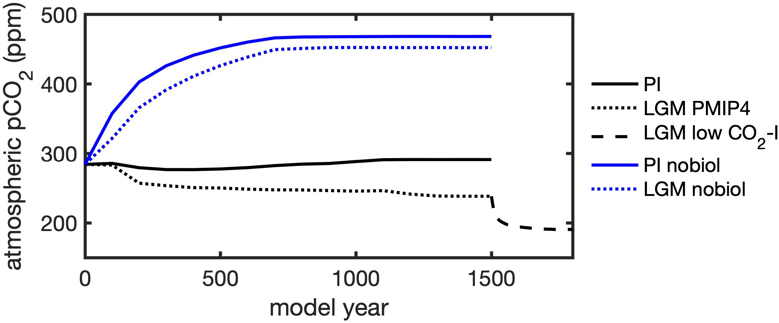
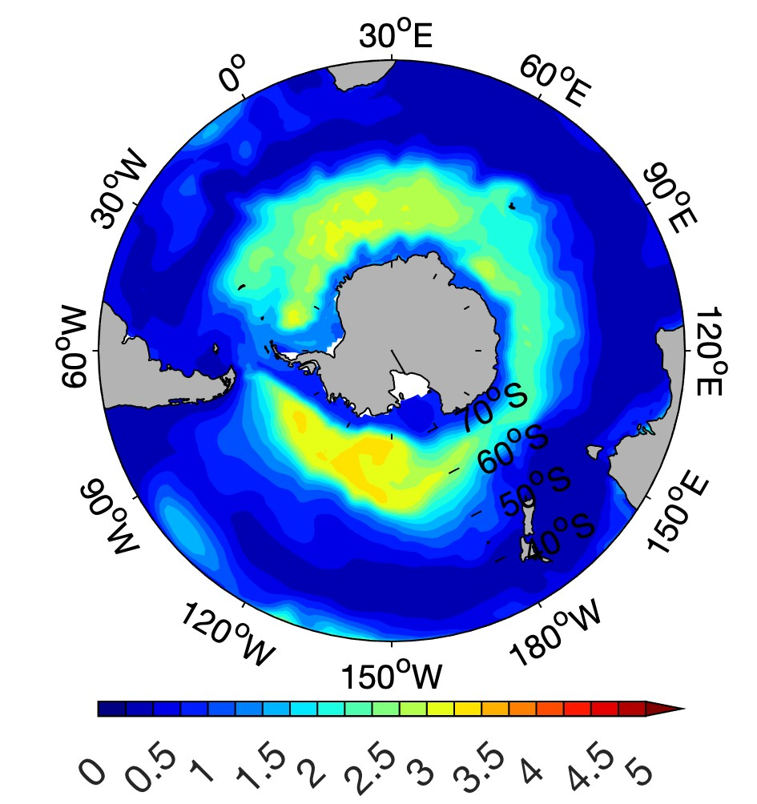
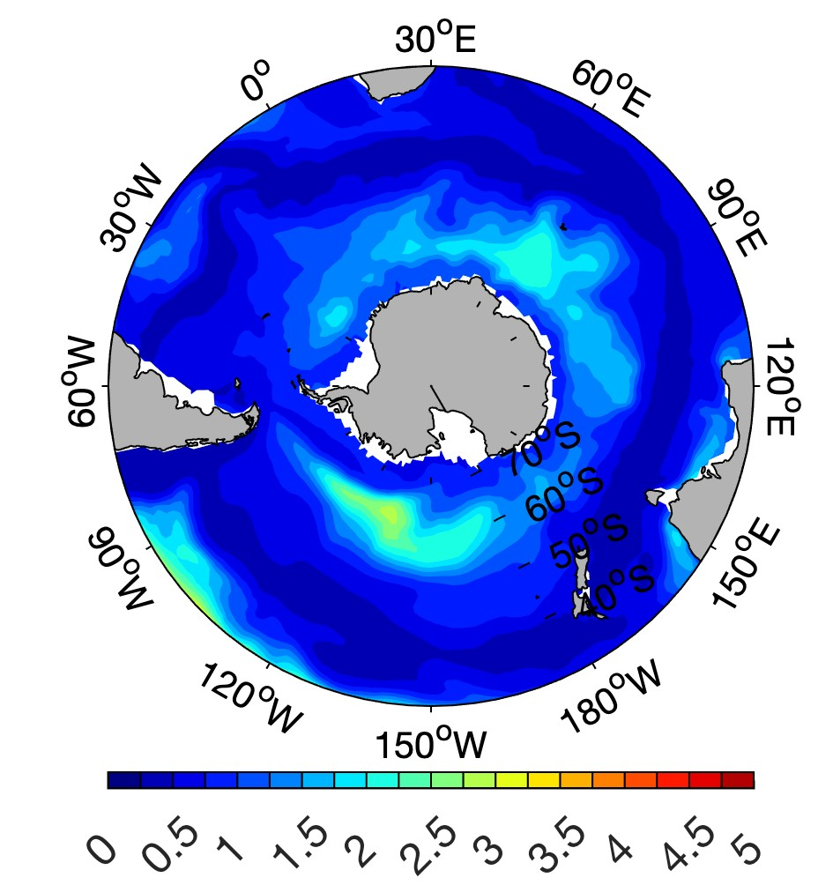
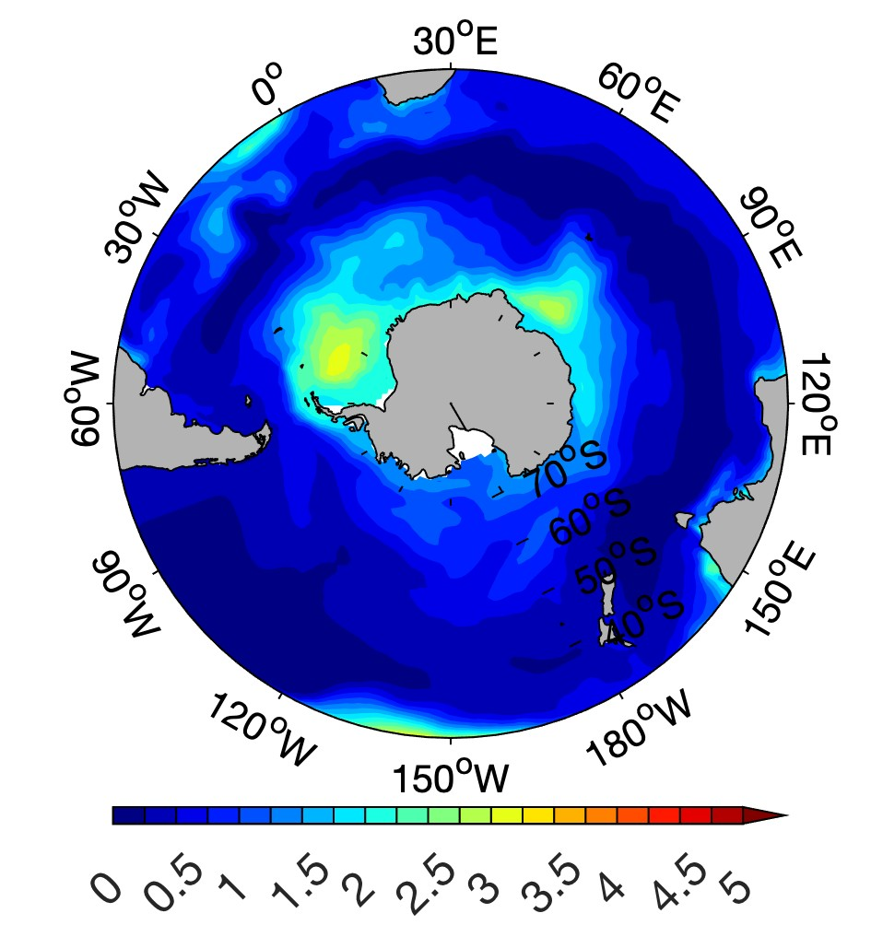
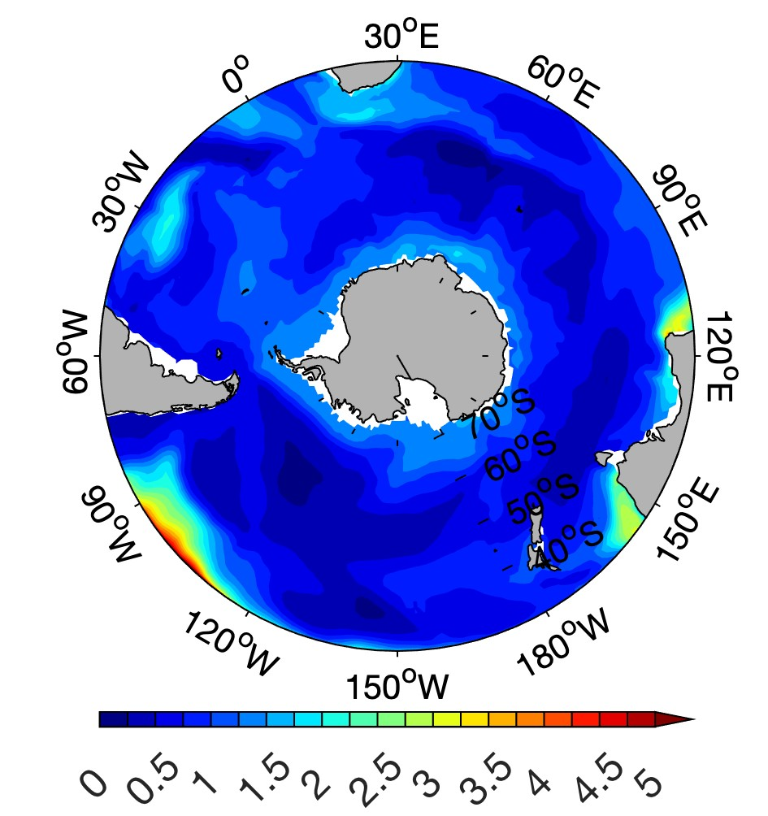
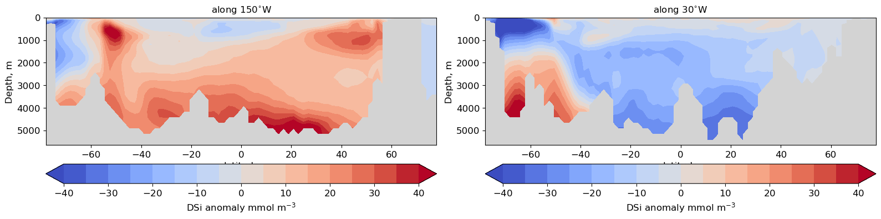
Drivers of marine carbon cycle
in AWI-ESM2
Ying Ye¹, Peter Köhler¹, Guy Munhoven², Martin Butzin^{1,3} and Christoph Völker¹
1Alfred Wegener Institute Helmholtz Centre for Polar and Marine Research, Bremerhaven, Germany
2 Laboratoire de Physique Atmosphérique et Planétaire, Université de Liège, Liège, Belgium
3 Now at MARUM-Center for Marine Environmental Sciences, University of Bremen, Germany
Motivation
Models and experiments
Ocean-only simulations:
FESOM2.1-REcoM3p-MEDUSA2
Aim of the studies presented here is to characterise the behaviour of important subcomponents of the marine carbon cycle in ocean-only and earth system setups for the preindustrial and last glacial maximum state:
Perturbations of the coupled ocean/sediment carbon system were studied in an ocean-only setup with prognostic atmosphere (Result 1).
The contribution of changes in the biological pump to glacial carbon drawdown was analysed (Result 2), and the role of changes in the silicon cycling due to changes in iron limitation was studied ( Result 3).
Ultimately these studies serve to understand the behaviour of the model in transient deglaciation set-ups; first transient runs are ongoing and will be analysed next.
Coupled simulations: AWI-ESM2
Exp | Climate | perturbation
R_{1000TgC} | PI | + 1000 TgC (atm)
R_{2000TgC} | PI | + 2000 TgC (atm)
R-PI | PI
R-PI_{nobiol} | PI | biology off
R-LGM | LGM | PMIP4
R-LGM_{nobiol} | LGM | biology off
R-deg | Deglaciation
Results
1. Response of marine sediments to perturbation in atmospheric CO₂
Two transient ocean-sediment coupled simulations (R_{1000TgC} and R_{2000TgC}) to study how sediments respond to changes in atmospheric CO₂. Starting from steady-state PI, 1000 and 2000 Pg C were added to the atmosphere and the model was run for further 2000 years.
Dissolution of calcite in surface sediments starts in the Atlantic; after 2000 years it is fully dissolved in large areas in the ocean (Fig. 1). CO₂ declines from 1235 to 515 ppm, and from 765 to 380 ppm in the two simulations, respectively (Fig. 2), showing the effect of carbonate compensation feedback.
2. Biological carbon pump during LGM and PI
Processes contributing to the glacial CO₂ drawdown studied in four ESM simulations: R-PI and R-LGM with biological production; R-PI_{nobiol} and R-LGM_{nobiol} with no biology, and carbon uptake by the ocean only driven by CO₂ solubility.
The contribution of the biological and solubility pump to the glacial CO₂ drawdown in our simulations is 37 and 16 ppm, respectively (Fig. 3), demonstrating a much more efficient biological carbon pump during LGM.
calcite wt% before perturbation
calcite wt% after 500 years
calcite wt% after 2000 years
Figure 1: Weight percentage of calcium carbonate in the surface sediment over the course of a perturbation of the carbon cycle by a pulsed addition of 2000 Pg carbon to the atmosphere.
Ye et al. 2023 (in review)
Figure 2: Atmospheric CO₂ mixing ratio over and after a sudden addition of 1000 and 2000 Pg carbon, respectively.
3. Nutrient supply and limitation during LGM
Effects of changed Fe cycle on Si cycling in AWI-ESM2 runs for LGM have been analysed. Due to the enhanced iron availability diatom Si:N ratio is much lower during LGM (Fig. 4). Surface water DSi in the Southern Ocean is lowered as well and more DSi stored in deep ocean (Fig. 5) and hence little increase of diatom production in low latitudes (no silicic acid leakage).
Figure 3: Atmospheric CO₂ in AWI-ESM2 runs for glacial (dotted) and preindustrial (solid) climates, with active (black) and inactive (blue) marine biological carbon pump. The dashed line is an LGM run with increased weathering input of alkalinity, to reach LGM CO₂ values.
Figure 4: Ratio of Si:N in diatom cells (left two panels) and in dissolved nutrients (right two panels) in preindustrial and LGM ocean states. In the pre-industrial, iron limitation in the Southern Ocean leads to an elevated Si:N ratio in diatoms and in biological drawdown there. In the LGM, this ratio is reduced by some alleviation of iron limitation. However, this does not lead to a corresponding increase in the remaining dissolved nutrients in the Southern Ocean, presumably because the remineralisation of exported Si happens deeper than that of N, leading to a shift of Si into the deep ocean, see also Fig. 5.
Figure 5: Changes in the concentration of dissolved silicic acid (LGM minus PI) along two North-South sections in the Pacific (left) and Atlantic (right) Ocean. More DSi is stored in Antarctic-Sourced deep and intermediate water masses, but the largest increase is in the deep Pacific, with only small increases in intermediate waters. This explains the absence of a strong low-latitude stimulation of diatom growth that has been suggested by the Silicic Acid Leakage Hypothesis.
Next steps
Effects of biogeochemical changes and CO₂ changes in ongoing transient runs for deglaciation will be analysed.
References
Gürses, Ö., Oziel, L., Karakuş, O., Sidorenko, D., Völker, C., Ye, Y., Zeising, M., Butzin, M., and Hauck, J.: Ocean biogeochemistry in the coupled ocean–sea ice–biogeochemistry model FESOM2.1–REcoM3, Geosci. Model Dev., 16, 4883–4936, 2023.
Ye, Y., Munhoven, G., Köhler, P., Butzin, M., Hauck, J., Gürses, Ö., and Völker, C.: FESOM2.1-REcoM3-MEDUSA2: an ocean-sea ice-biogeochemistry model coupled to a sediment model, Geosci. Model Dev. Discuss., https://doi.org/10.5194/gmd-2023-181, in review, 2023.

