Slide 1
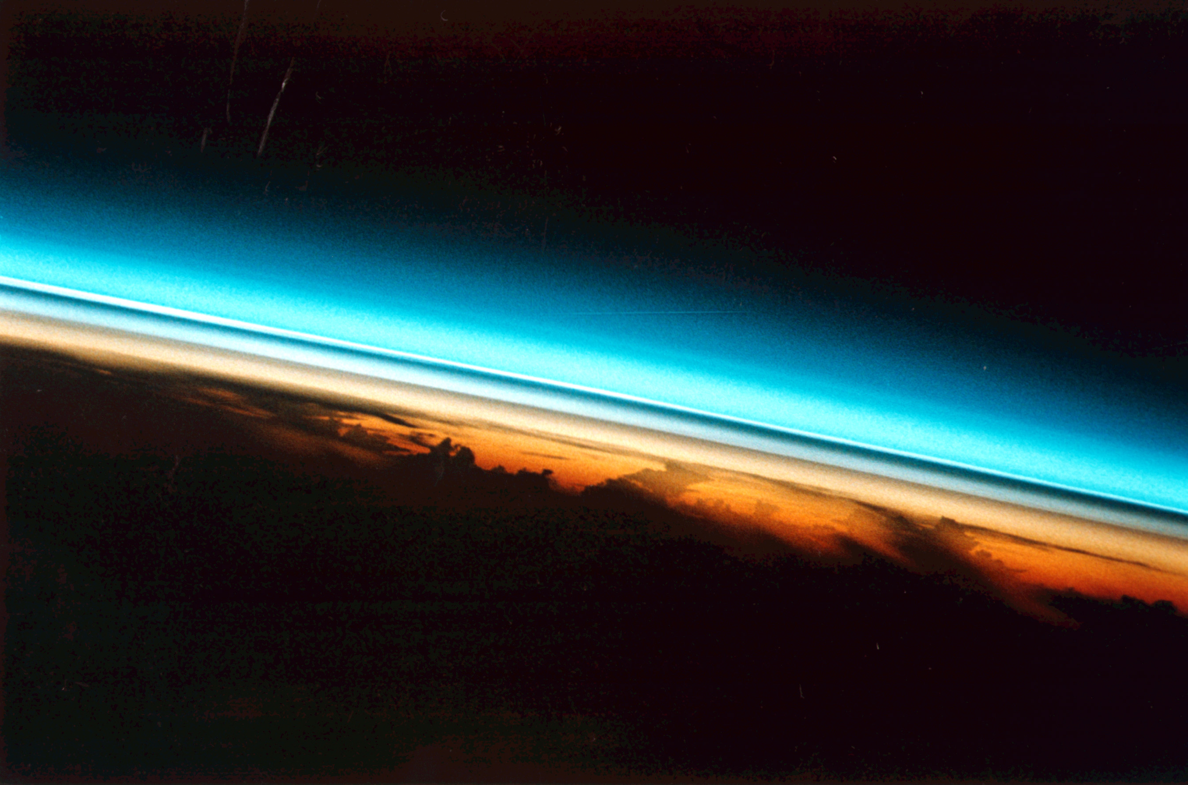





Model calculations of the contribution of SO₂ to
the stratospheric aerosol layer
Chiranjeevi Nalapalu, Ingo Wohltmann,
Markus Rex, Michael Hoepfner, Ralph Lehmann
Photo: Space shuttle image of stratospheric aerosol layer after Pinatubo eruption

Slide 2
Motivation
Stratospheric aerosol layer is important for
Radiative balance of earth and climate change
Stratospheric chemistry (“ozone hole”)
Geo-Engineering
Many processes of the stratospheric aerosol layer are not well
known
What is the contribution of tropospheric species like SO₂ to stratospheric aerosol layer? Sources? Processes? Sensitivities?

Slide 3
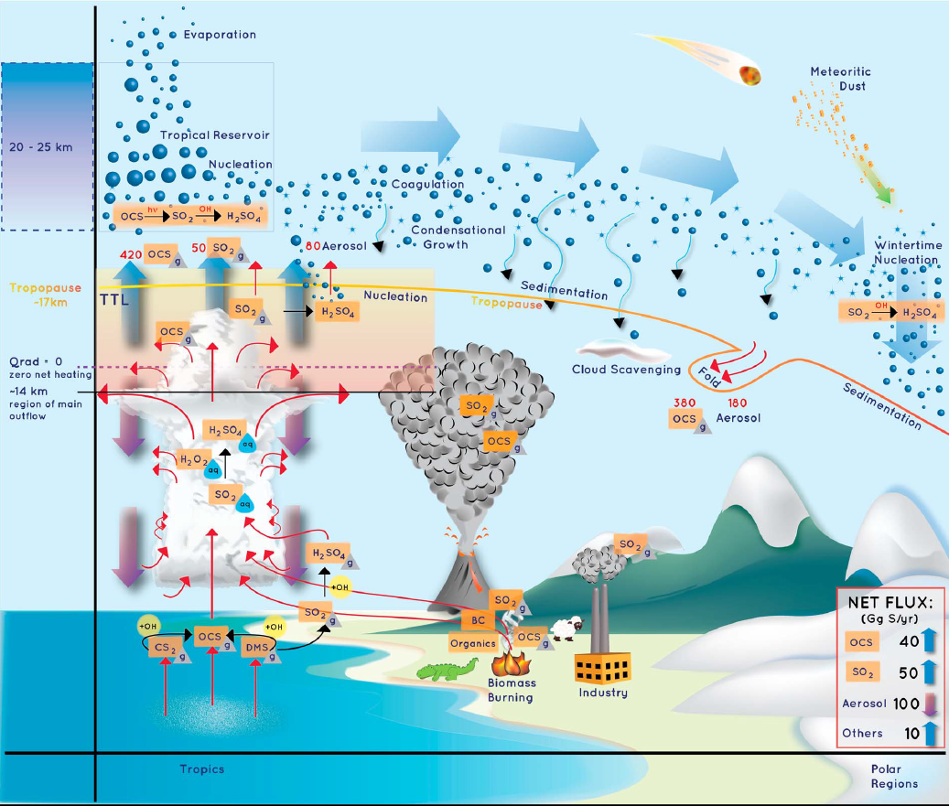
Kremser et al., Rev. Geophys., 2015, doi:10.1002/2015RG000511

Slide 4
Approach
Examine chemistry of SO₂ and its transport to the stratosphere
Chemical and microphysical “box” model on moving air parcel trajectories ending in the stratosphere
Numerous sensitivity runs to assess range of uncertainty
Focus on “background” values under volcanically quiescent conditions
Don’t model the processes in the stratospheric aerosol layer, we are interested in the source of the SO₂ in the layer
Initialization at start of trajectories from existing model data at top of boundary layer, boundary layer processes and SO₂ sources at surface are not our task

Slide 5
Our existing tools
Trajectory model of the ATLAS Chemistry and Transport Model of our working group.
Convection model: Trajectory model includes “statistical“ convection model on individual trajectories
Simplified chemical and microphysical model focussing on the relevant SO₂ and sulfur chemistry and cloud interactions
CAMS data for initialization of chemistry model at top of boundary layer

Slide 6
Model
Backward trajectories (≤ 4 months) starting at 400 K in [30N, 30S], ending at 80% ps (ps = surface pressure)
Wind fields and cloud water content ← ERA 5 and ERA Interim
Convection: trajectories are displaced vertically with a certain probability
Chemistry is run forward in time on the trajectories

Slide 7


Reactions in our Chemical Box Model
Gas Phase Reactions
Liquid Phase Reactions

Slide 8
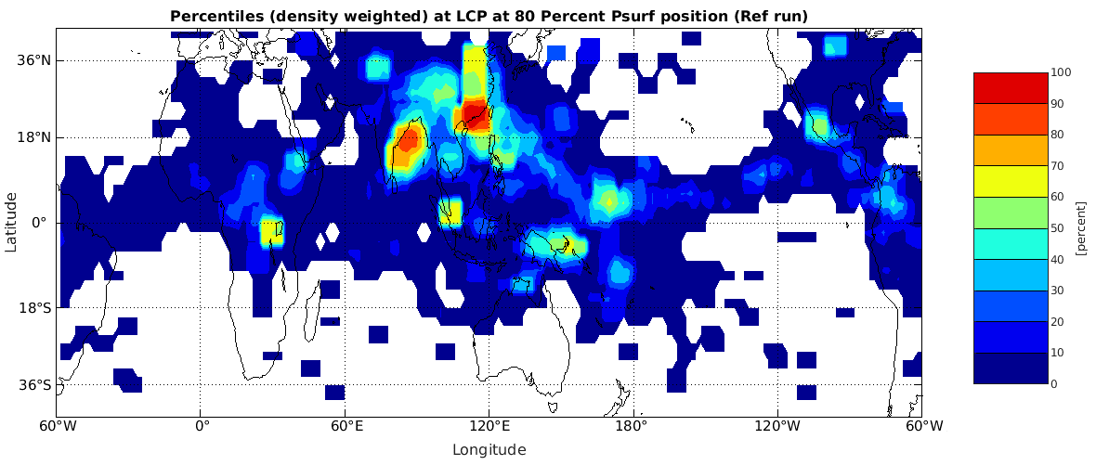
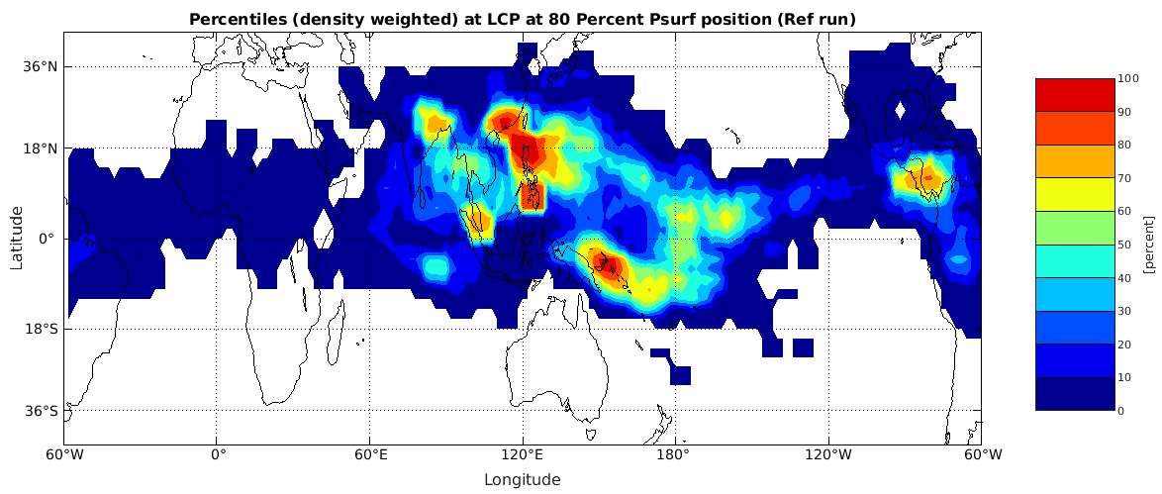
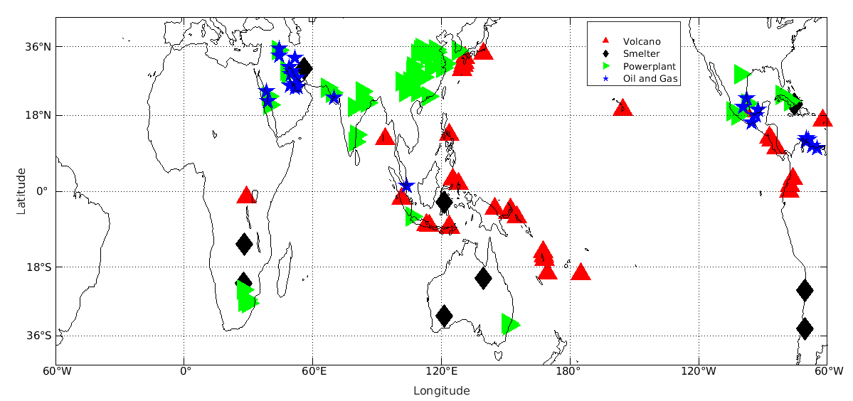
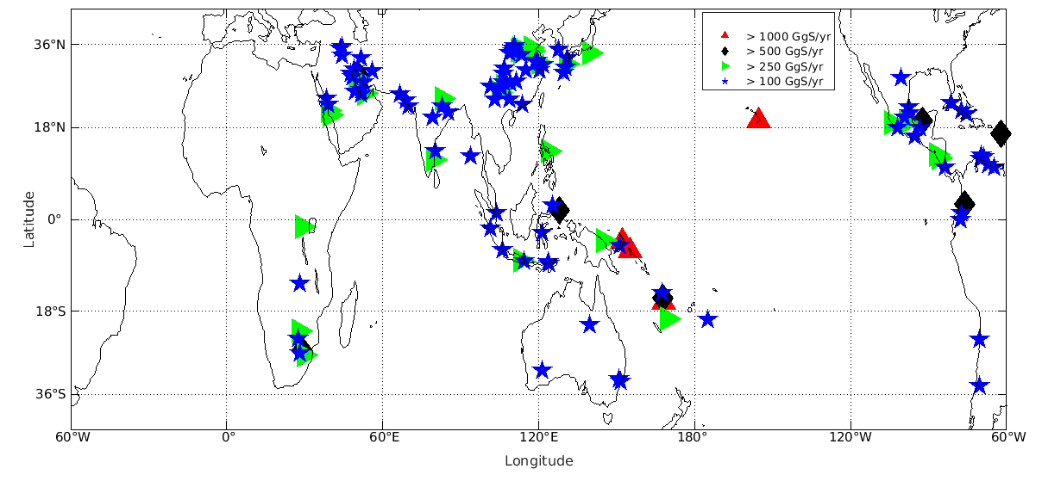
What are the main sources of SO2 in the troposphere?
ERA5
ERA
Interim
Fioletov et al., Atmos. Chem. Phys., 2016, doi:10.5194/acp-16-11497-2016

Slide 9
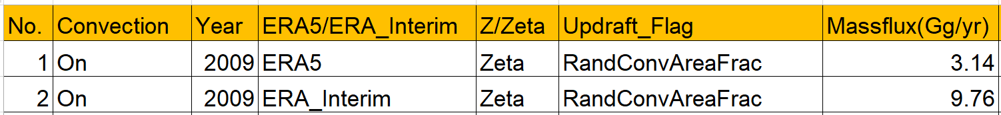
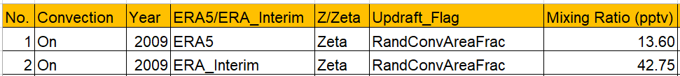
Mass flux
How much SO2 is transported to the Stratosphere?
Rollins et al. 2017 In Situ -> 3.6 Gg/Yr
Sheng et al. 2015 SOCAL-AERv1 Model -> 50 Gg/Yr
Mixing ratio
Rollins et al. 2017,2018 In Situ -> 5-10 pptv
Höpfner et al. 2015 MIPAS Satellite -> 24 pptv
Doeringert et al. 2012 ACE-FTS Satellite -> 5-10 pptv
Feinberg et al. 2019 SOCOL-AERv1,v2 Model -> 20-30 pptv

Slide 10
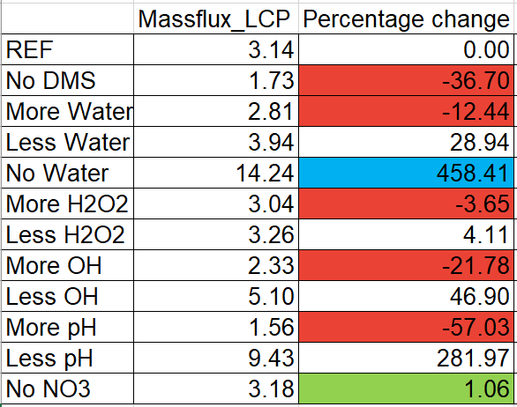
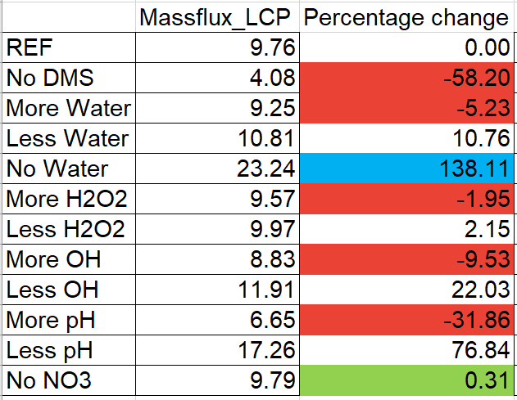
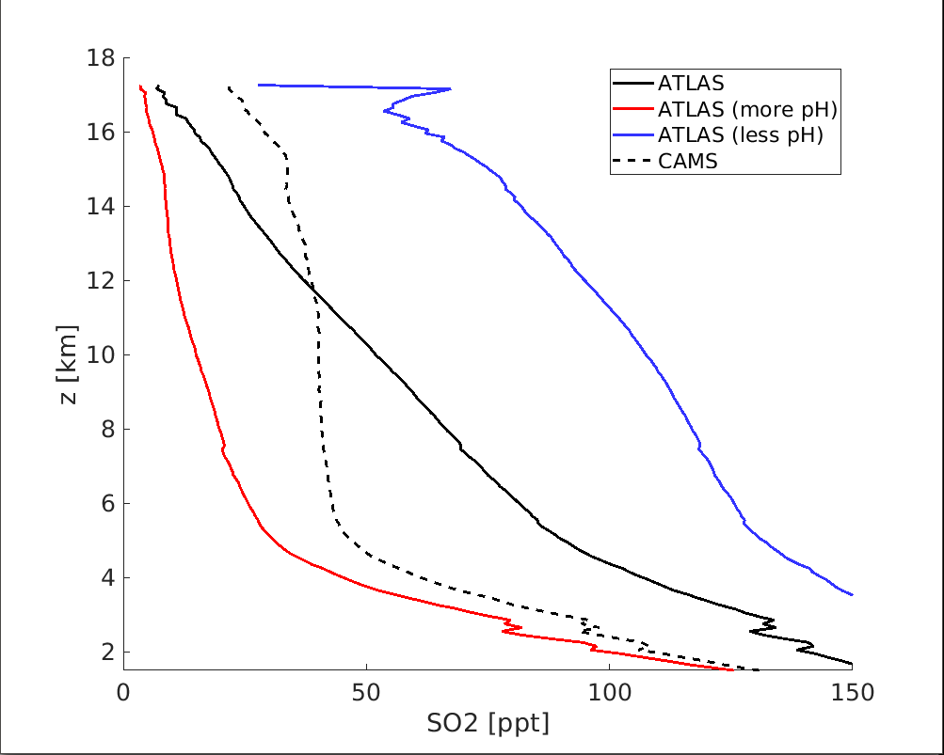
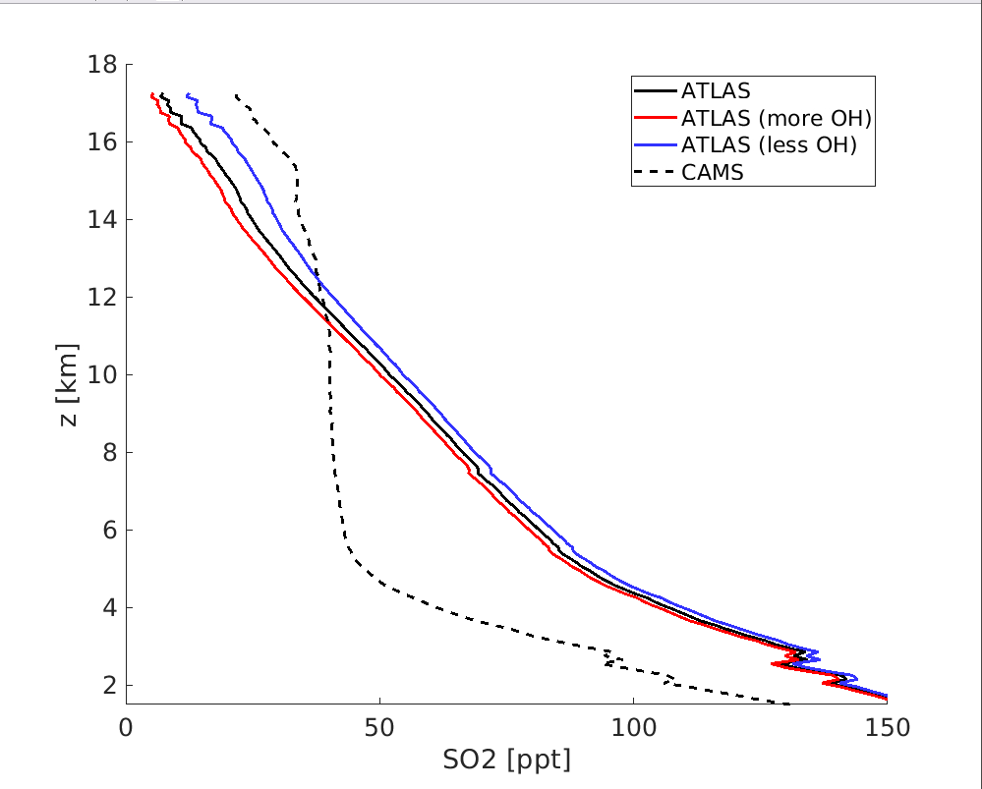
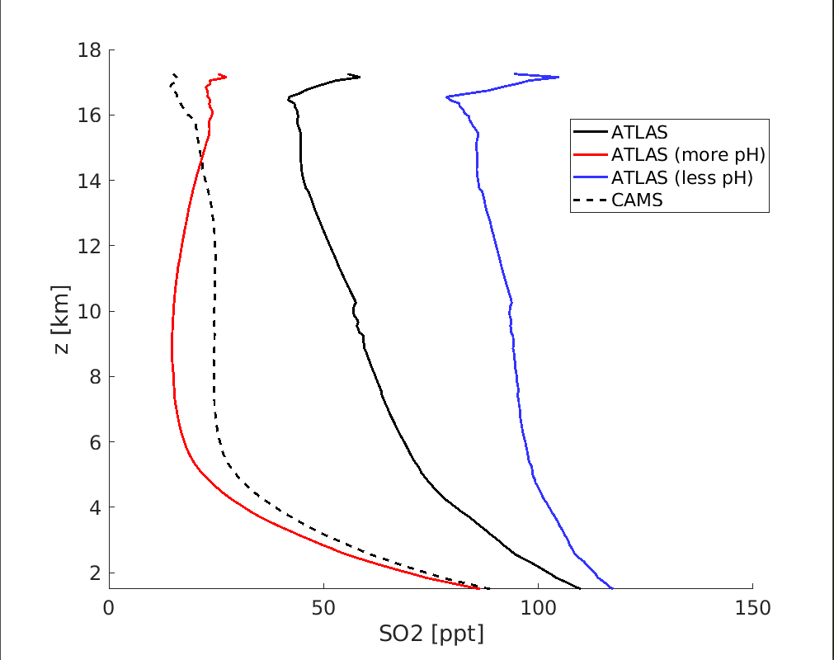
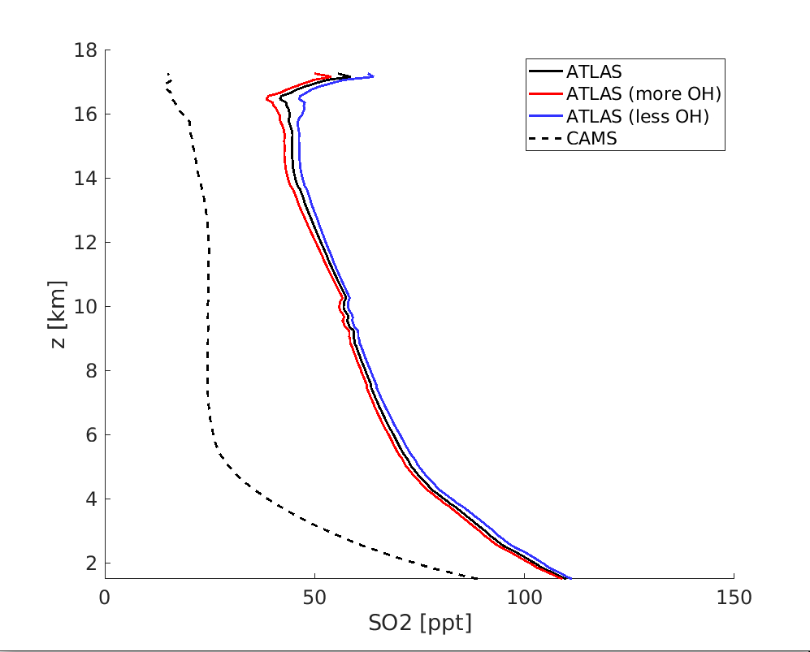
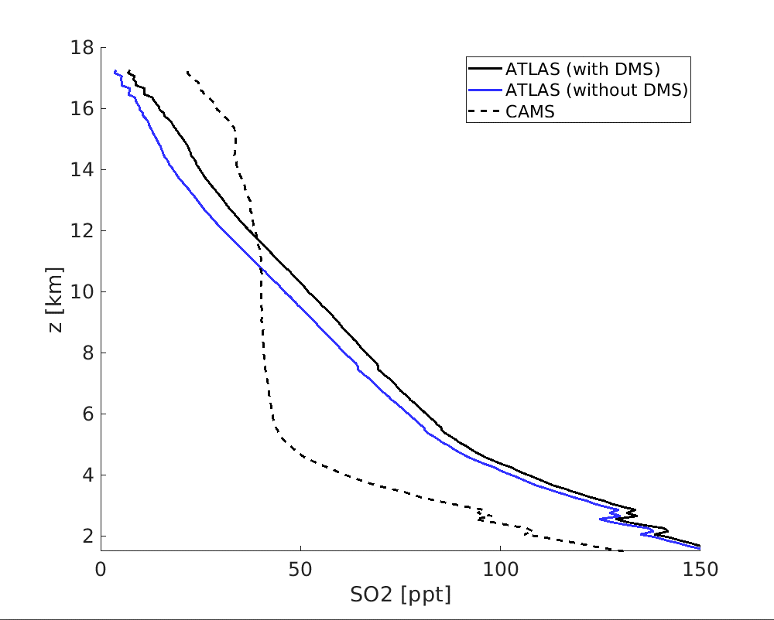
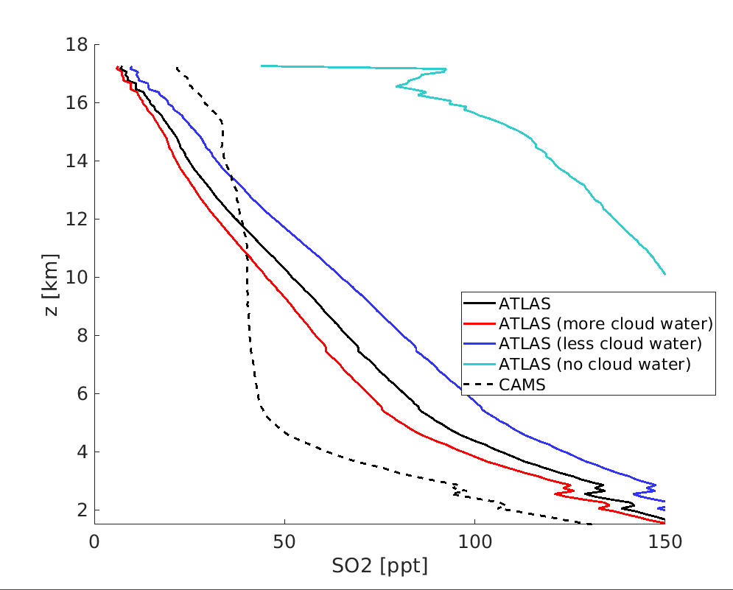
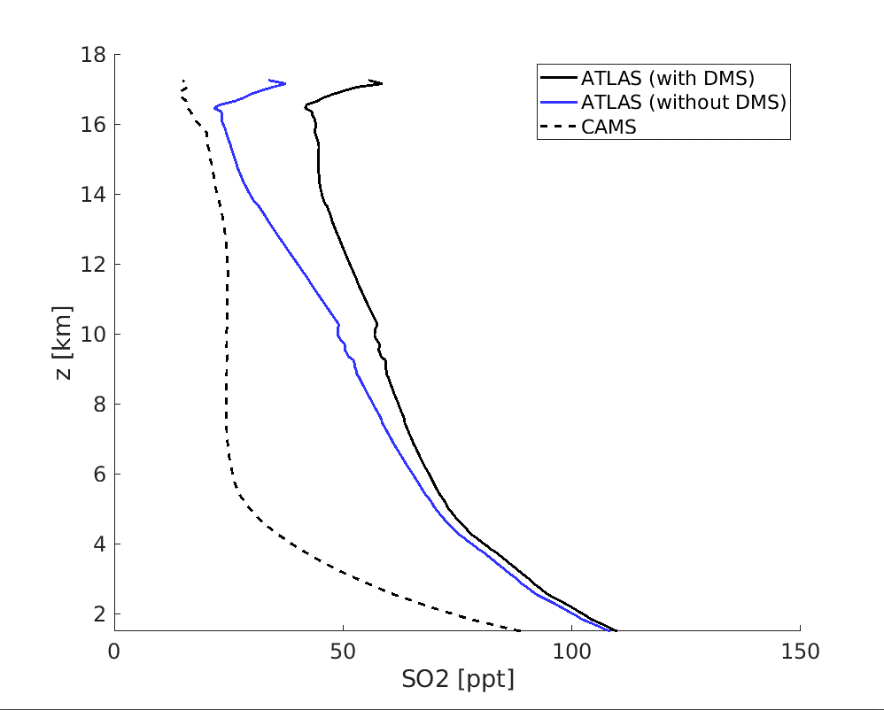
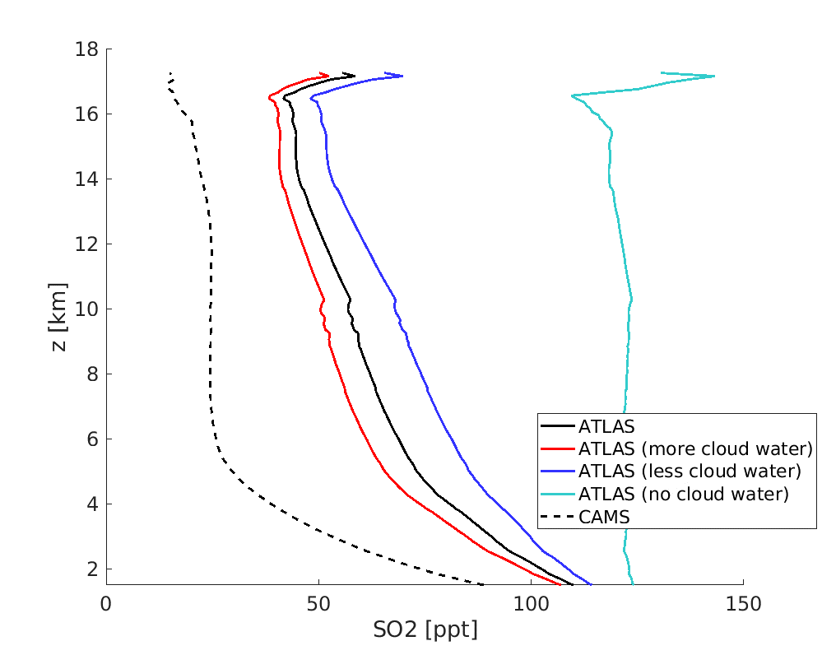
Sensitivities
ERA5
ERA Interim

Slide 11
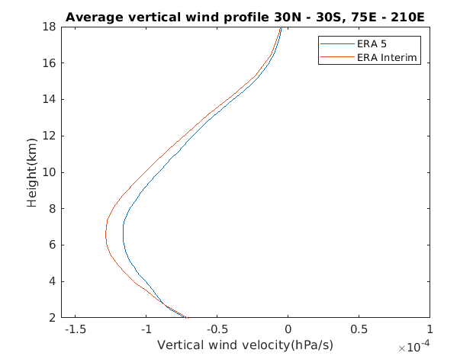
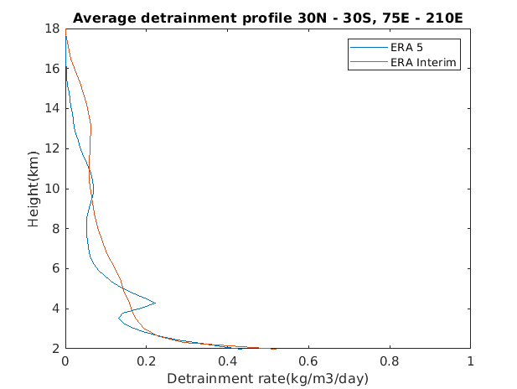
Process understanding:
Updraft and Detrainment rates

Slide 12
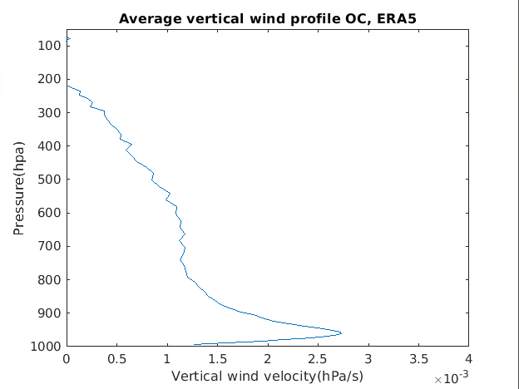
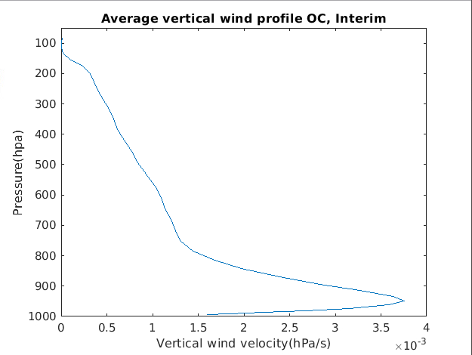
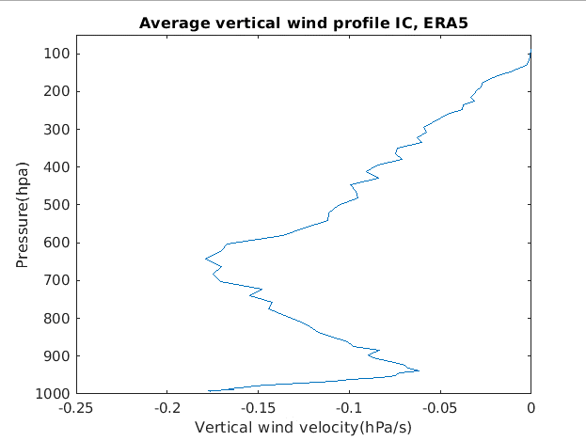
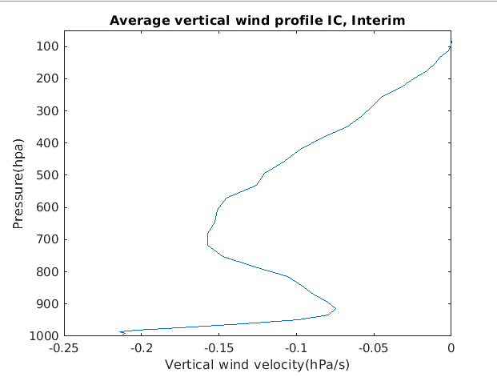


Updrafts outside and inside convection
ERA5
ERA Interim
Vertical wind profiles from model runs measured in hPa/s
OC = Outside convection
IC = Inside convection

Slide 13
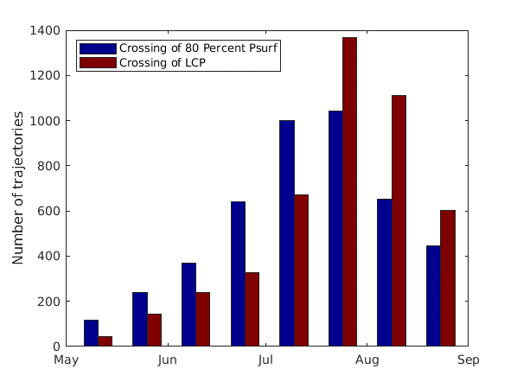
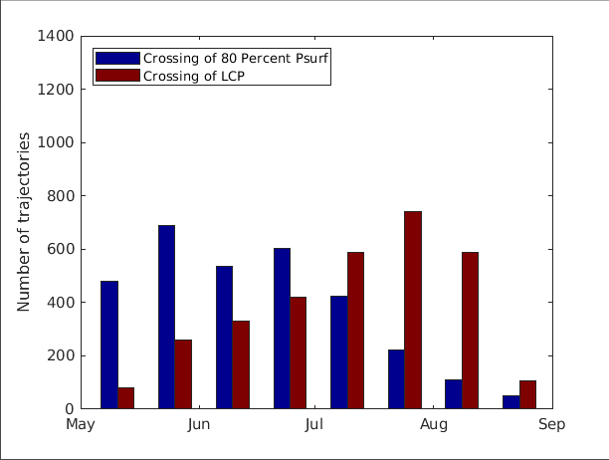
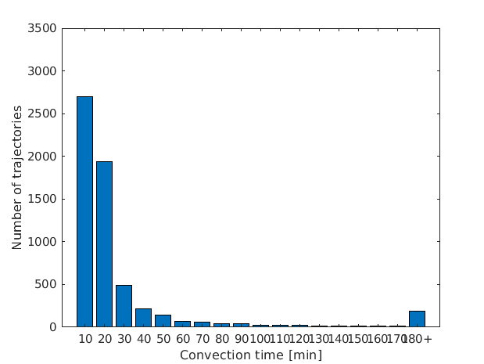
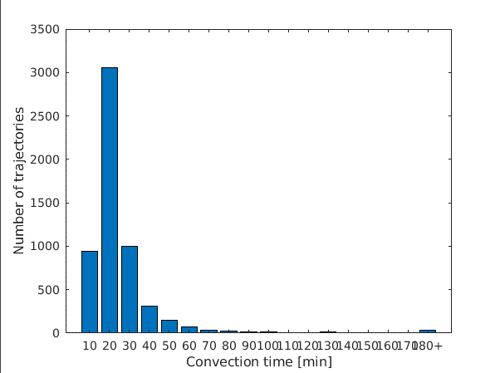
Crossing time and convection time
ERA5
ERA Interim

Slide 14

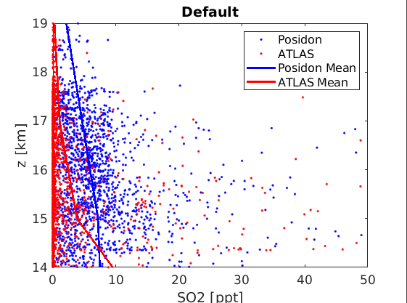
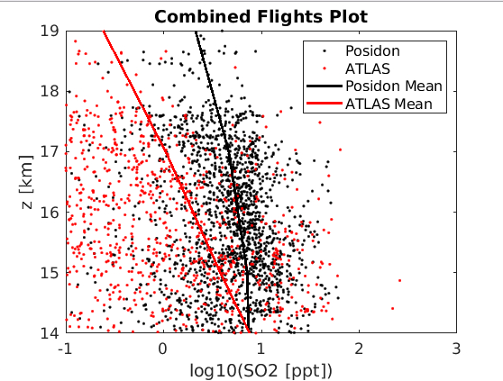
Comparison with POSIDON data

Slide 15

Thank you
Questions?
Conclusion
The main sources of SO2 were found to be degassing volcanoes and anthropogenic sources
The amount of SO2 reaching the Aerosol layer is 3-10 GgS/yr
The most sensitive parameter was pH( OH and DMS were also significant),
The differences in ERA5 and ERA interim datasets were significantly large
Our model underestimates SO2 when compared to POSIDON data
cnalapal@awi.de

