Slide 1
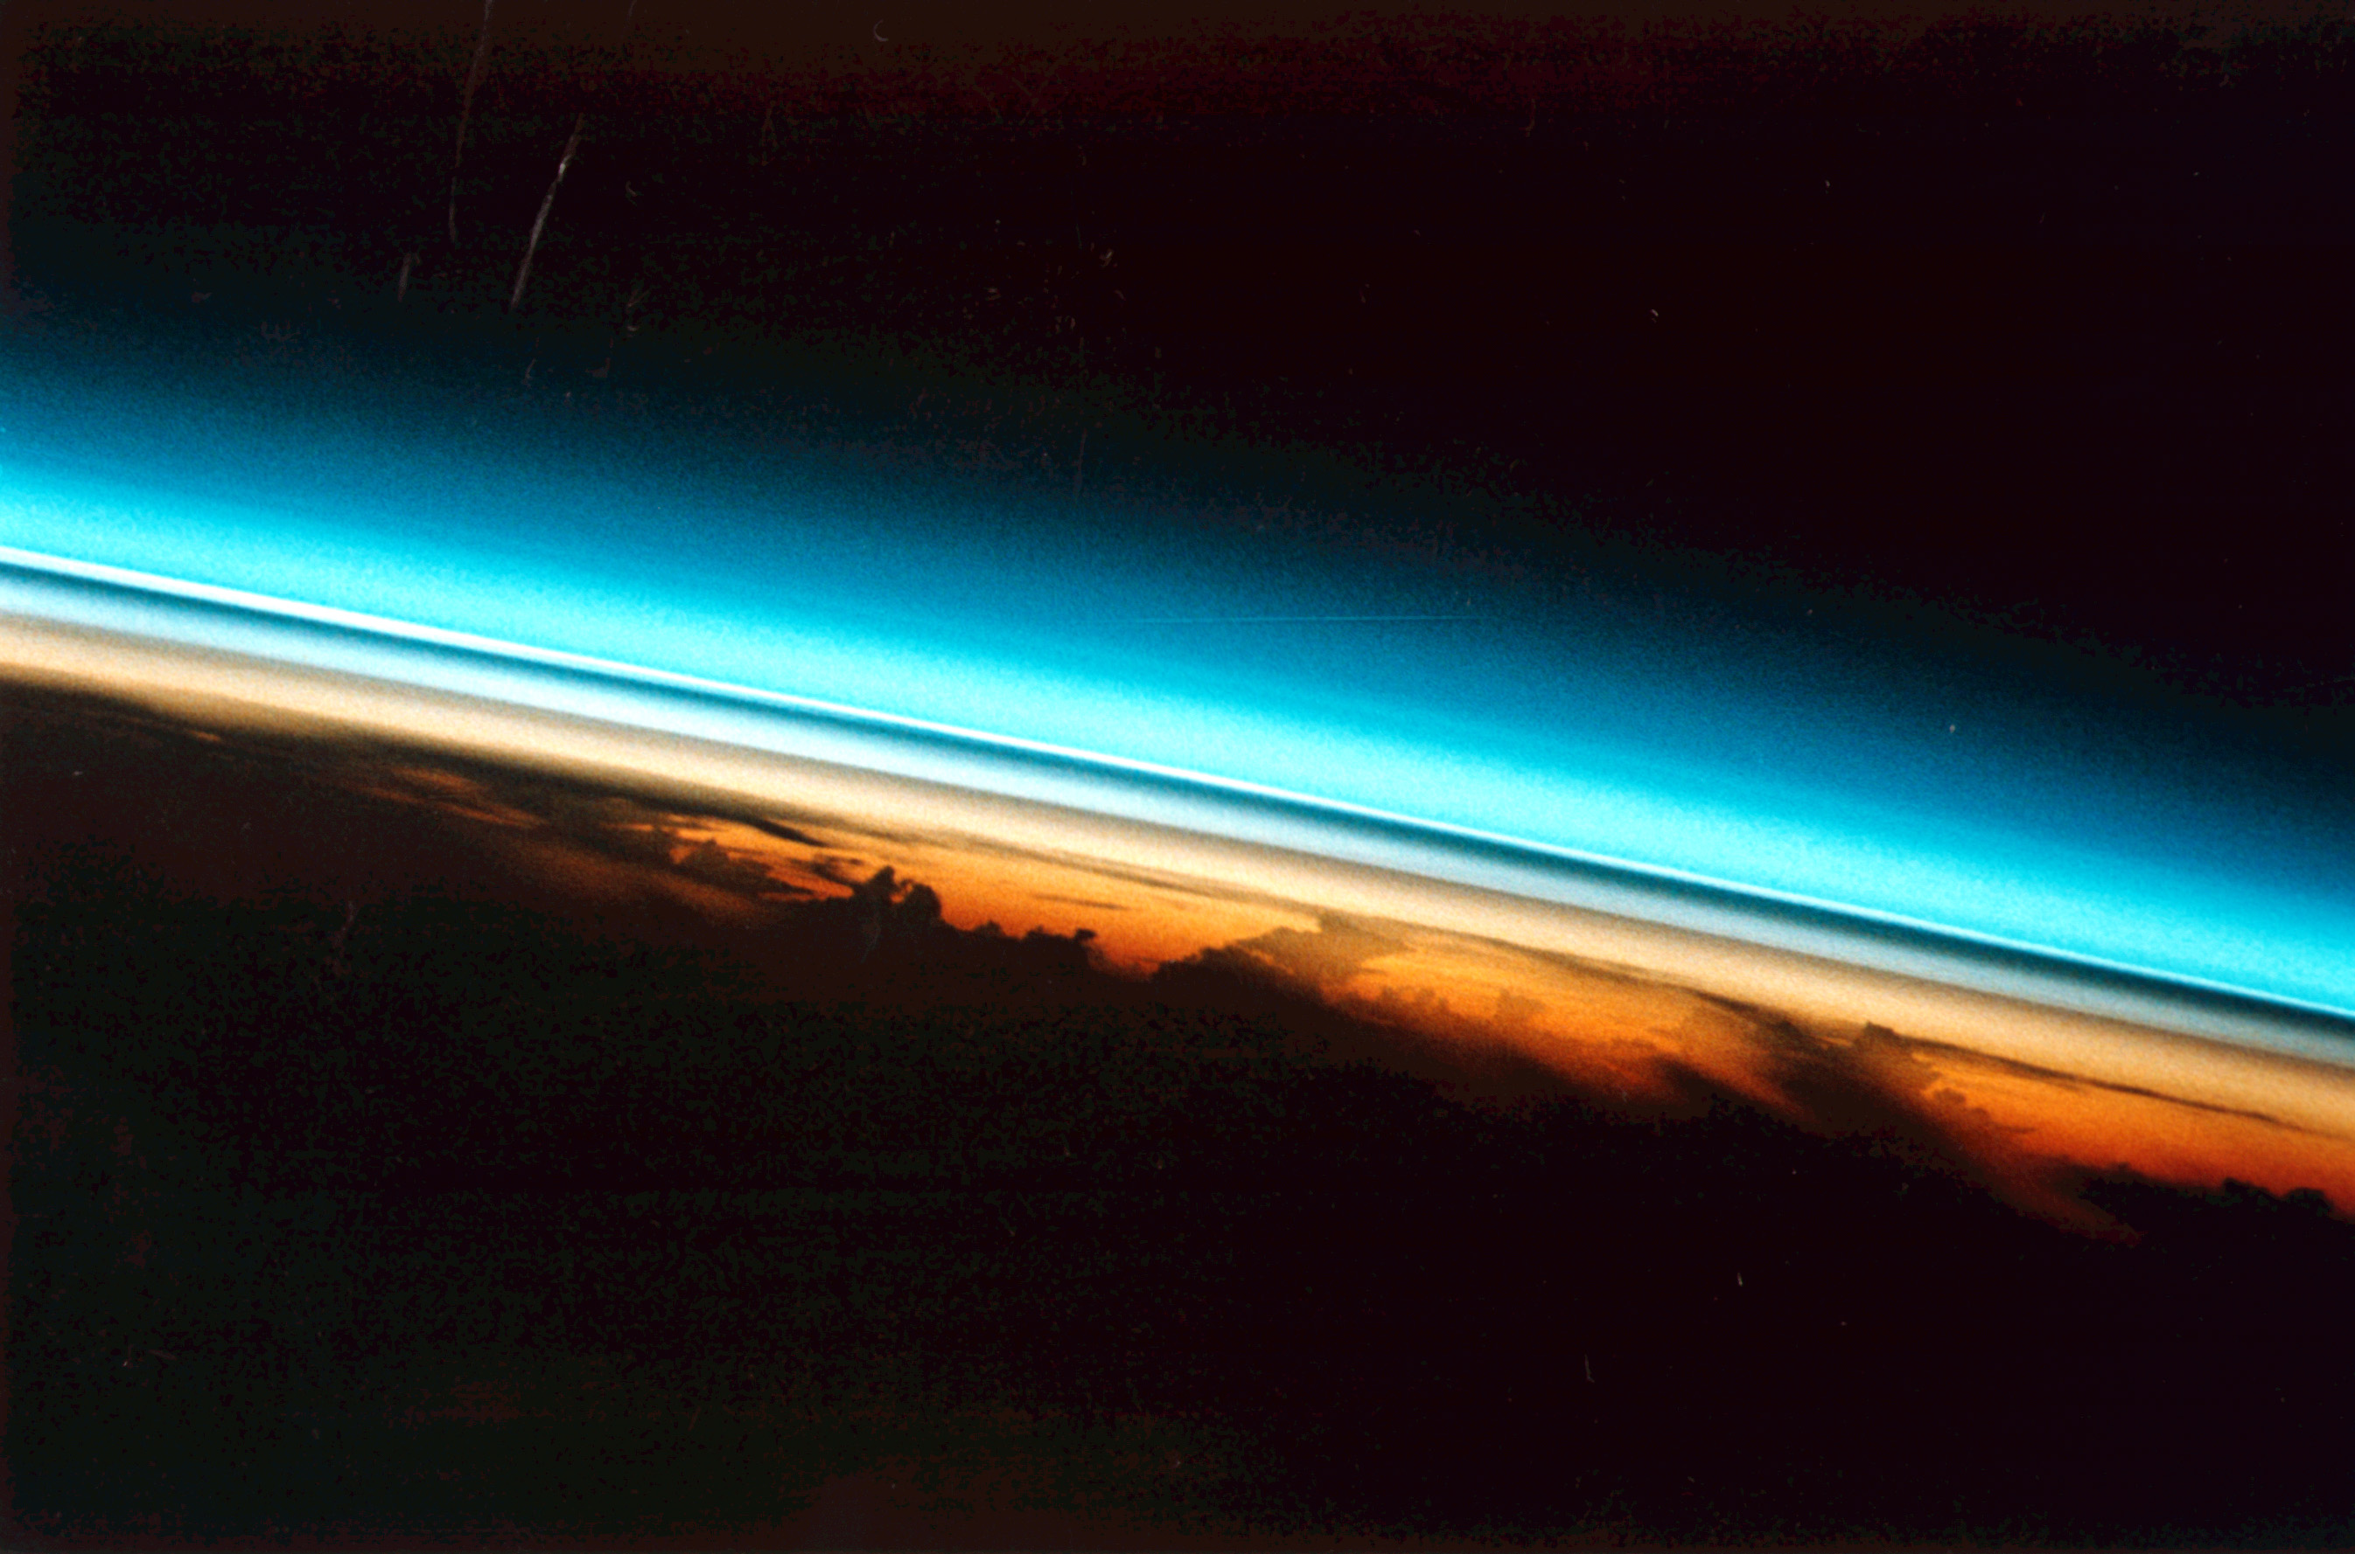

Model calculations of the contribution of SO₂ to
the stratospheric aerosol layer
Chiranjeevi Nalapalu
PhD Candidate
AWI Potsdam
Supervisors: Dr I. Wohltmann, Prof. M. Rex, Priv. Doz. Dr. M. Hoepfner
PPhoto: Space shuttle image of stratospheric aerosol layer after Pinatubo eruption

Slide 2
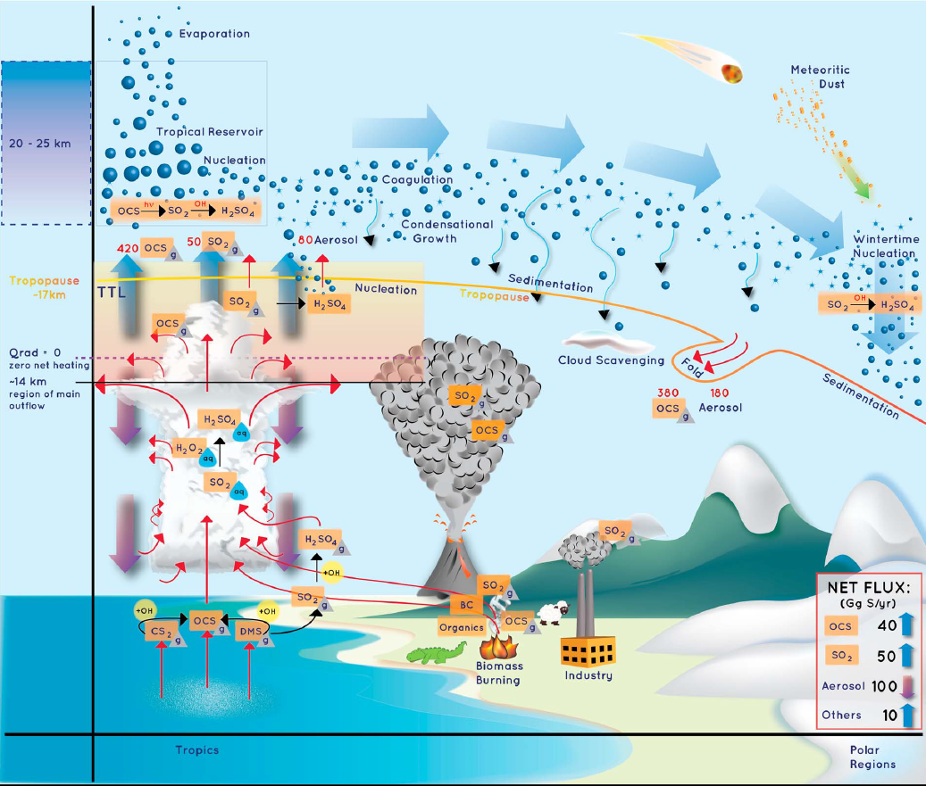
Motivation
Stratospheric aerosol layer is important for
Radiative balance of earth and climate change
Stratospheric chemistry (“ozone hole”)
Geo-Engineering
Many processes of the stratospheric aerosol layer are not well
known
Contribution of tropospheric species like SO₂ to stratospheric aerosol layer poorly quantified
Kremser et al., 2016

Slide 3
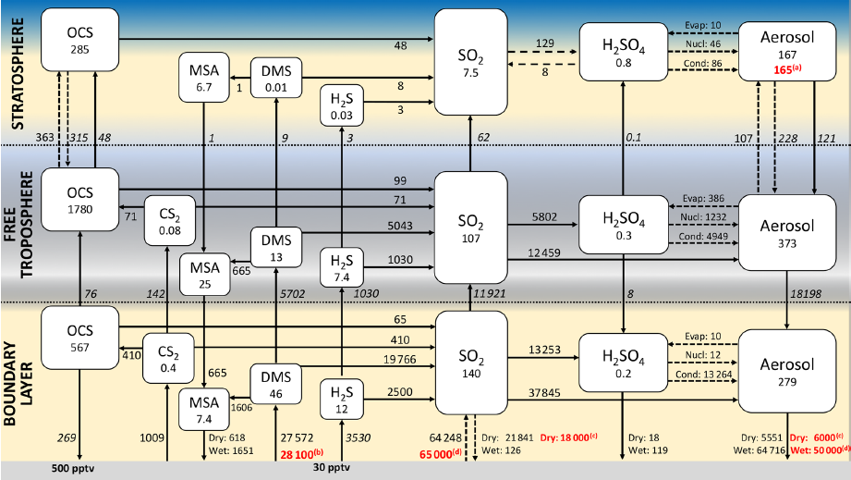
That‘s what we are interested in
Approach
Examine chemistry of SO₂ and its transport to the stratosphere
Chemical and microphysical “box” model on moving air parcel trajectories ending in the stratosphere
Numerous sensitivity runs to assess range of uncertainty
Focus on “background” values under volcanically quiescent conditions
Feinberg et al., 2019

Slide 4
Our existing tools
Trajectory model of the ATLAS Chemistry and Transport Model of our working group
Convection model: Trajectory model includes „statistical“ convection model on individual trajectories
Simplified chemical and microphysical model focussing on the relevant SO₂ and sulfur chemistry and cloud interactions
CAMS model for initialization of chemistry model at top of boundary layer

Slide 5
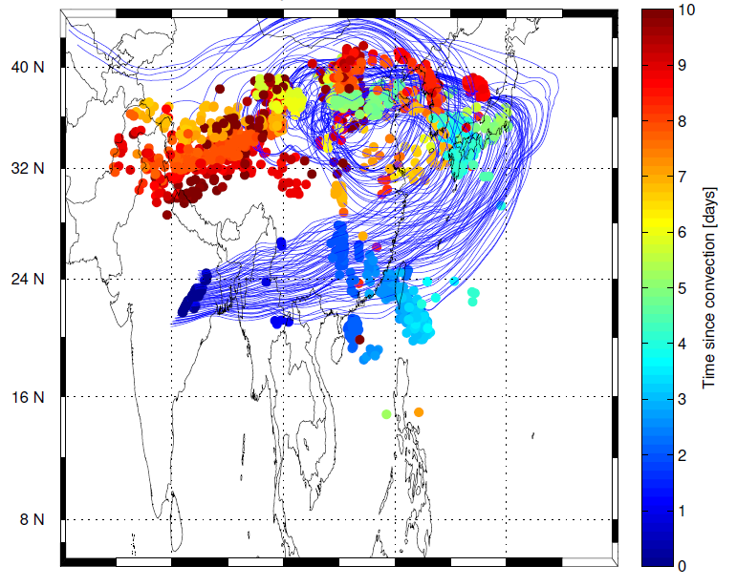
Results from preliminary work
Example for trajectories ending at the measurements of a flight we want to compare with
Trajectories (blue)
Convective events on the trajectories (colored dots)
Color shows „age“ of convection

Slide 6
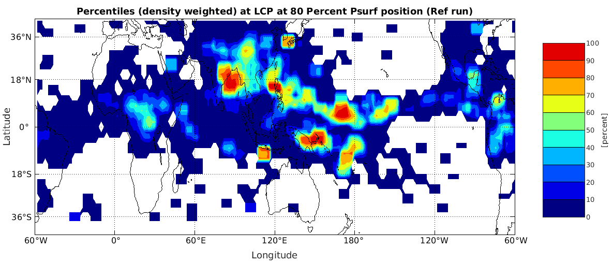
Results from preliminary work

Slide 7
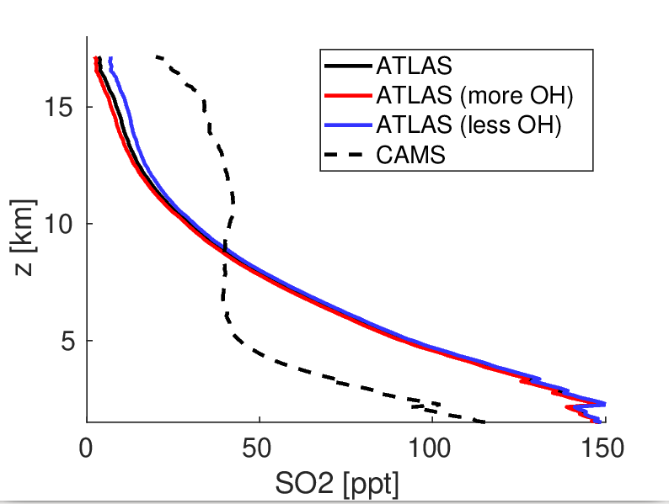
Results from preliminary work
Example for sensitivity runs
Mean over large ensemble of trajectories reaching the stratosphere
Modelled SO₂ from chemistry model
Sensitivity to different values of OH

Slide 8
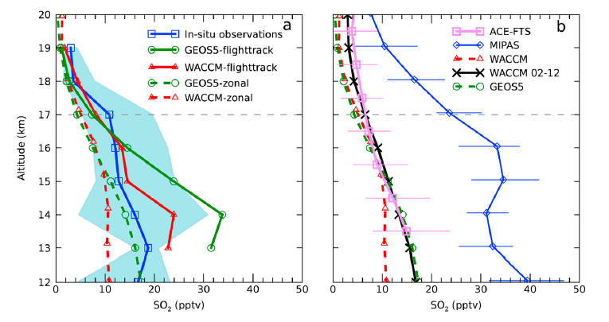
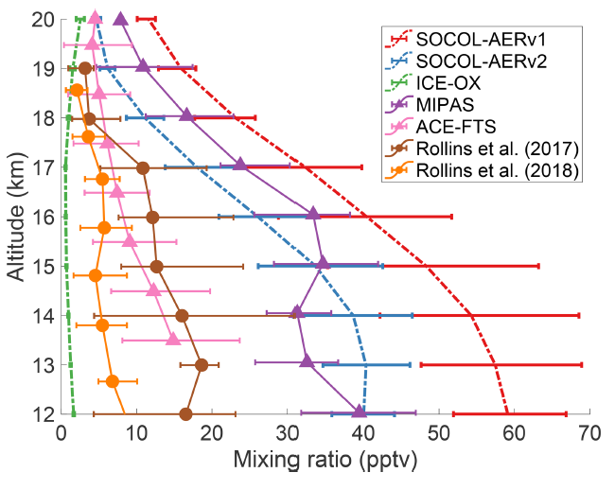
Comparison and validation of
model results with measurements
Some results from the literature how this can look like
Rollins et al., 2017
Feinberg et al., 2019

