Slide 1
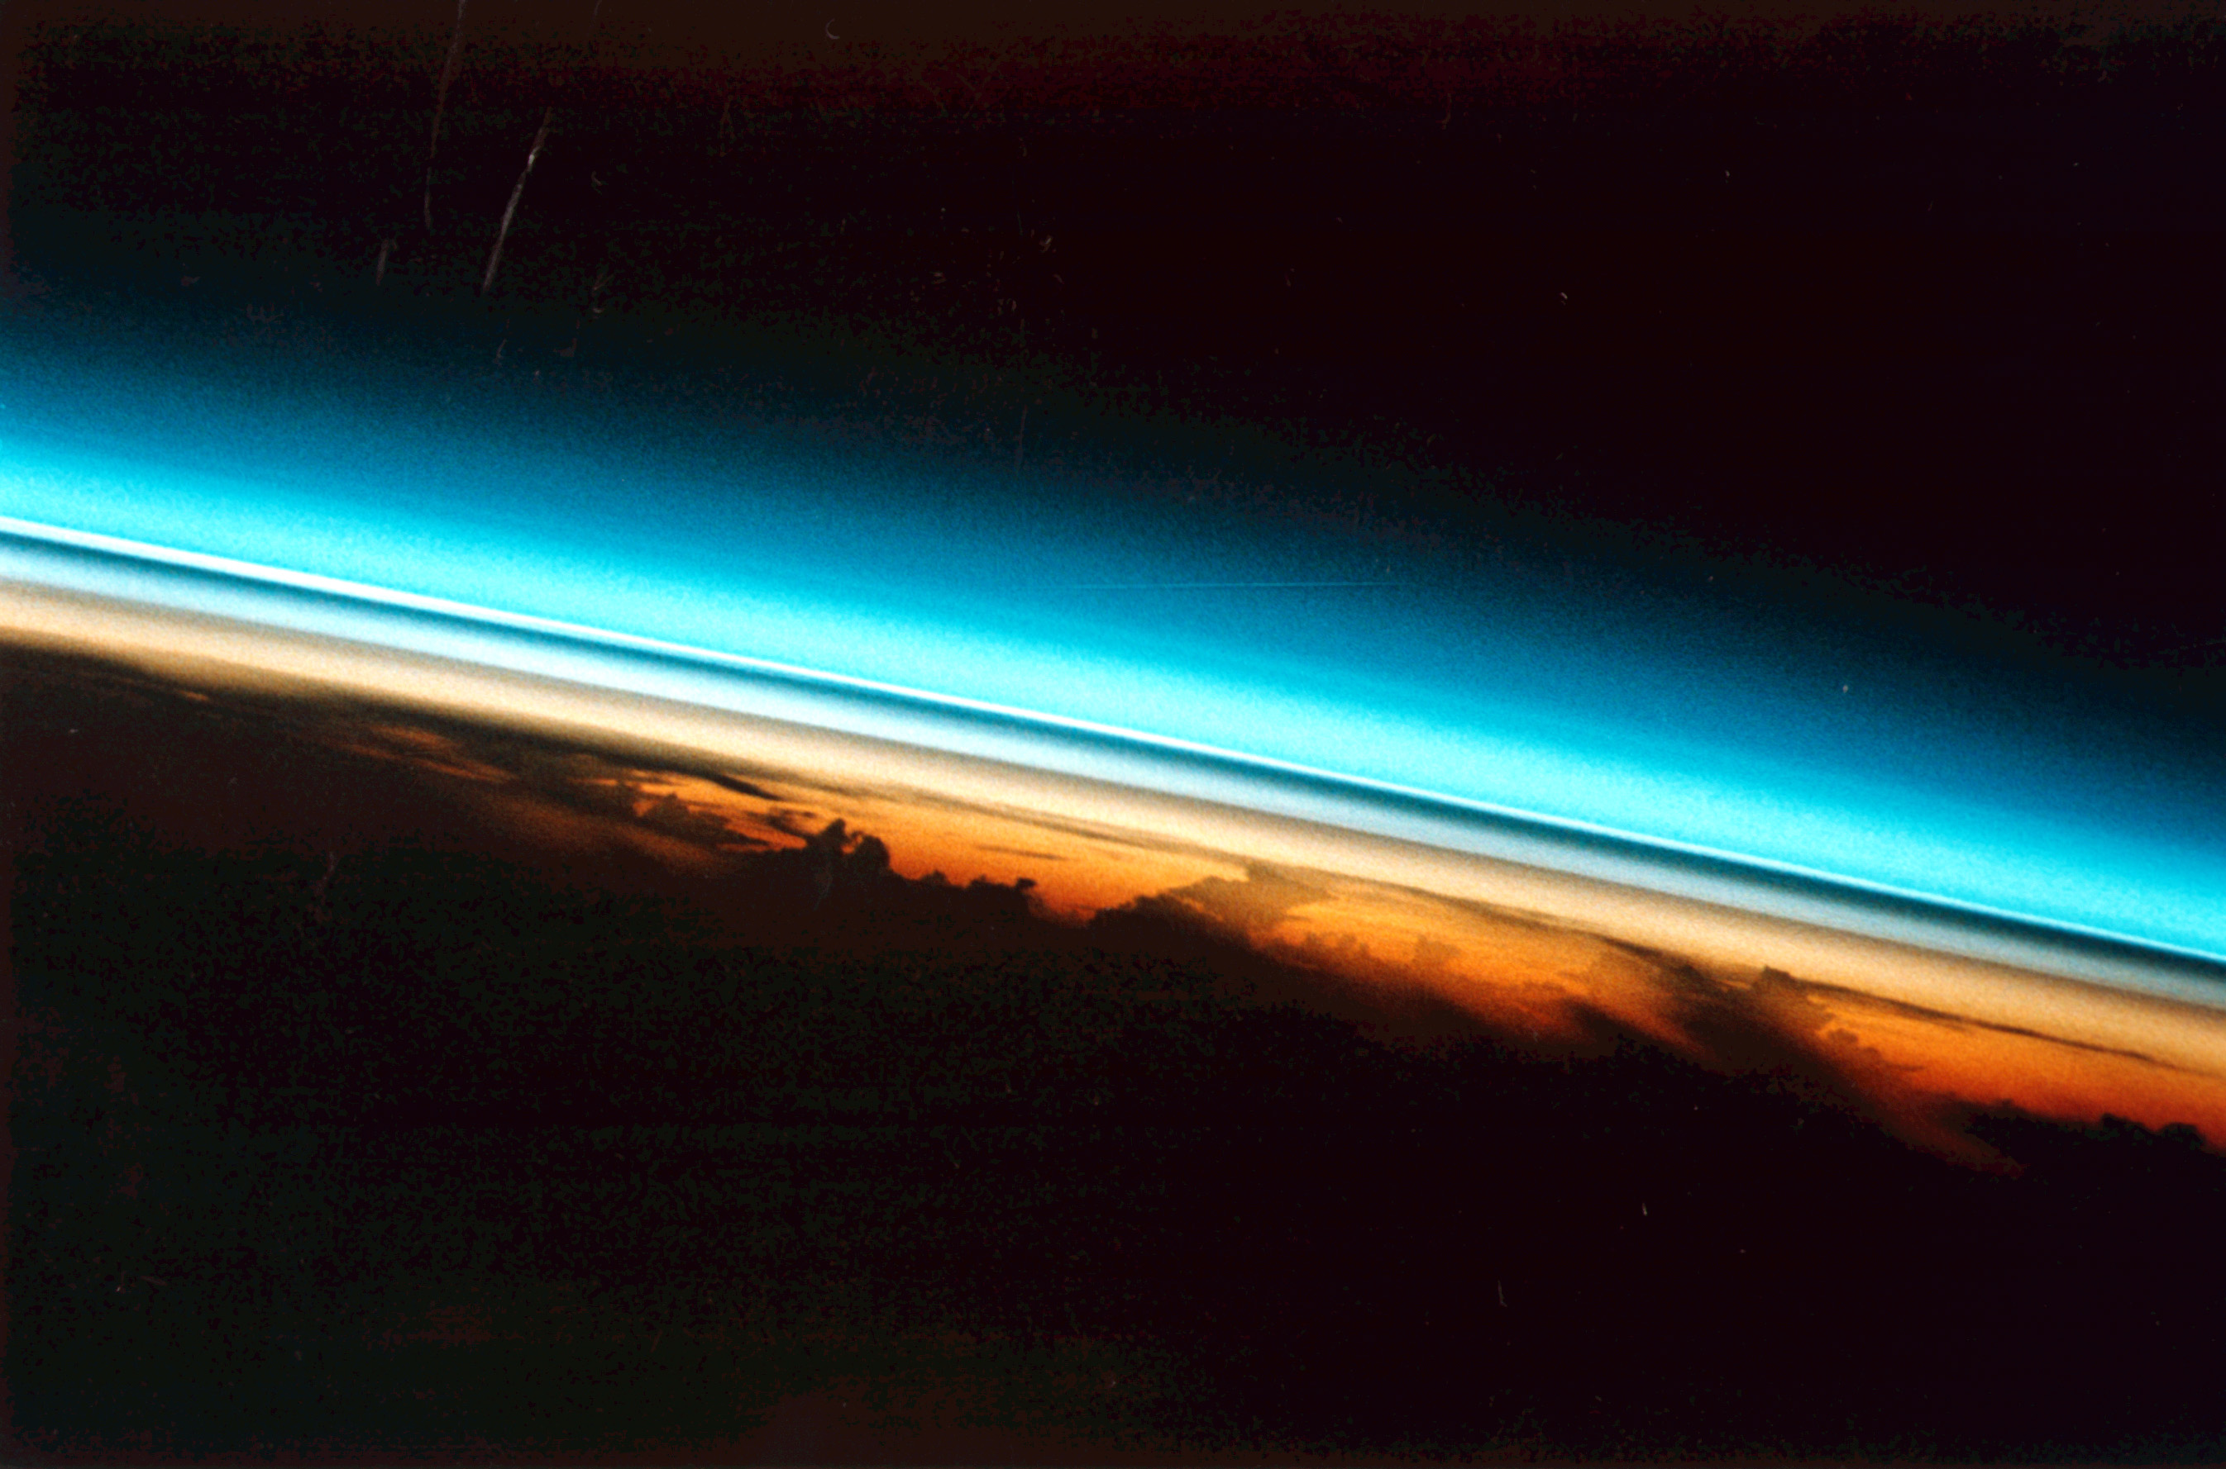





Model calculations of the contribution of SO₂ to
the stratospheric aerosol layer
Chiranjeevi Nalapalu, Ingo Wohltmann,
Markus Rex, Michael Hoepfner, Ralph Lehmann
Photo: Space shuttle image of stratospheric aerosol layer after Pinatubo eruption

Slide 2
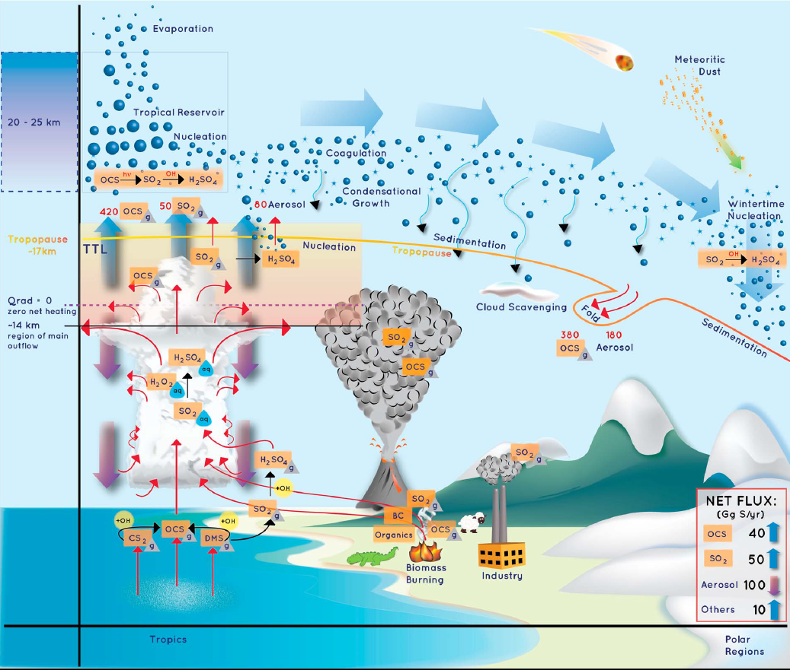
Kremser et al., Rev. Geophys., 2015, doi:10.1002/2015RG000511

Slide 3
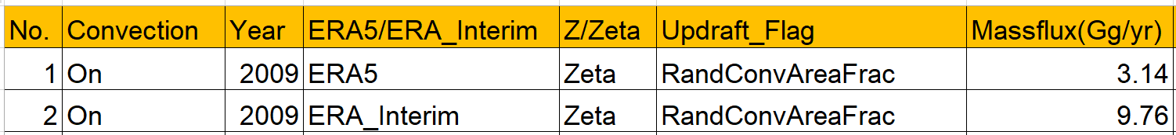
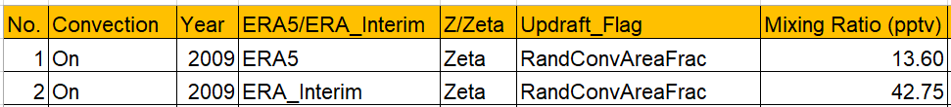
Mass flux
How much SO2 is transported to the Stratosphere?
Rollins et al. 2017 In Situ -> 3.6 Gg/Yr
Sheng et al. 2015 SOCAL-AERv1 Model -> 50 Gg/Yr
Mixing ratio
Rollins et al. 2017,2018 In Situ -> 5-10 pptv
Höpfner et al. 2015 MIPAS Satellite -> 24 pptv
Doeringert et al. 2012 ACE-FTS Satellite -> 5-10 pptv
Feinberg et al. 2019 SOCOL-AERv1,v2 Model -> 20-30 pptv

Slide 4
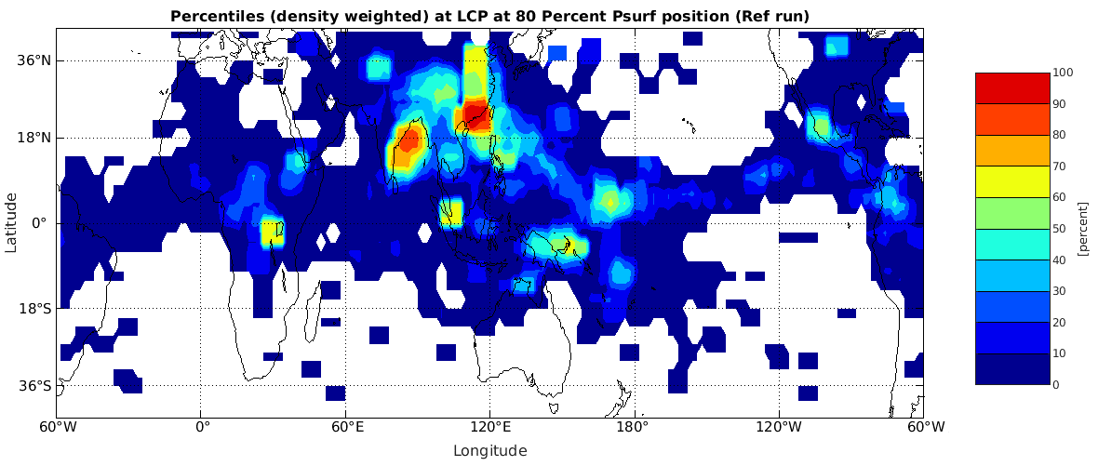
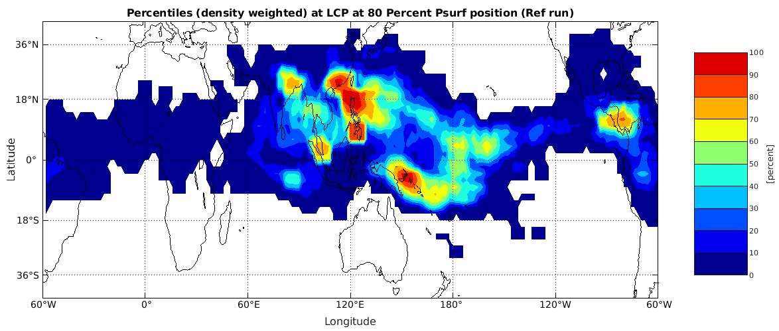
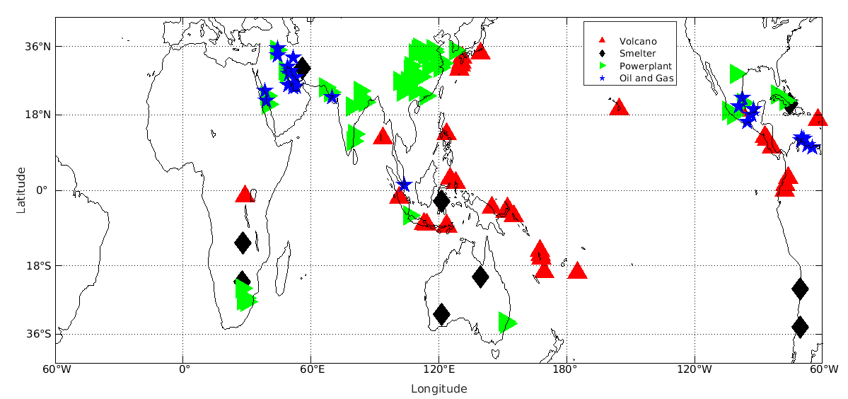
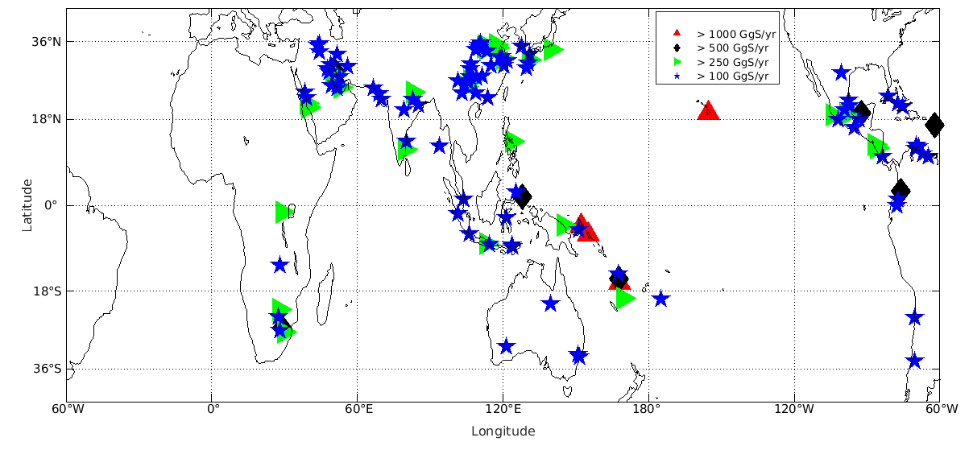
What are the main sources of SO2 in the troposphere?
ERA5
ERA
Interim
Fioletov et al., Atmos. Chem. Phys., 2016, doi:10.5194/acp-16-11497-2016

Slide 5
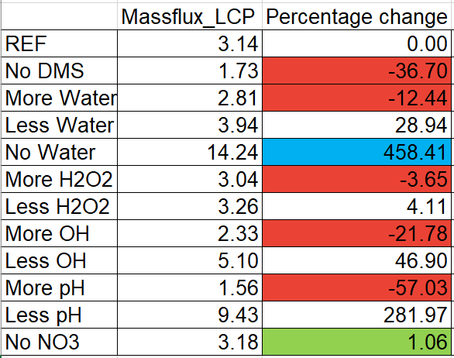
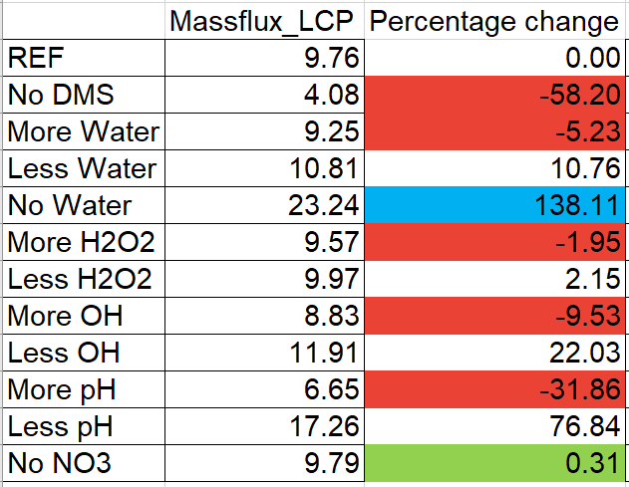
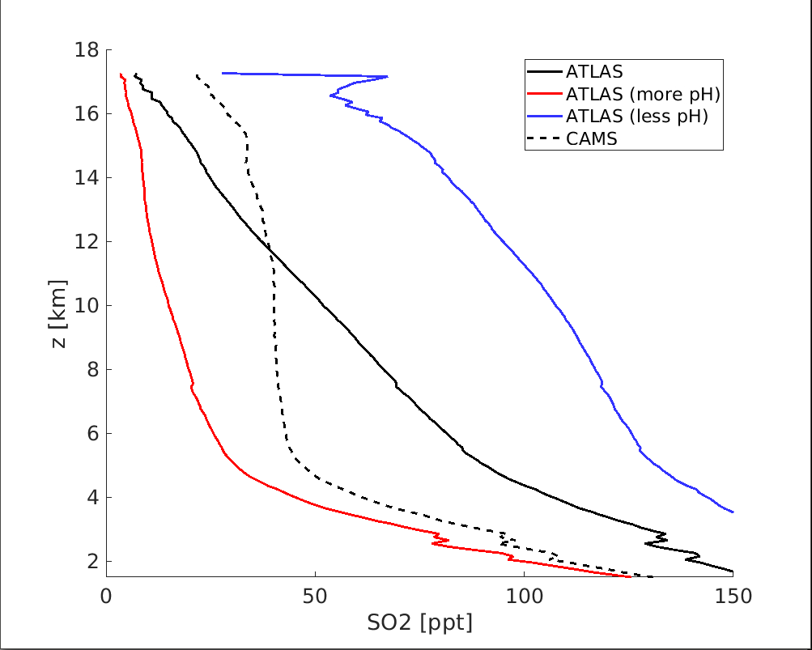
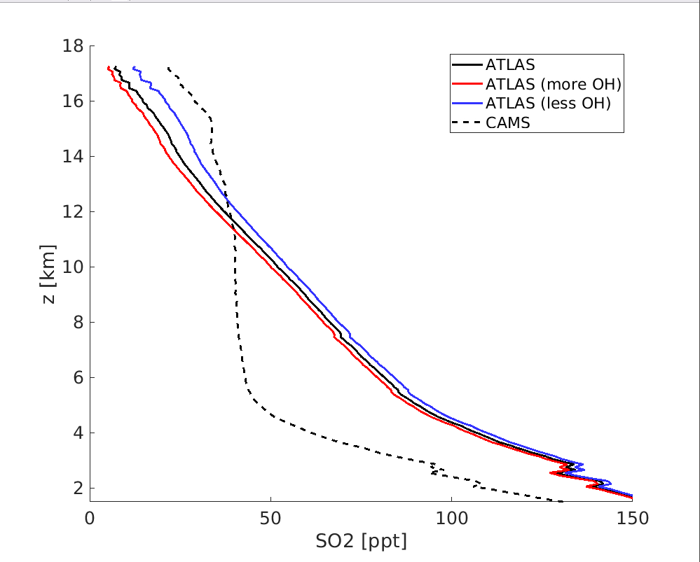
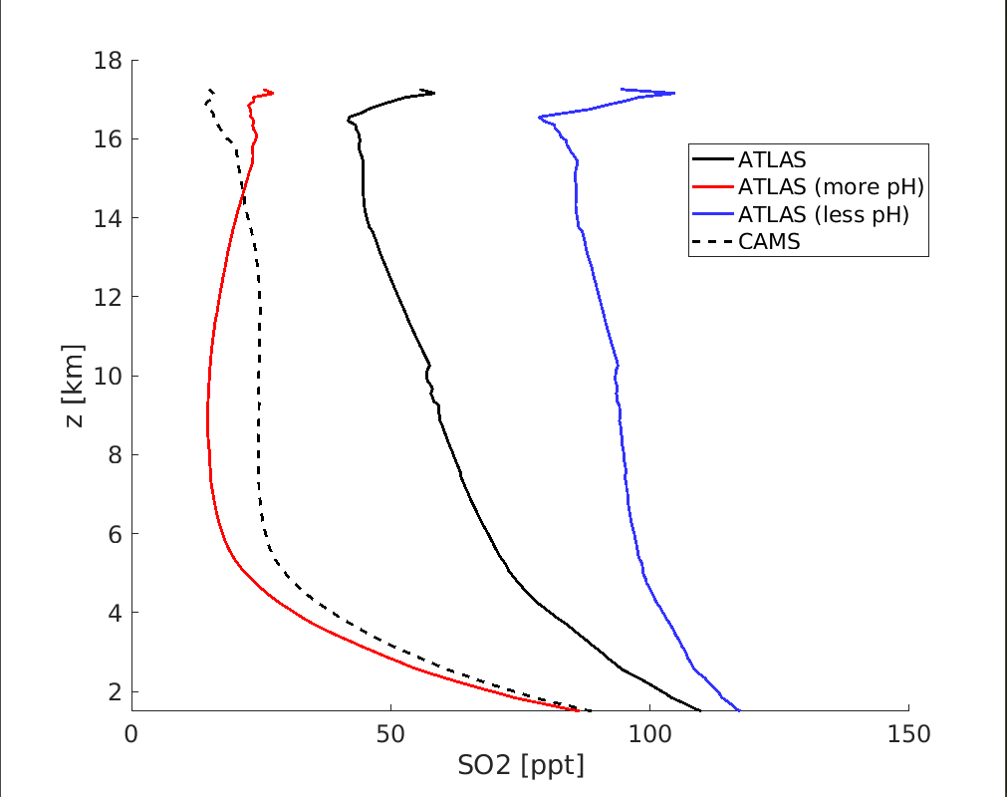
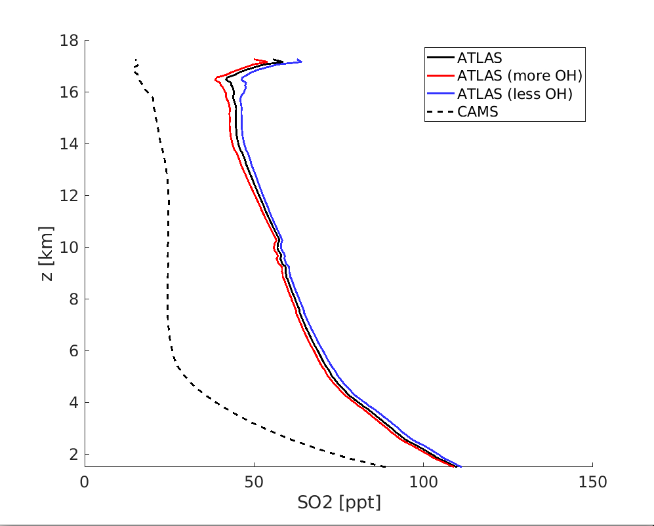
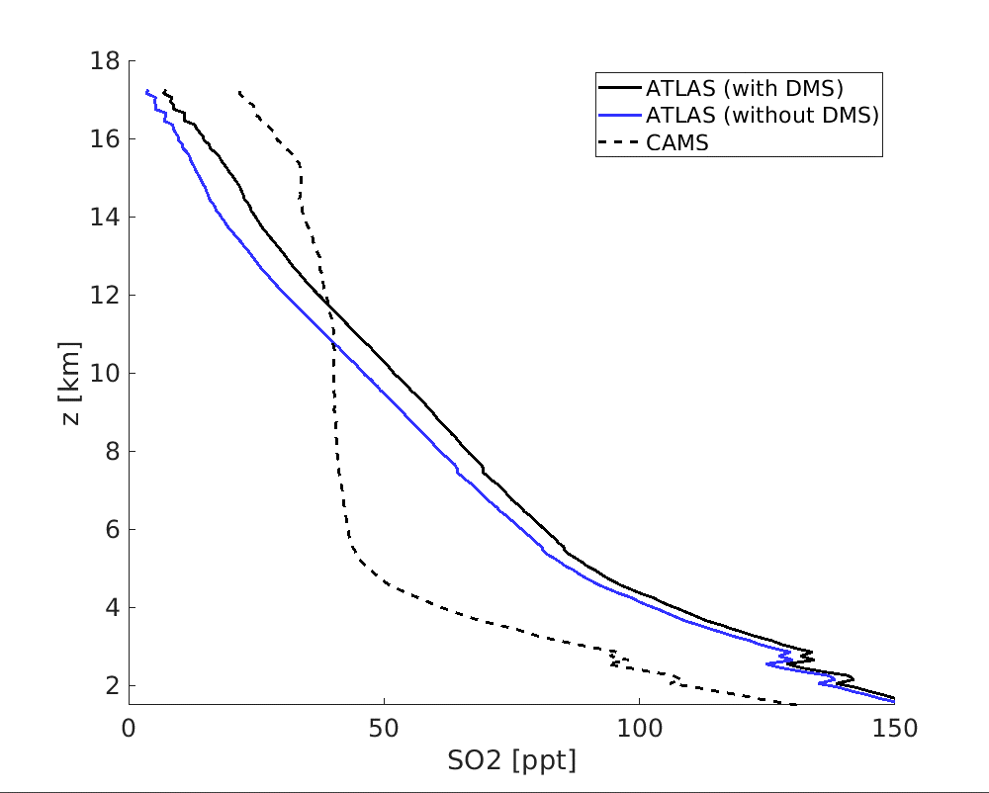
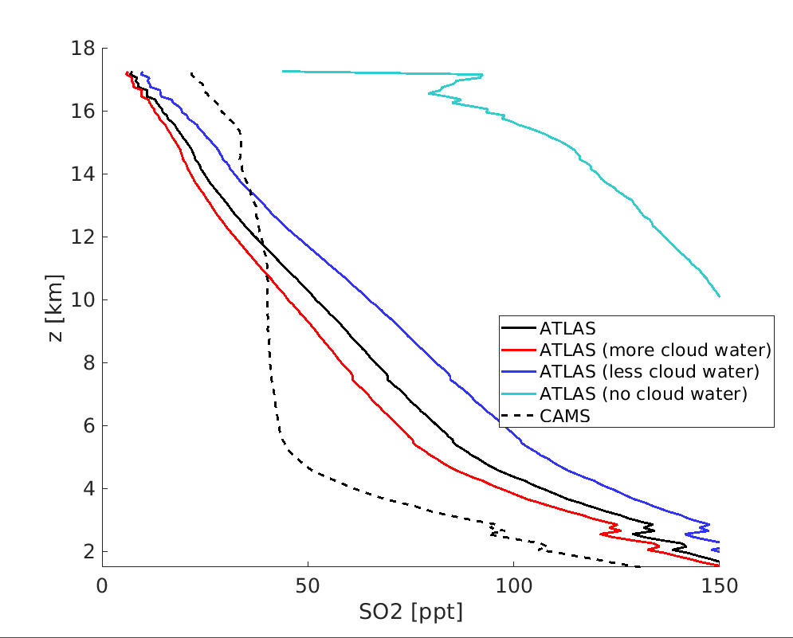
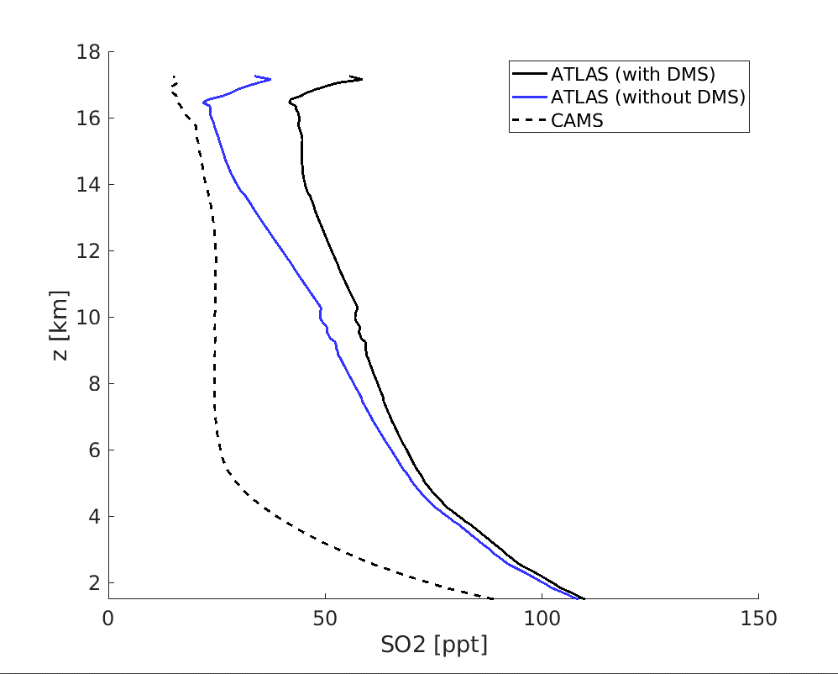
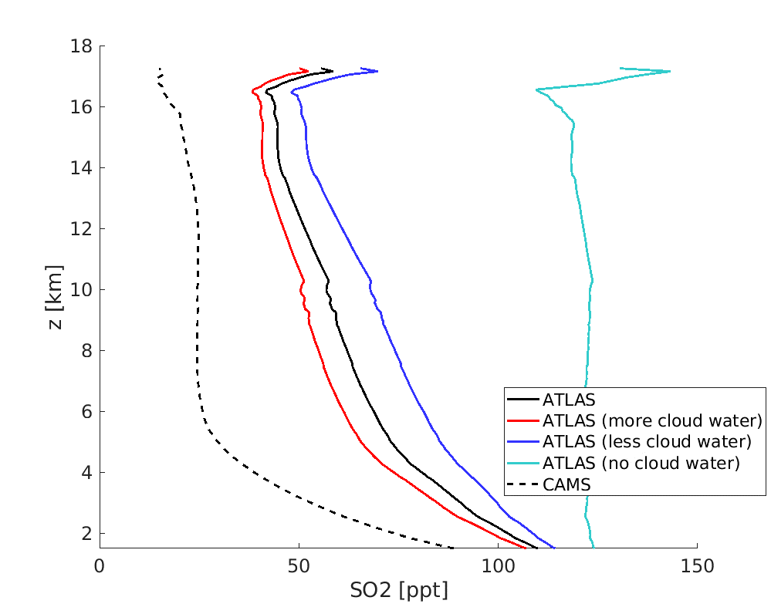
Sensitivities
ERA5
ERA Interim

Slide 6

Thank you
Conclusion
The main sources of SO2 were found to be degassing volcanoes and anthropogenic sources
The amount of SO2 reaching the Aerosol layer is 3-10 GgS/yr
The most sensitive parameter was pH (OH and DMS were also significant),
The differences in ERA5 and ERA interim datasets were significantly large
cnalapal@awi.de

