Slide 1
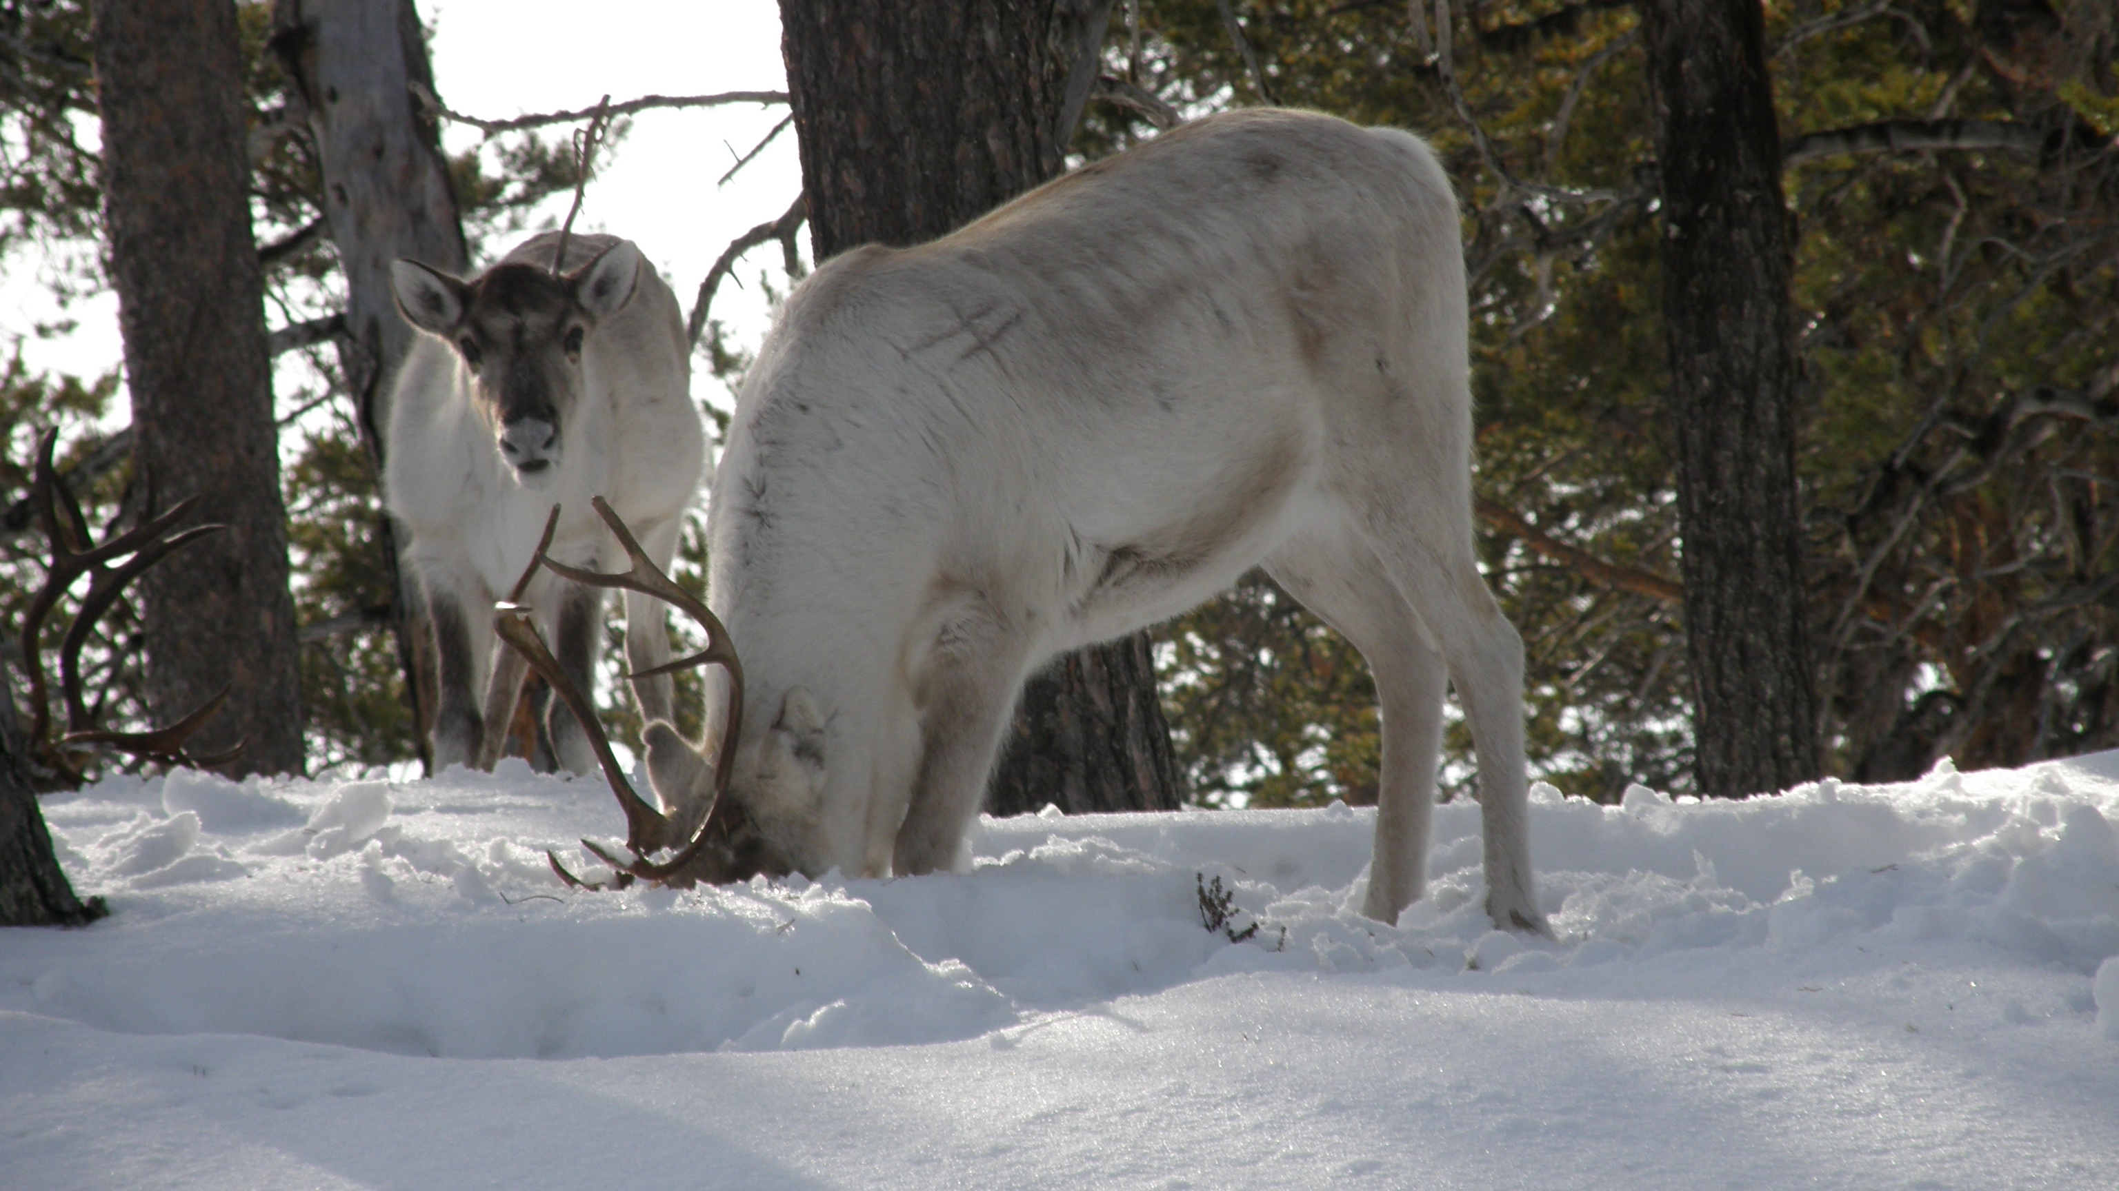



Using climate model projections to provide relevant climate information to Arctic reindeer herding communities
photo by
Minna Turunen
Heidrun Matthes, J. Otto Habeck, Roza Laptander, Teresa Komu, Kirill Istomin, Tim Horstkotte, Sirpa Rasmus, Jussi T. Eronen, Bruce C. Forbes, Hans Tømmervik

Slide 2
background
CHARTER (Drivers and Feedbacks of Changes in Arctic Terrestrial Biodiversity)
  aims to simulate the future effects of social-ecological changes for indigenous and local communities and traditional livelihoods in the Arctic
questions we started with:
What kind of information from climate model projections of the future would be relevant for reindeer herders?
What would help them in the development of adaptation strategies in connection to climate change?
questions that were used in communication with reindeer herders (interviews, literature):
What weather conditions are good/bad for the important events of the reindeer herding year?
What makes a reindeer herding year good/bad?

Slide 3
critical seasonal conditions in reindeer herding
spring (calving)
  snow free patches
  snow storms
  ice crusts
  river and lake ice
early summer (calf marking, migration)
  high water levels in rivers
  strong currents
early spring
  snow melt
  rain on snow
  ice crusts
summer
insect harassment (insect numbers)
insect harassment (insect attacks)
hot summers
wet/dry summers
permafrost degradation
shifts in occurrence of predators/plants
snow bed degradation
daily snow height, snow cover fraction | daily precipitation (liquid, solid) | daily dew point temperature
daily air temperature (mean, minimum, maximum) | daily soil temperature and moisture | daily wind speed (mean, maximum)
river and lake ice | river discharge | clouds
summer
insect harassment (insect numbers)
insect harassment (insect attacks)
hot summers
wet/dry summers
permafrost degradation
shifts in occurrence of predators/plants
snow bed degradation
winter
  rain on snow
  mild temperatures (from -5°C to +3°C)
early winter (migration)
  rain on snow
  hoarfrost; frozen water on plants/lichen
  ice crust on bare ground (ground ice or frost)
late autumn (rutting , round ups)
  wet/dry soil at the moment of first snow
  frozen/unfrozen soil at the moment of first snow
early autumn
  mushroom growth
  warm conditions during rutting
  wet conditions during rutting
early autumn
  mushroom growth
  warm conditions during rutting
  wet conditions during rutting
Notes:
explain herding year and conditions:
combination of seasonality in the Arctic and practicalities of reindeer herding results in an eight seasons calendar
specific critical conditions depend on where the herders live, on practices of reindeer herding and local climate conditions
this slide provides a synthesized overview of critical conditions given by reindeer herders in the European Arctic
to compute conditions from climate models, we need to know what variables they depend on, limitations there: mushrooms, ect
variables we identified, note: for the questions we raise here, daily data is needed for all variables
additional criteria: uncertainty estimates, multiple scenarios

Slide 4
critical seasonal conditions – availability of variables
spring (calving)
  snow free patches
  snow storms
  ice crusts
  river and lake ice
early summer (calf marking, migration)
  high water levels in rivers
  strong currents
early spring
  snow melt
  rain on snow
  ice crusts
daily snow height, snow cover fraction | daily precipitation (liquid, solid) | daily dew point temperature
daily air temperature (mean, minimum, maximum) | daily soil temperature and moisture | daily wind speed (mean, maximum)
river and lake ice | river discharge | clouds
daily snow height, snow cover fraction | daily precipitation (liquid, solid) | daily dew point temperature
daily air temperature (mean, minimum, maximum) | daily soil temperature and moisture | daily wind speed (mean, maximum)
river and lake ice | river discharge | clouds
daily snow height, snow cover fraction | daily precipitation (liquid, solid) | daily dew point temperature
daily air temperature (mean, minimum, maximum) | daily soil temperature and moisture | daily wind speed (mean, maximum)
river and lake ice | river discharge | clouds
summer
insect harassment (insect numbers)
insect harassment (insect attacks)
hot summers
wet/dry summers
permafrost degradation
shifts in occurrence of predators/plants
snow bed degradation
winter
  rain on snow
  mild temperatures (from -5°C to +3°C)
early winter (migration)
  rain on snow
  hoarfrost; frozen water on plants/lichen
  ice crust on bare ground (ground ice or frost)
late autumn (rutting , round ups)
  wet/dry soil at the moment of first snow
  frozen/unfrozen soil at the moment of first snow
early autumn
  mushroom growth
  warm conditions during rutting
  wet conditions during rutting
Notes:
variables available, for example from CMIP6, CORDEX
some are not available at al, like soil moisture, soil temperature
others are available from comparatively small numbers of models

Slide 5
critical seasonal conditions – availability of variables
spring (calving)
  snow free patches
  snow storms
  ice crusts
  river and lake ice
spring (calving)
  snow free patches
  snow storms
  ice crusts
  river and lake ice
spring (calving)
  snow free patches
  snow storms
  ice crusts
  river and lake ice
spring (calving)
  snow free patches
  snow storms
  ice crusts
  river and lake ice
early summer (calf marking, migration)
  high water levels in rivers
  strong currents
early summer (calf marking, migration)
  high water levels in rivers
  strong currents
early spring
  snow melt
  rain on snow
  ice crusts
early spring
  snow melt
  rain on snow
  ice crusts
early spring
  snow melt
  rain on snow
  ice crusts
summer
insect harassment (insect numbers)
insect harassment (insect attacks)
hot summers
wet/dry summers
permafrost degradation
shifts in occurrence of predators/plants
snow bed degradation
summer
insect harassment (insect numbers)
insect harassment (insect attacks)
hot summers
wet/dry summers
permafrost degradation
shifts in occurrence of predators/plants
snow bed degradation
summer
insect harassment (insect numbers)
insect harassment (insect attacks)
hot summers
wet/dry summers
permafrost degradation
shifts in occurrence of predators/plants
snow bed degradation
daily snow height, snow cover fraction | daily precipitation (liquid, solid) | daily dew point temperature
daily air temperature (mean, minimum, maximum) | daily soil temperature and moisture | daily wind speed (mean, maximum)
river and lake ice | river discharge | clouds
summer
insect harassment (insect numbers)
insect harassment (insect attacks)
hot summers
wet/dry summers
permafrost degradation
shifts in occurrence of predators/plants
snow bed degradation
winter
  rain on snow
  mild temperatures (from -5°C to +3°C)
winter
  rain on snow
  mild temperatures (from -5°C to +3°C)
winter
  rain on snow
  mild temperatures (from -5°C to +3°C)
early winter (migration)
  rain on snow
  hoarfrost; frozen water on plants/lichen
  ice crust on bare ground (ground ice or frost)
early winter (migration)
  rain on snow
  hoarfrost; frozen water on plants/lichen
  ice crust on bare ground (ground ice or frost)
early winter (migration)
  rain on snow
  hoarfrost; frozen water on plants/lichen
  ice crust on bare ground (ground ice or frost)
late autumn (rutting, round ups)
  wet/dry soil at the moment of first snow
  frozen/unfrozen soil at the moment of first snow
late autumn (rutting, round ups)
  wet/dry soil at the moment of first snow
  frozen/unfrozen soil at the moment of first snow
early autumn
  mushroom growth
  warm conditions during rutting
  wet conditions during rutting
early autumn
  mushroom growth
  warm conditions during rutting
  wet conditions during rutting
Notes:
things we can calculate, even though maybe from a small ensemble size, green
things we can calculate but need to verify extensively to see if they provide the information we are looking for, yellow
things that would require impact models to calculate them: catchment models, permafrost models, lake ice models
things we cannot calculate because of a lack of variables
example: hot summers

Slide 6
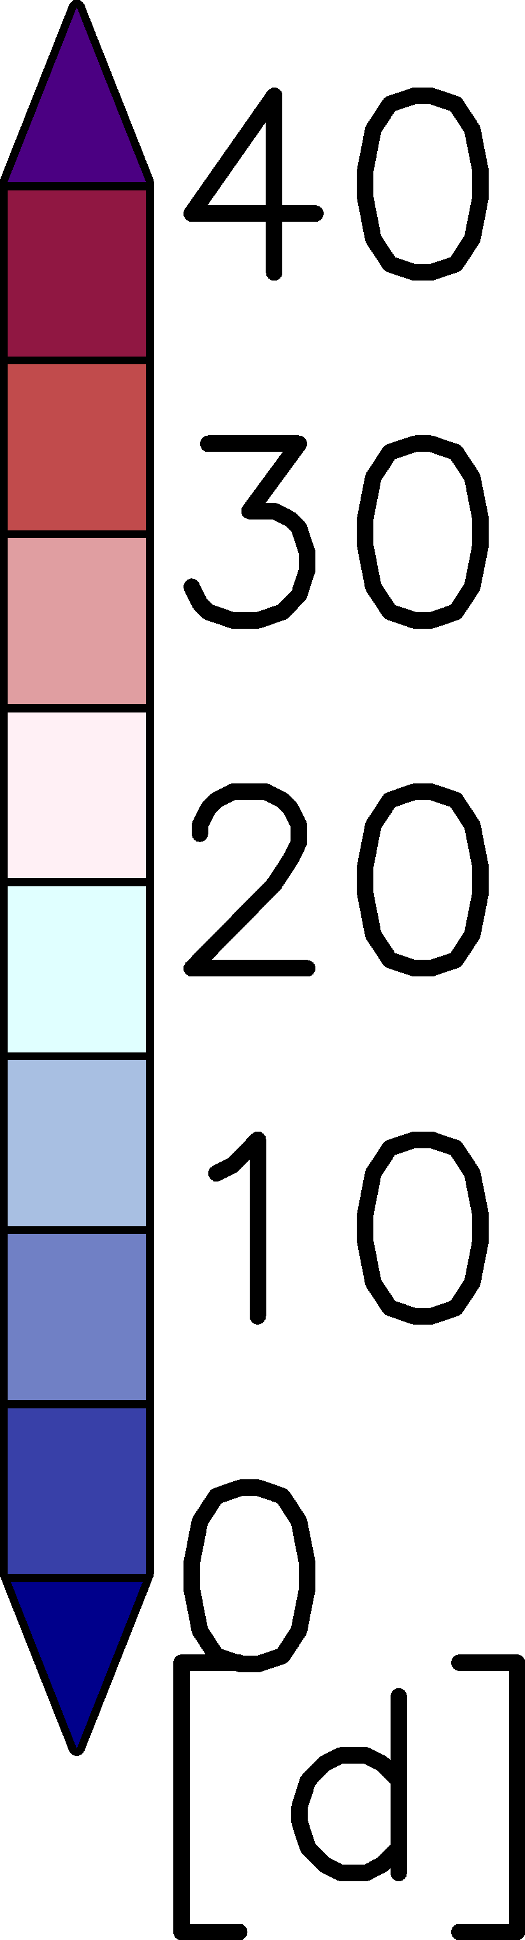
hot summers – days with tasmax > 25°C from CMIP6
CMIP5 - hist
CMIP6 - hist
observation
EUR11 - hist
CMIP5 - end of century
CMIP6 - end of century
EUR11 - end of century
RCP85
SSP5-RCP85
RCP85
Notes:
most up to date comprehensive data set available at present: global CMIP6 models
adaptation of adaptation strategies
we could be done here, but this is a session on regional climate modelling, so why am I here?
like people in every other environment dependent livelihood, reindeer herders have adaptation strategies for dealing with bad conditions: they might delay the timing of events like migration, they might use supplementary feeding, but even though most herders in the area I showed are not or not anymore nomads, still, their first adaptation strategy is movement. Can I outrun it?
How big is it spatially? How persistent is it in time?
This question cannot be answered from global models (today)
CORDEX data is CMIP5, new initiative for the Arctic exists, but lack for many other regions

Slide 7
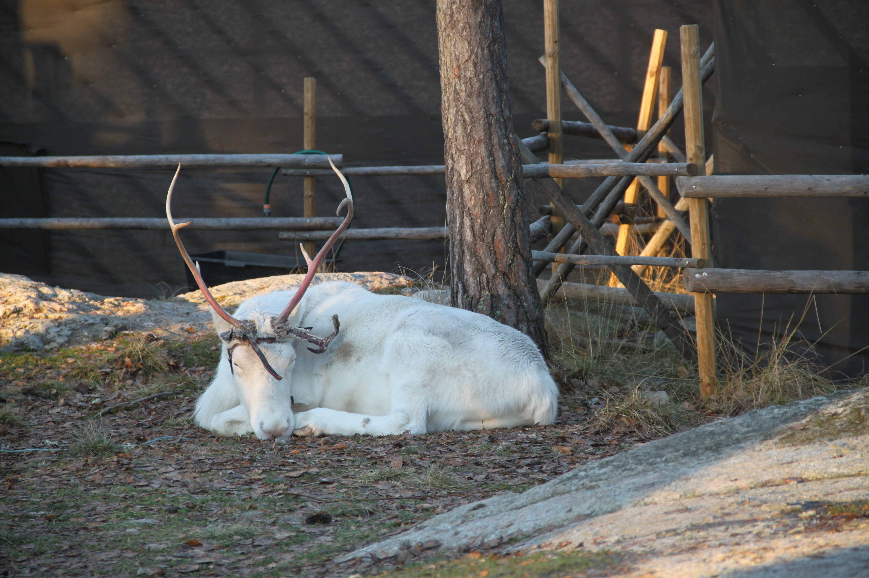
conclusions
questions?
Resolution is everything!
  at least daily temporal resolution of variables is necessary to compute the indices relevant for herders
  high spatial resolution is necessary for adaption of adaptation strategies
You can never output too many variables!
  specific target groups of climate model projections have specific needs in variables
  providing information on different possible futures with adequate uncertainty estimates requires these variables from big intercomparison projects
Notes:
both are issues of storage, of course, but for broad impact related research, they are important!

