Slide 1
Search for Chemical Key Features in Dissolved Organic Matter in the Ocean
Presenter: Marlo Bareth
1st supervisor: Boris Koch
2nd supervisor: Gabriel Zachmann
Advisor: Sebastian Maneth
Advisor: Christian L. Müller

Slide 2
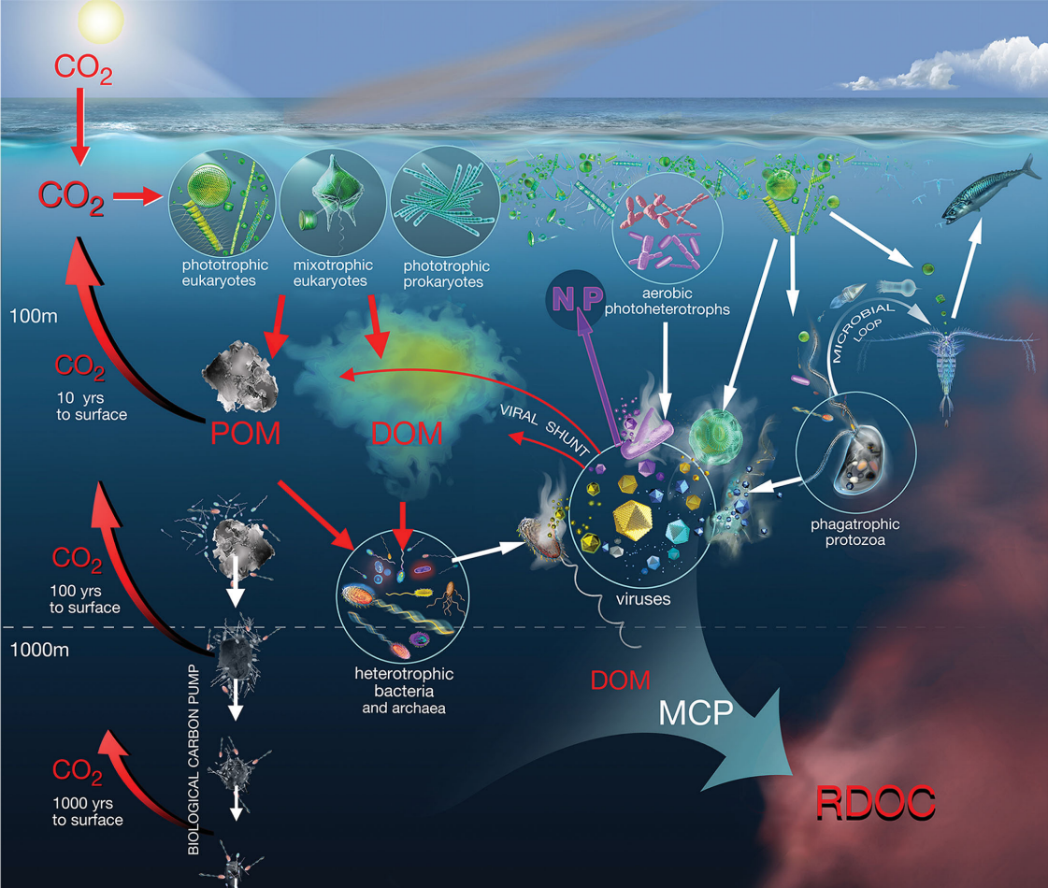
What is dissolved organic matter?
Chemical compounds in filtered sea water
Marine biomass 3 Pg C
Particulate Organic Matter 30 Pg C
Dissolved Organic Matter (DOM) 662 Pg C
Atmospheric CO₂ 897 Pg C
Notes:
1-2 There are a lot of DOM producers and sinks, like fishs and alagae.
DOM +/- 32Pg

Slide 3
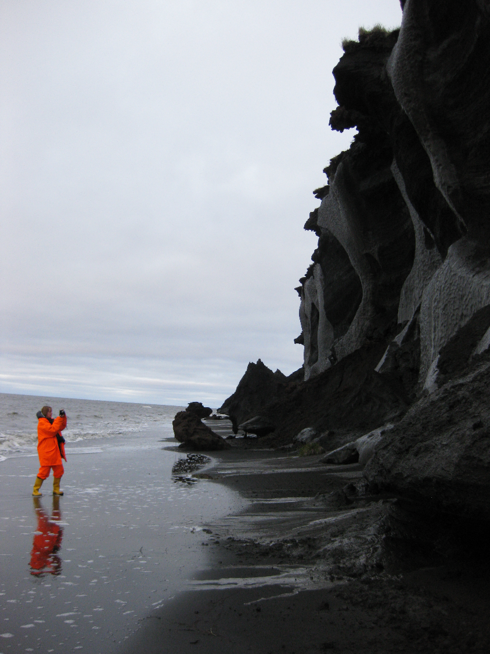
Climate change in the Arctic
Increasing temperatures
Melting permafrost
→ Influences on the carbon cycle
Eroding permafrost coast
Photo: B. Koch
Notes:
And we try to measure its changes on dissolved organic matter

Slide 4
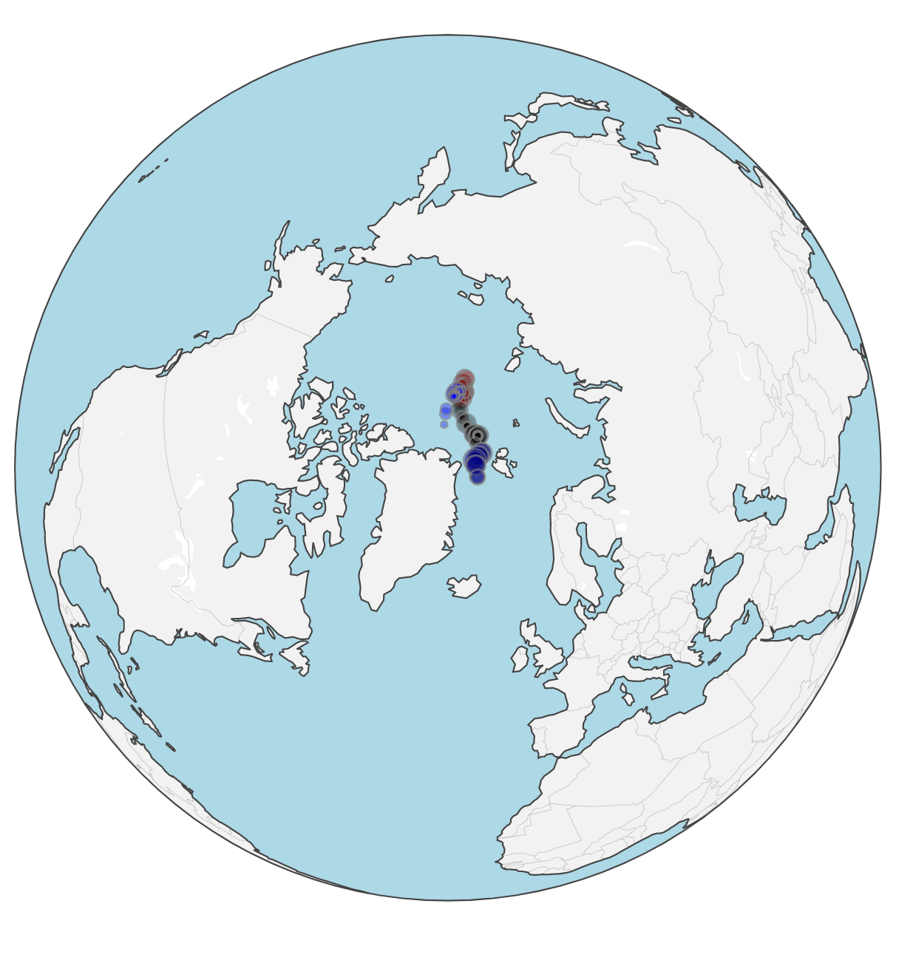
DOM in the Arctic
95 Arctic water samples from the MOSAiC drift study
Terrestrial input from Siberian rivers & permafrost creates a large carbon inventory that will likely increase in the future
Sink in the global carbon cycle
Kong et al.

Slide 5
How do we measure terrestrial carbon?
Fluorescent DOM (FDOM)
Provides info on DOM sources (terrestrial versus marine)
Parallel Factor Analysis gives us a terrestrial component
We want to predict the terrestrial PARAFAC component

Slide 6
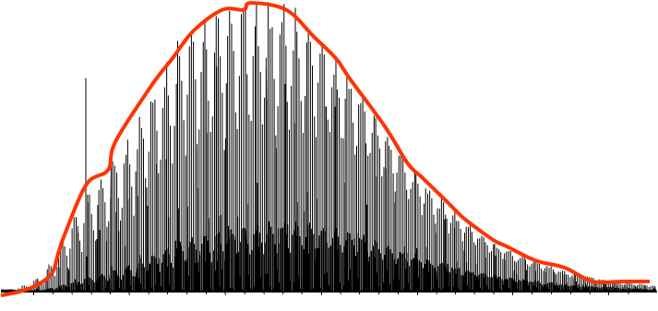
What chemical features do we have?
C₁₀H₂₀O₆
Liquid chromatography coupled to mass spectrometry (LC – MS) measures the exact mass e.g. 236.26… g/mol
From the molecular mass, we can determine the element composition (called molecular formula) e.g. 236.26… → C₁₀H₂₀O₆
LC adds chemical information for each formula C₁₀H₂₀O₆ @ 13 minutes
Feature: Molecular formula timepoint (MFT)
75k unique MFTs
Many MFTs but only few samples
Not all MFTs available for all samples (~80% missing values)
Abundance
C₁₀H₂₀O₆ at 13 minutes
Retention time
Molecular mass
Proxy
-1.2
0.5
1.7

Slide 7
Aims and model selection
Develop a general method to reliably predict sources and processes related to marine DOM using ML
Our use case: Which compounds can predict the amount of terrestrial DOM in the Arctic? What is the chemical composition of terr. DOM?
Which ML method delivers the best prediction?
Do all features provide important information for prediction?
Does the time dimension (chromatography) provide better prediction power?

Slide 8
Which models to use?
Random Forest (RF)
Support Vector Machine (SVM) with different kernels
Linear
Polynomial
Radial basis function
Generalized Linear Models (GLM)

Slide 9
Workflow
Data
Preparation
Experiments
Comparison
GLM
Correlation experiments
SVM
LC-MS data
Normalization
Additive log ratio
In-between models
RF
Scale
Fluorescence data
Standardization
Expected chemical properties
Data reduction
Reliability checks
Notes:
Normalize by the amount of carbon
Additive log ration based on the ubiquitous feature with the least variance
As we can not assume COMPOSITIONAL data

Slide 10
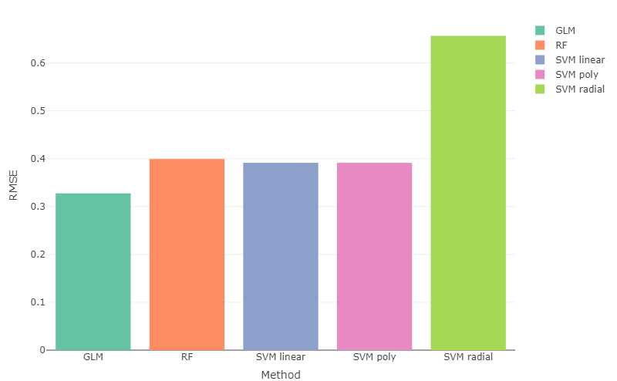
Which model delivers the best predictions?
Hyperparameter tuning
5 fold - 5 repeats cross validation
20% validation set
Standardized by using the z-score (mean is zero and one unit is one standard deviation)
Focus on…
GLM as it performs best
RF as we assumed non linearity
Notes:
Continuing with GLMs for best performance and RF for nonlinearity
RBF SVM had a very small sigma value as the best result on the grid search. This probably resulted in overfitting.
Range of Y: -1.2262 to 1.7245

Slide 11
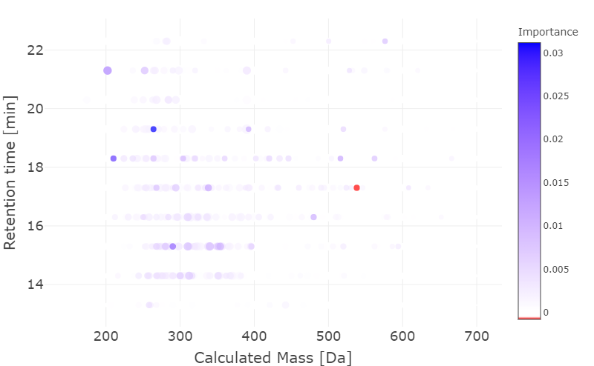
Random Forest importance
Do all features provide important information?
How does the prediction power decrease when we shuffle the values of this MFT/column
Two challenges
Which direction does this feature change the prediction?
Shapley Additive exPlaination values
Are the importance values stable?
Notes:
C₂₄H₃₀N₂O₁₂ at 17.3 minutes has a negative importance of 1.7e-4
SHAP values use a game theoretic approach that measures each player's contribution to the final outcome. Features with positive SHAP values positively impact the prediction, while those with negative values have a negative impact

Slide 12
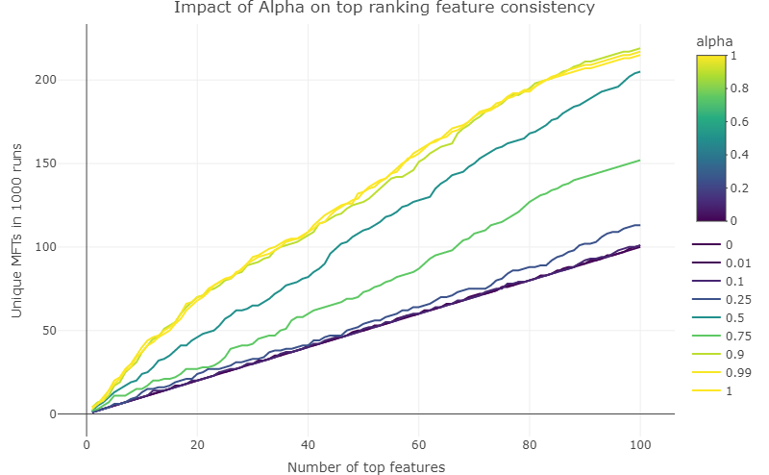
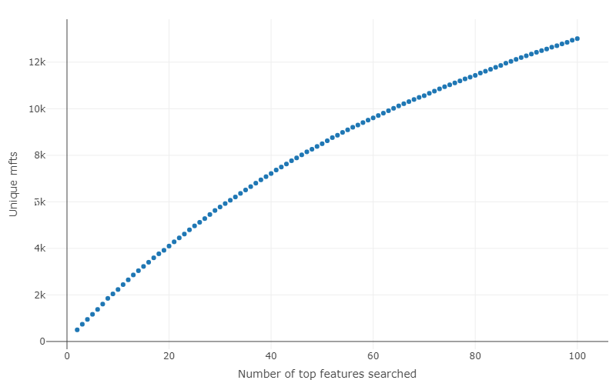
Feature consistency
Highly unstable: Very different results for RF importances reruns
1000 runs and we investigate the top X features
GLMs more stable selection than RFs
Generalized Linear Models
Random Forest

Slide 13
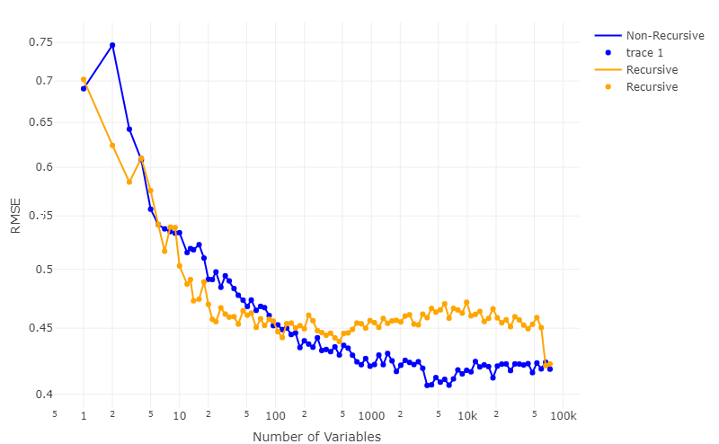
Recursive Feature Elimination (RFE)
Addressing the variance of previous results
Removing unimportant variables and building a new model
10 times repeated 10 fold cross validation
High stability: ~100 variables enough for predictions

Slide 14
Does the time dimension provide better prediction power?
Data reduction: Taking the sum of molecular formulas at different timepoints
We loose the temporal/chemical dimension
Hypothesis rejected
Possible explanation: Combining the timepoints leads to less sparsity, which improves the prediction
Abundance
Retention time
Molecular mass

Slide 15
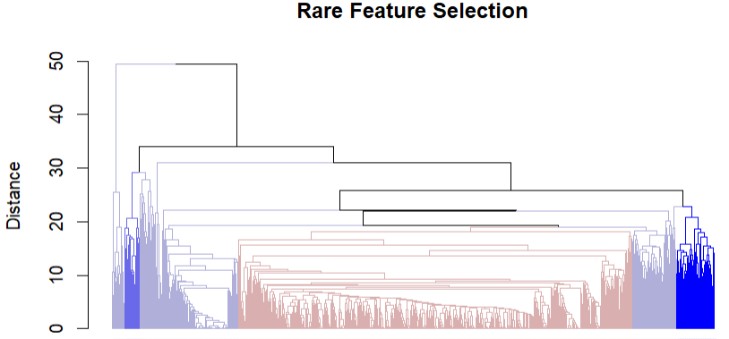
How to retain full feature information?
Aggregate features instead of removing
Rare Feature Selection in High Dimensions
Xiaohan Yan, J. Bien
Requires a hierarchical clustering with a similarity metric
Preliminary results
MFTs
Notes:
RFE/ timeflattening leaves out information
Rare Feature Selection in High Dimensions
Xiaohan Yan
&Jacob Bien

Slide 16
What is still to do?
Finished
To do
GLM
Correlation experiments
SVM (linear)
LC-MS data
In-between models
Normalization
Additive log ratio
RF
Scale
Fluorescence data
Compare chemical properties
Data reduction
Reliability checks
Notes:
The evaluation of the different methods prediction weights
To each other (overlaps, outliers)
To the terrestrial chemicals properties in literature
To the correlation experiments of Xianyu
Compare to removed time features
Use the dilution series to evaluate the performance over different ranges

Slide 17
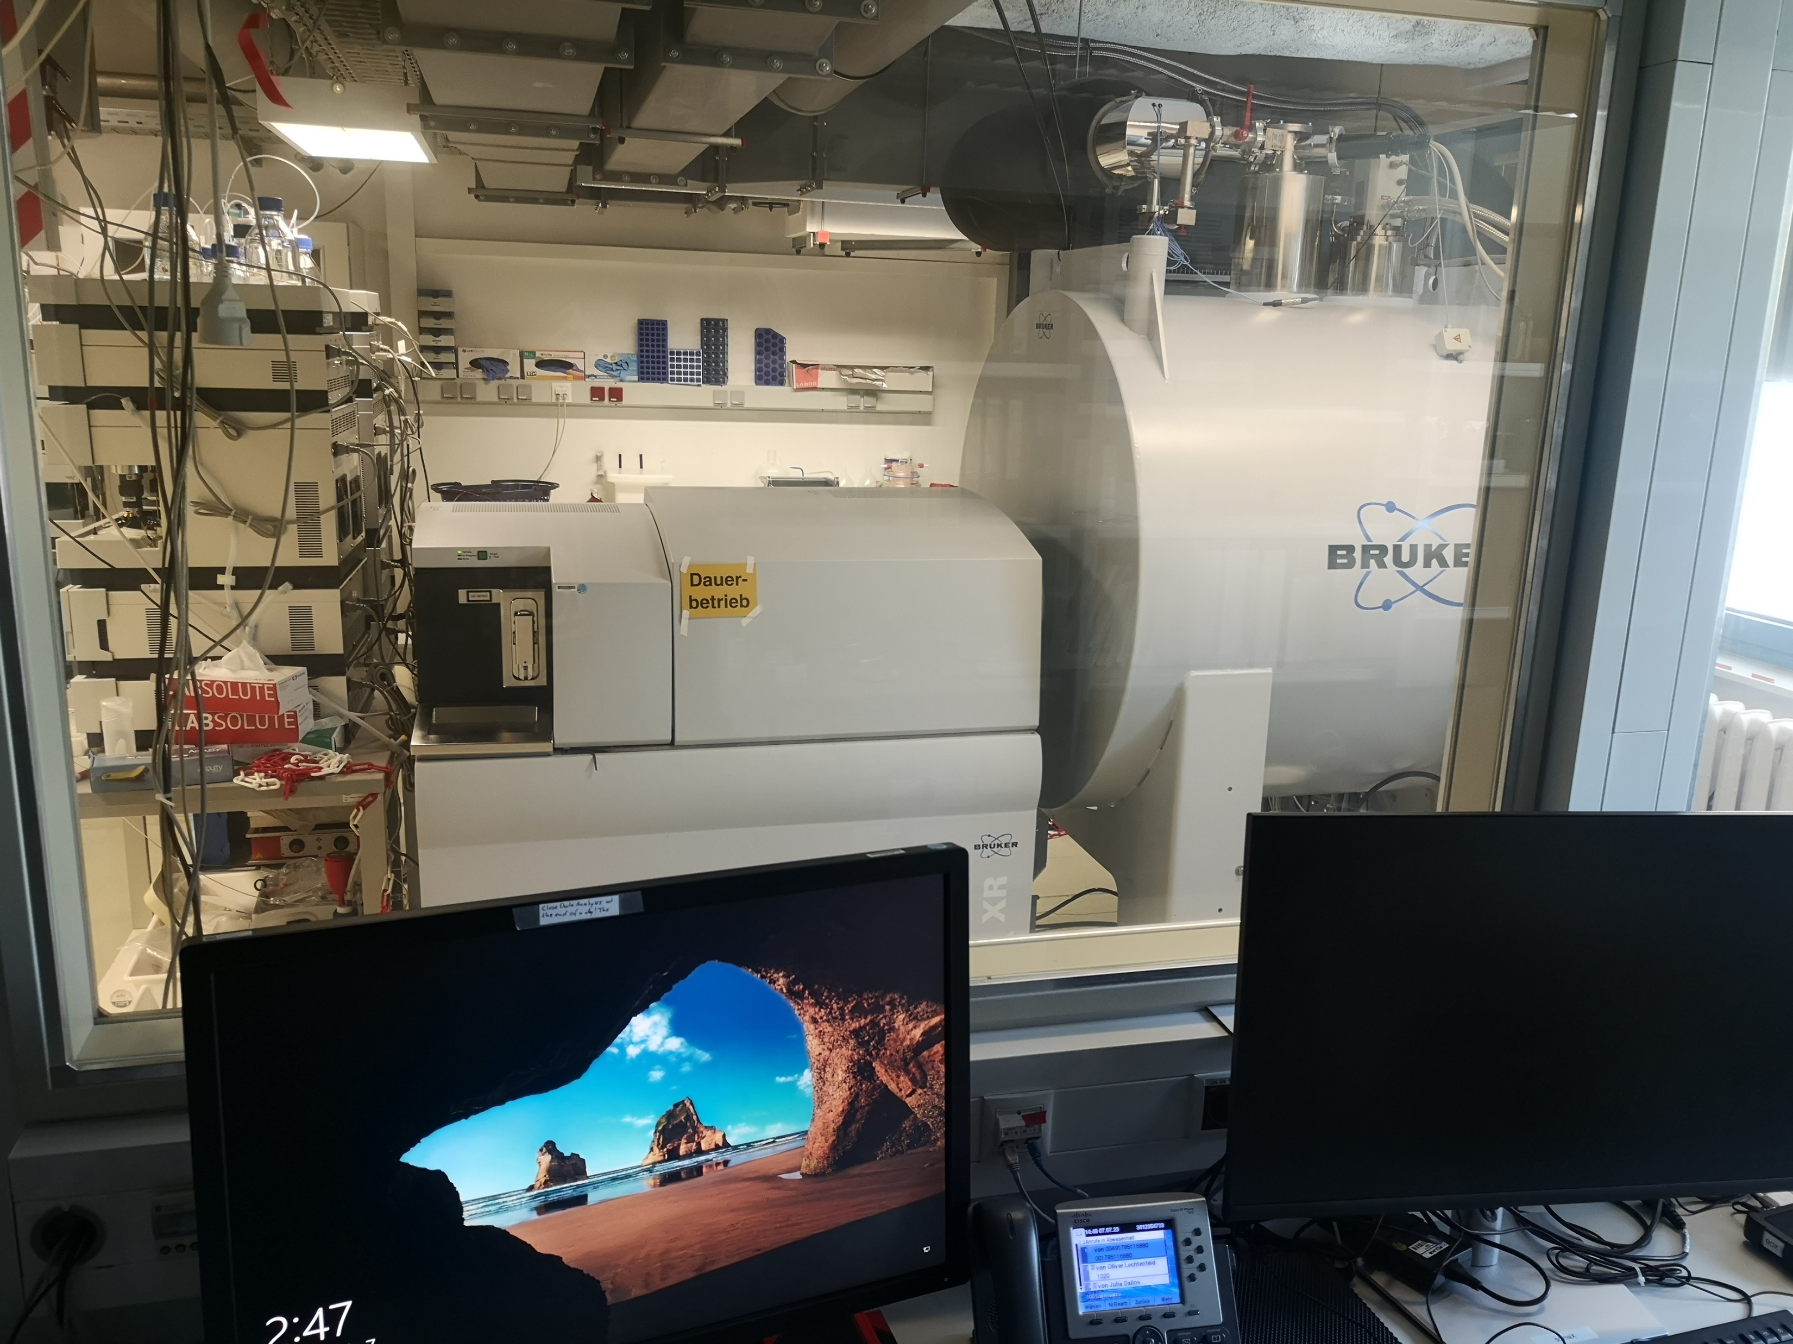
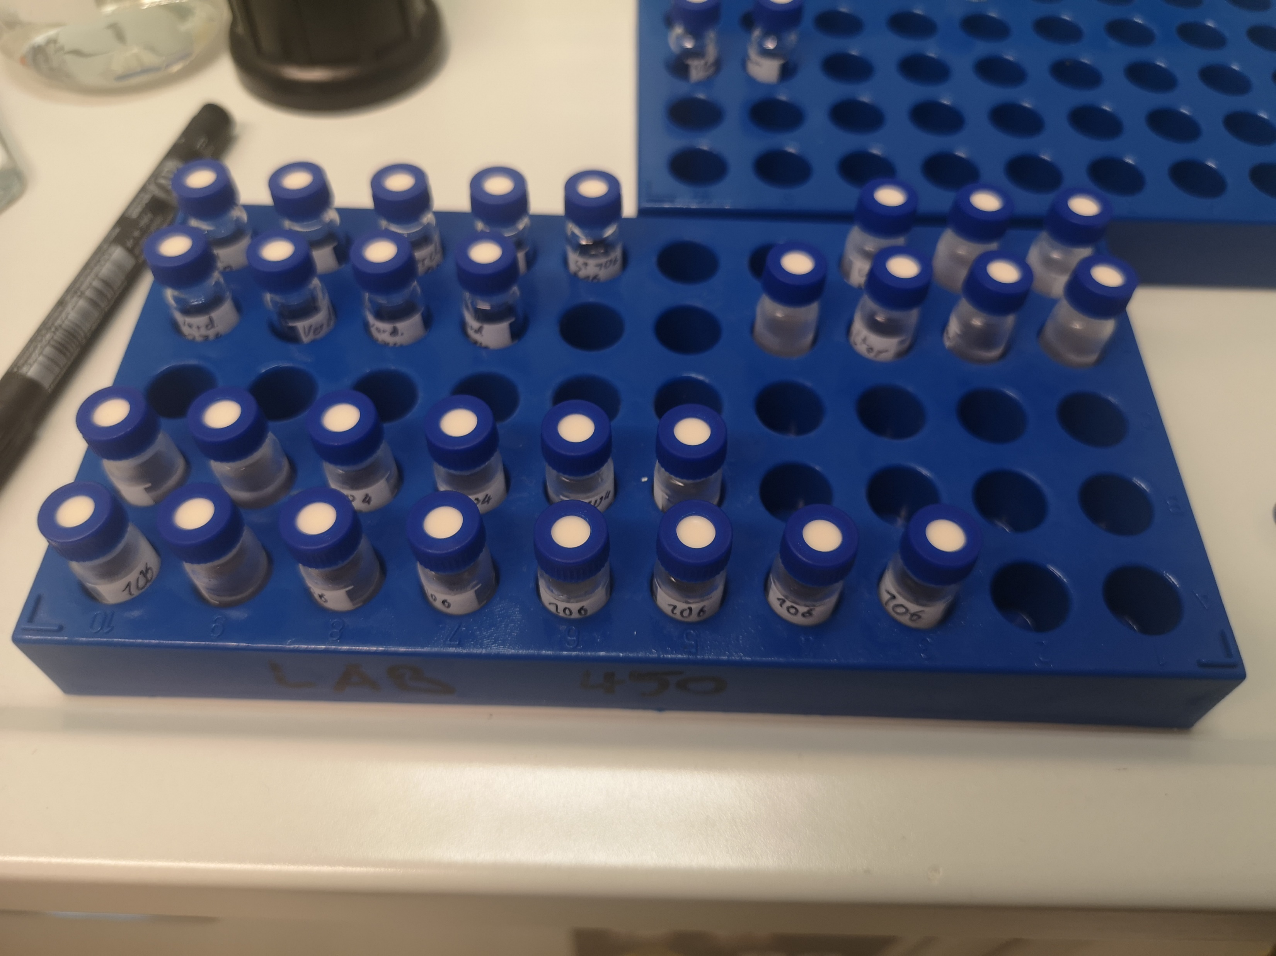
How to improve ground truth?
The terrestrial PARAFAC component is not the best ground truth
Ongoing lab work at the Centre for Environmental Research (UFZ) in Leipzig
Using a known scale (dilution series), we can try to predict the terrestrial content
Mixing Arctic (terrestrial influence) with Antarctic water (purely marine sources)
Apply model for ground truthing
terr. water
marine water
Notes:
Xi

Slide 18
Summary and perspective
Summary:
GLM provided the best prediction and consistent top ranking features
For Random Forests we built good models with only ~100 Features
Trading the time dimension resulted in better predictions
We were able to retain all information by aggregating features, if we have a similarity metric
Future projects:
Building a similarity metric for molecular formulas using chemical structures in databases like PubChem
Build an Immersive Analytics tool and use virtual reality to efficiently visualize the results

Slide 19
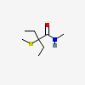
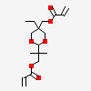
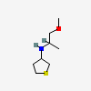
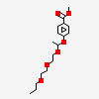
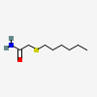
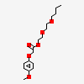
Similarity of chemical compounds
Chemical similarities are not well defined for molecular formulas
For chemical structures, there are fingerprints
They are accessible through data bases like PubChem
Molecular formulas
C₈H₁₇NOS
C₁₇H₂₆O₆
>2000 DB entries
>1000 DB entries
Notes:
Comparing the similarity is tricky when we only have the mol. Formula.

Slide 20
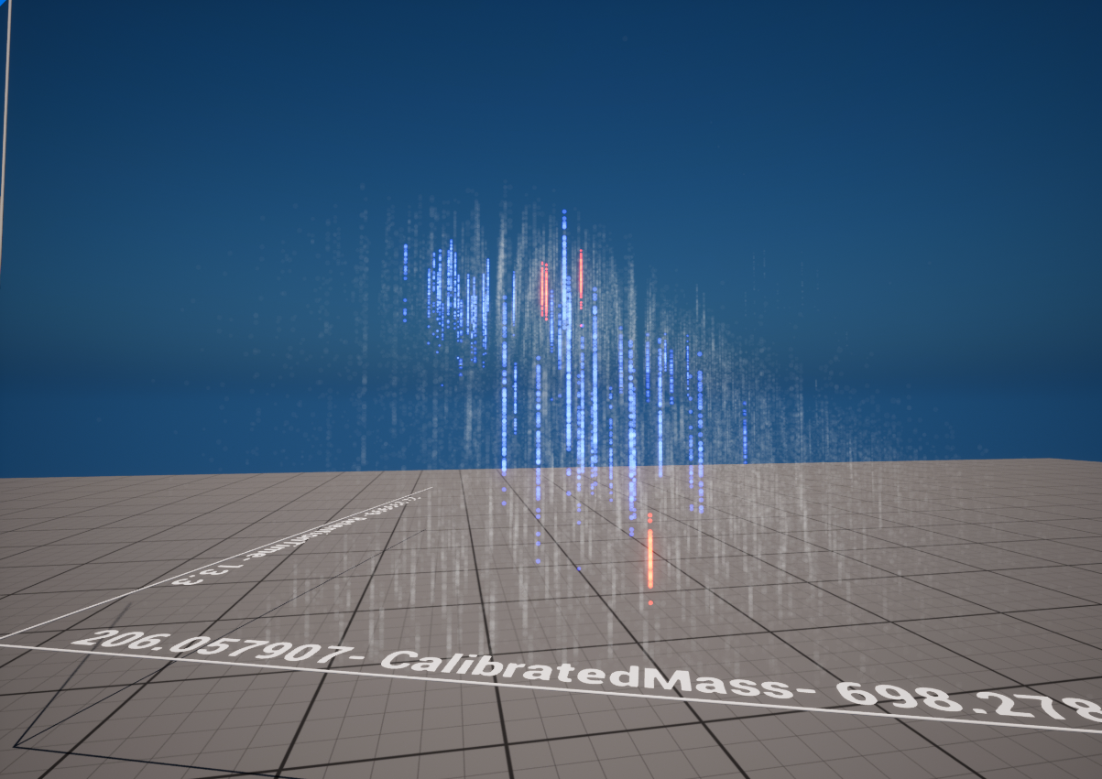
Immersive visualization
How can the formulas, time points and chemical key features be efficiently visualized?
Immersive Analytics and virtual reality can offer possible solutions
First test with simple plots

Slide 21
Thank you for your attention
Question and feedback are welcome!

Slide 22
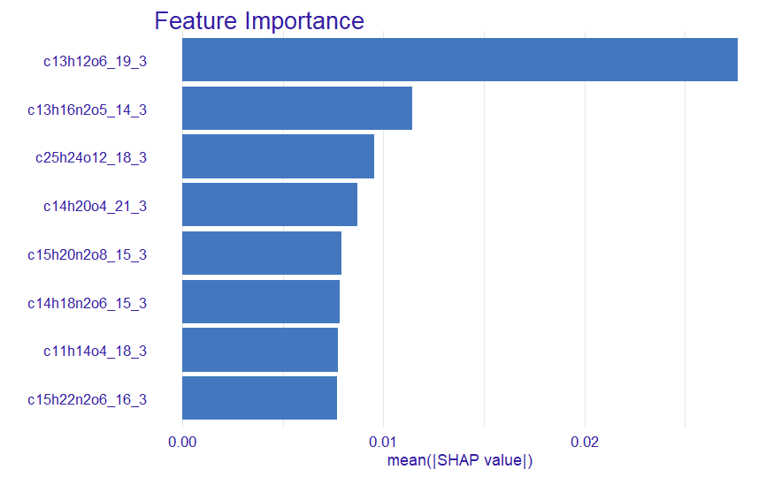
Backup slides
(Preliminary)
SHAP Values for the RF Model
C₁₃H₁₂O₆ @ 19.3 min
C₁₃H₁₆N₂O₅ @ 14.3 min
C₂₅H₂₄O₁₂ @ 18.3 min
C₁₄H₂₀O₄ @ 21.3 min
C₁₅H₂₀N₂O₈ @ 15.3 min
C₁₄H₁₈N₂O₆ @ 15.3 min
C₁₁H₁₄O₄ @ 18.3 min
C₁₅H₂₂N₂O₆ @ 16.3 min

Slide 24
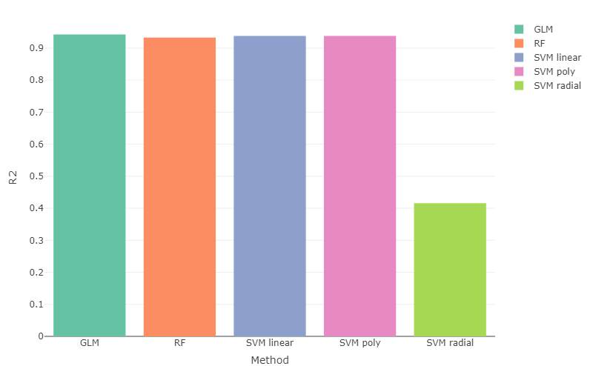

Slide 25
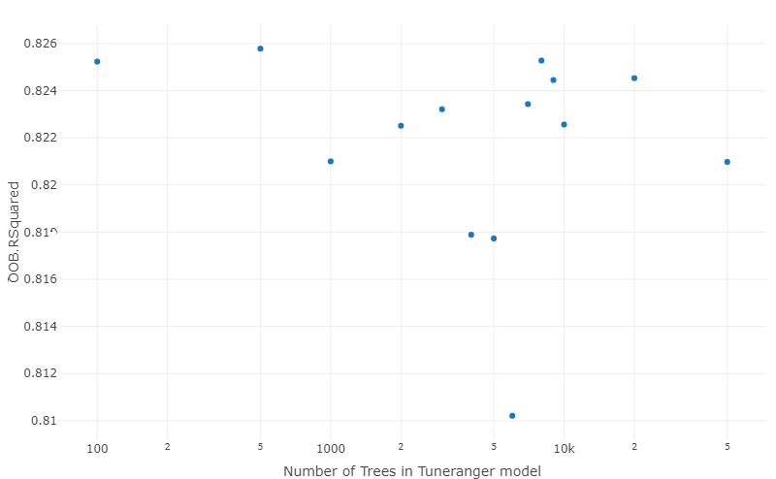

Slide 26
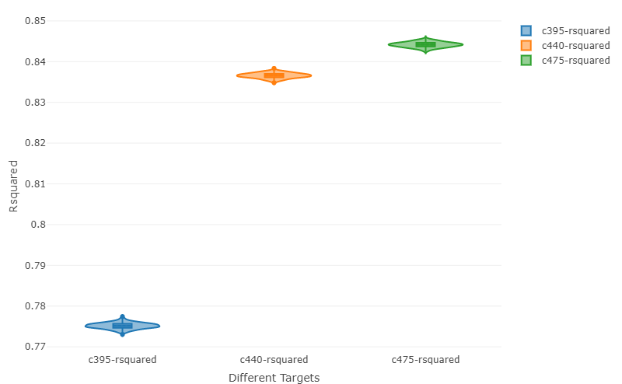

Slide 27
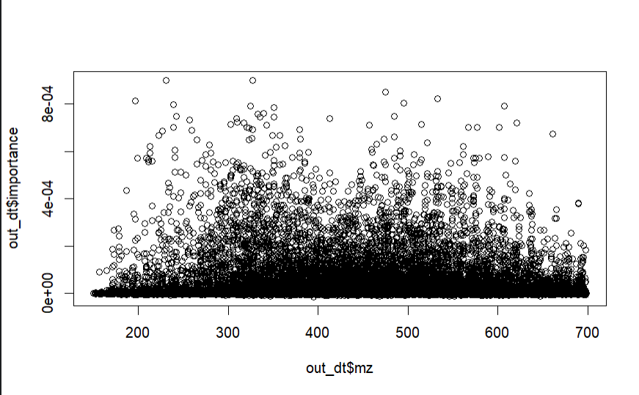

Slide 28
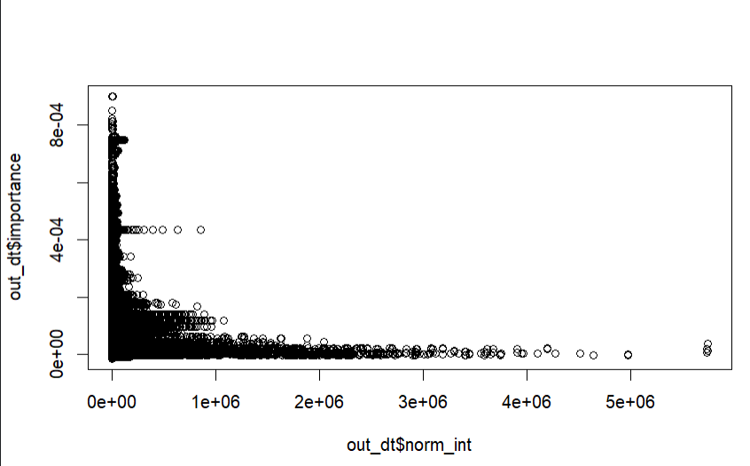

Slide 29
