Slide 1


Combining sea-ice and ocean data assimilation with nudging atmospheric circulation in the AWI Coupled Prediction System
Svetlana N. Losa, Longjiang Mu, Marylou Athanase, Jan Streffing, Miguel Andrés-Martínez, Lars Nerger, Tido Semmler, Dmitry Sidorenko,
A. Sánchez-Benítez, Helge F. Goessling
Svetlana.Losa@awi.de
Acknowledgements:
The AWI-CPS is developed with the help of the ESM-tools and ESM-tools team.
The simulations were performed with resources provided by the North-German Supercomputing Alliance (HLRN) and by the German Climate Computing Centre (DKRZ)
Thanks to the FESOM team and IFS team
EGU General Assembly 2023, Vienna (Austria), 24 – 28 April 2023

Slide 2
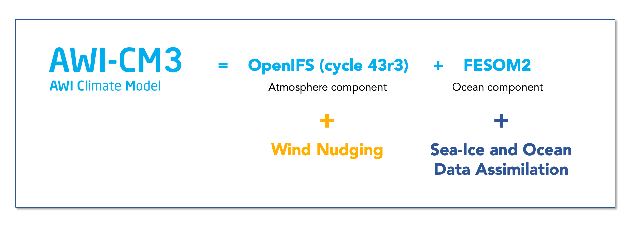
AWI coupled prediction system: AWI-CPS
Streffing et al. (2022, GMD)
Graphics after
M. Athanase
Extending AWI-CM3 by assimilating sea-ice and ocean observational data and nudging atmosphere large scale circulation to improve sea ice and ocean forecast
EGU GA Vienna (Austria) 26.04.2023
2

Slide 3
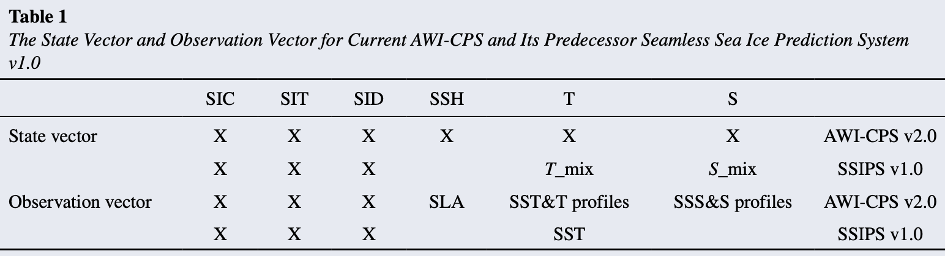

AWI-CPS v.2.0
Streffing et al. (2022, GMD)
Graphics after
M. Athanase
Mu et al. (2021, 2022, JAMES)
Data assimilation (DA) with an Ensemble Kalman Filtering (Nerger, L., Janjić, T., Schröter, J., Hiller, W., 2012) within the Paralell Data Assimilation Framework (PDAF, Nerger, L & W. Hiller, 2013)
$$X^{a}= \overline{X^{f}}+ X^{f}\overline{T}(\overline{W^{ETKF}}+W^{ETKF})$$
$${\overline{w}}^{ETKF}={A\left[\left(HX^{f}\right)\overline{T}\right]}^{T}R^{−1}\left(y^{0}−H\overline{x^{f}}\right)$$
$A^{−1}= γ^{−1}\left(m−1\right)I+{\left[\left(HX^{f}\right)\overline{T}\right]}^{T}R^{−1}$ ${\left[\left(HX^{f}\right)\overline{T}\right]}^{T}$
$$\overline{T}=I_{m ×m}−\frac{1}{m}1_{m×m}$$
EGU GA Vienna (Austria) 26.04.2023
3

Slide 4
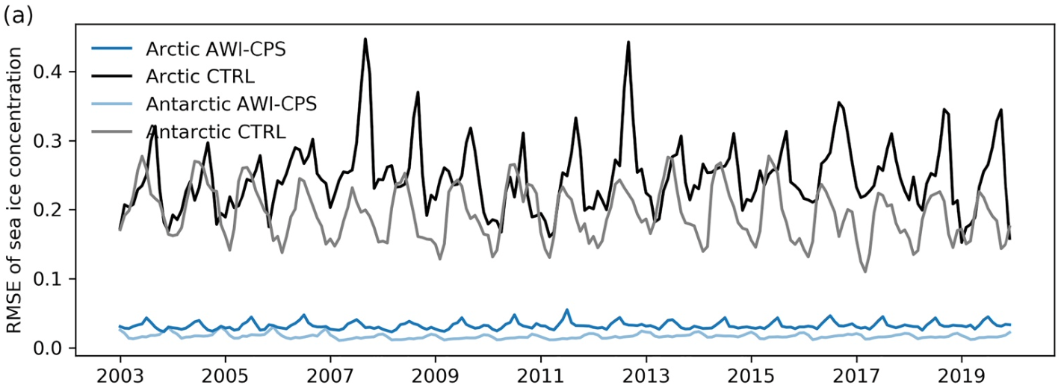
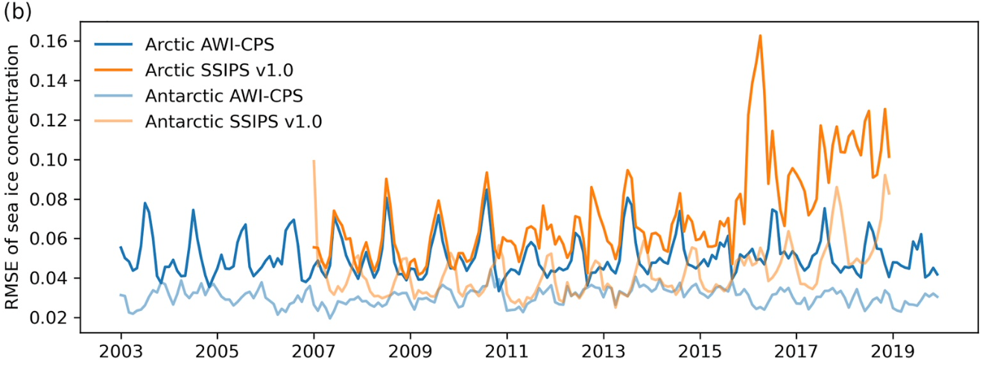
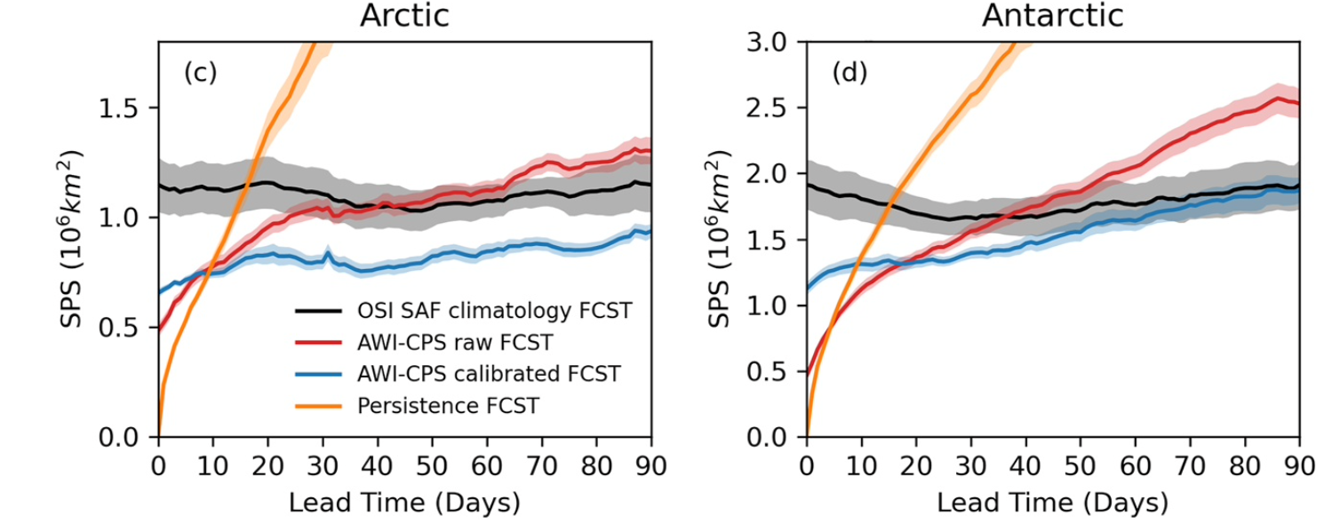
AWI-CPS v.2.0: Validated Mu et al. (2021, 2022, JAMES)
vs. NOAA/NSIDC Climate Data Record observations
AWI-CP system’s forecasting skills are limited by “random weather”
Mu et al. (2021, 2022)
Data assimilation (DA) with an Ensemble Kalman Filtering within the Paralell Data Assimilation Framework (PDAF, Nerger & Hiller, 2013)
AWI-CP system’s forecasting skills are limited by “random weather”
ISDA on-line event 10.02.2023
4
Notes:
Daily Spatial Probability Score of AWI-CPS forecasts as a function of lead time over the area where sea ice concentration (SIC) is non-zero (a, b) and where SIC standard deviation is larger than 0.025 as in Dirkson et al. (2019) (c,
d). The errors of forecasts with the lead time have been averaged over the period 2011–2019 and all initial seasons. The shading area indicates their standard errors (approximate 67% confidence intervals) over that period. The Ocean and Sea Ice Satellite Application Facility (OSI SAF) climatology forecast (OSI SAF CLIM, black) and the persistence forecast, which keeps the observed state on the initial day, serve as benchmarks. AWI-CPS forecasts are evaluated before (AWI-CPS RAW) and after (AWI-CPS CALI) calibration with the Trend-Adjusted Quantile Mapping method.
b) Root Mean Squared Error of monthly mean sea-ice concentration with respect to the independent NOAA/NSIDC Climate Data Record observations

Slide 5
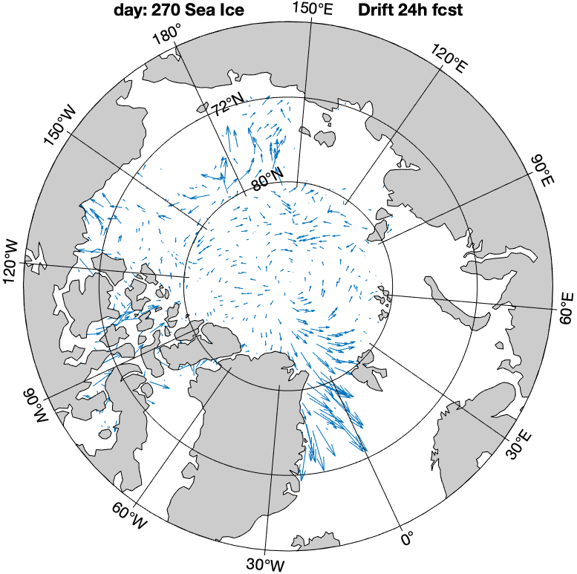
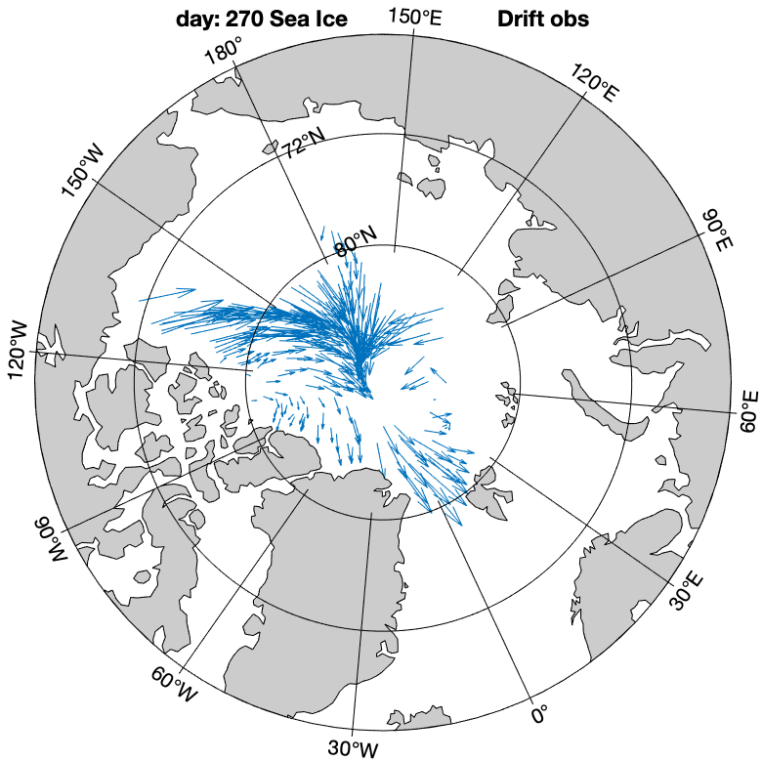
Chaotic atmosphere
T + 3 days
T + 6 days
Graphics after
H. F. Goessling
H
H
H
H
H
L
Initial state
(time T)
L
L
L
L
L
reanalysis
H
Model Sea-Ice Drift 24-h forecast vs.
observation OSI SAF (OSI-405-c)
5
Notes:
Nudged towards ERA5 reanalysis

Slide 6
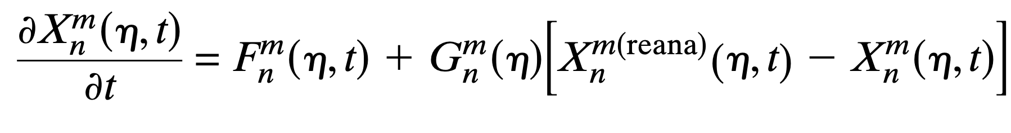
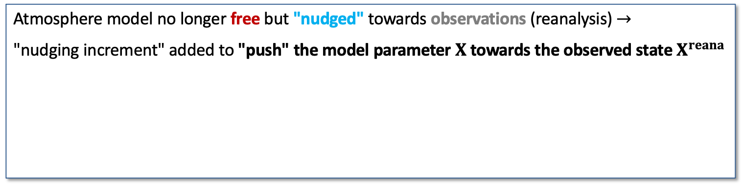
Constrain the atmosphere
T + 3 days
T + 6 days
model w/o nudging
H
H
Graphics from
H. F. Goessling
H
L
H
L
H
L
L
Initial state
(time T)
H
L
L
H
H
reanalysis
model with nudging
L
L
Spectrally nudged model
Atmosphere model no longer free but "nudged" towards observations (reanalysis) $→$
"nudging increment" added to "push" the model parameter $X$ towards the observed state $X^{reana}$
From
Sánchez-Benítez et al. 2022
Model forcing
Nudging increment
6
Notes:
Nudged towards ERA5 reanalysis

Slide 7

AWI-CPS: with atmosphere constrained
Credit to ESM-Tools team
TCO159L91 CORE2
Main AWN (w/o ODA) results:
improved sea ice variability
(vs. CS2-SMOS: 0.4<r< 0.9)
2m temperature cold bias
overestimated SIT & SIE
Credit to Marylou Athanase
$τ =$ 24h, truncation T20
covariance inflation
Augmenting AWI-CPS (including sea-ice and Ocean observational DA) with nudging atmosphere large scale circulation
Expectations from joint AWN and ODA:
accurate representation of large scale atmospheric circulation
  -> improved simulated variability of ocean and sea ice
decreased DA analysis increment
improved prediction skills on a longer time scales
EGU GA Vienna (Austria) 26.04.2023
7

Slide 8
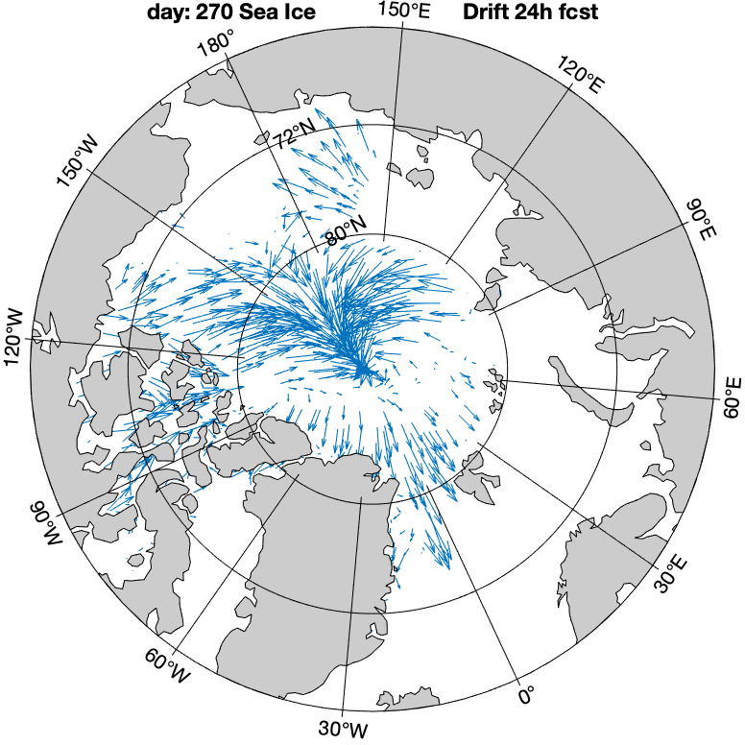
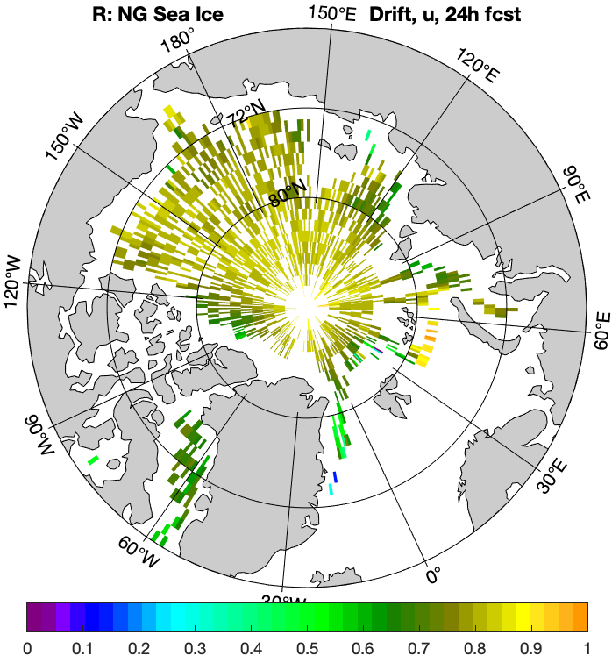
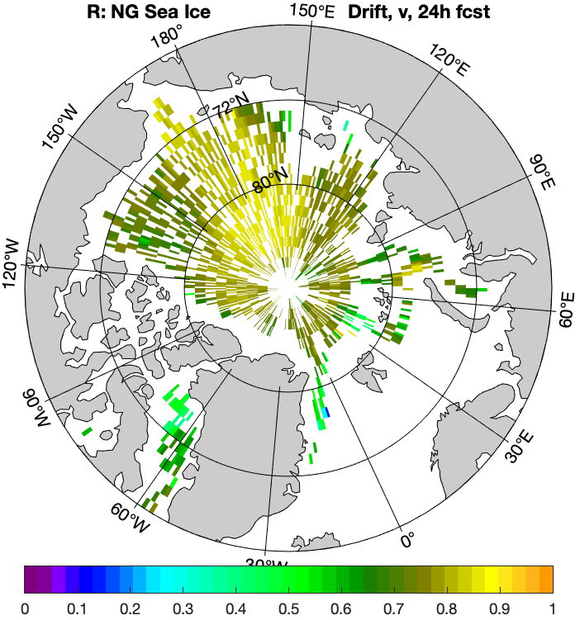
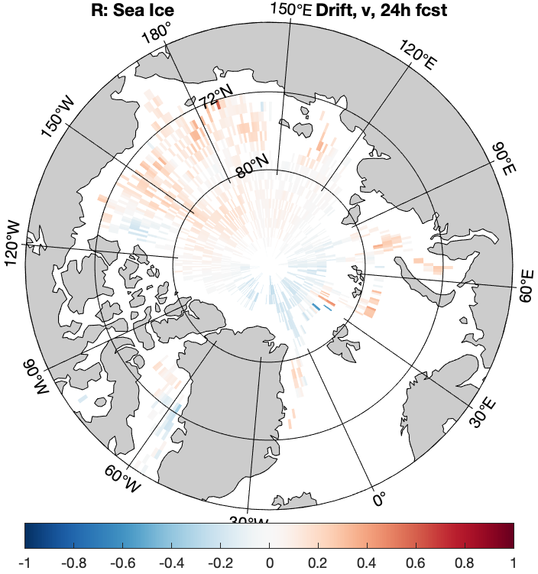
DA: AWI-CPS2.1 2018 test example – SIDrift – 24h frcst
observation OSI SAF (OSI-405-c)
with nudging
without nudging
yearly correlation with observations
with nudging
without nudging
8
Notes:
Slide8: Low panels show correlation between predicted (24-hour forecast) and observed sea ice drift (SIDrift) u and v components (the Pearson’s correlation coefficiets are calculated for the 2018 year time series.
Low left and middle panels depict the results of the experiments with nudging. Low right panel exemplifies just correlations obtained for SIDrift v component in the experiment without nudging (for u component the correlation is also very low).

Slide 9
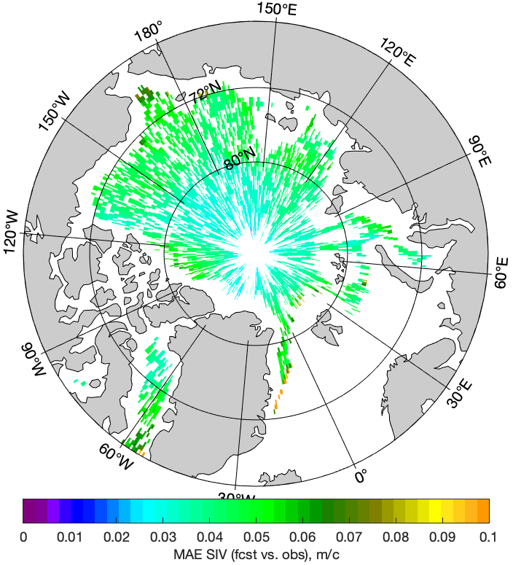
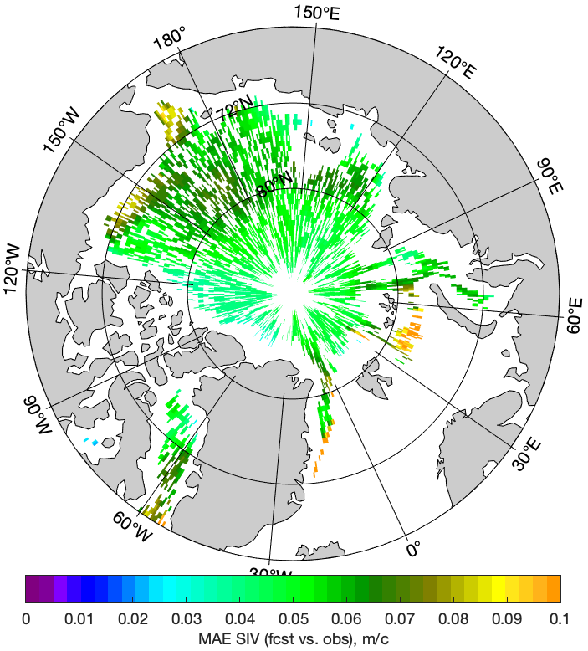
DA: AWI-CPS2.1 2018 test example – SIDrift velocity
Velocity 24h forecast: annual mean absolute deviation from observations (OSI SAF)
MAE SID velocity (fcst vs. obs.), ms⁻¹
ms⁻¹
MAE SID velocity (fcst vs. obs.), ms⁻¹
with nudging
without nudging
The simulations were performed with resources provided by the North-German Supercomputing Alliance (HLRN)
and by the German Climate Computing Centre (DKRZ)
EGU GA Vienna (Austria) 26.04.2023
9
Notes:
Slide 9: The shown are the mean absolute diviation of the 24h forecast of the SI Drift mean velocity itself (not just the components, but as sqrt(u*u+v*v)) from the corresponding observations over the year 2018.
The mean (over the year) absolute errors (MAE) are presented for the case with (left) and without (right) nudging.

Slide 10
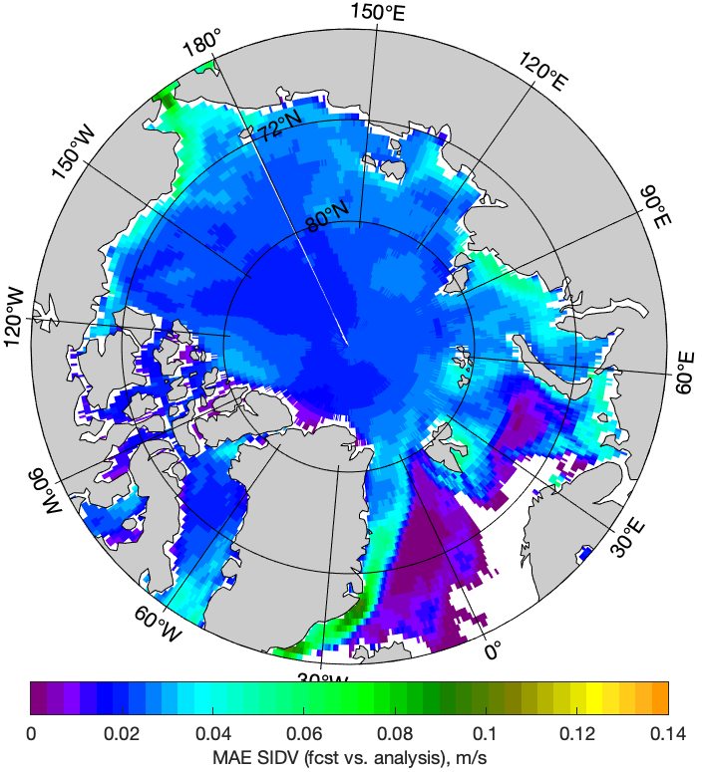
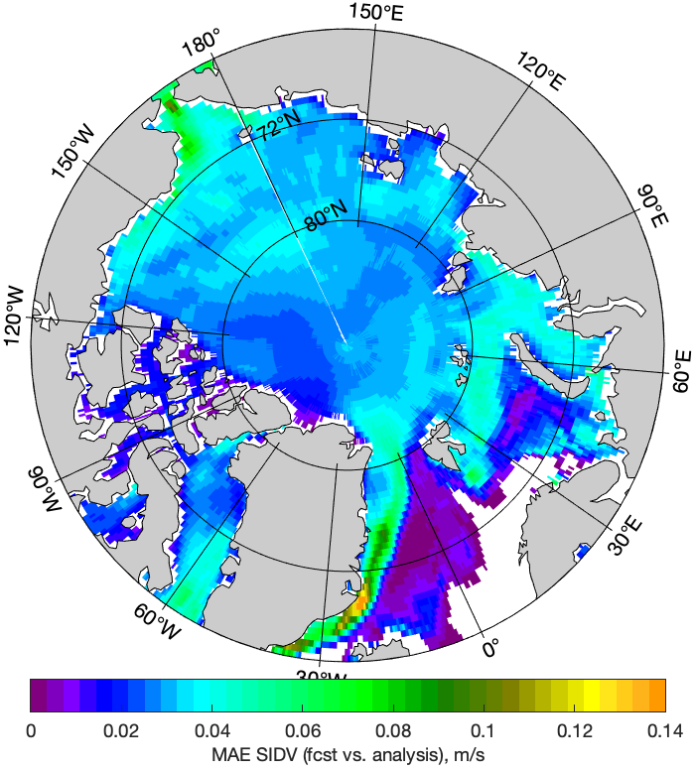
DA: AWI-CPS2.1 2018 test example – SIDrift velocity
Velocity: annual mean absolute estimates of the DA increment
decreased
ms⁻¹
with nudging
without nudging
EGU GA Vienna (Austria) 26.04.2023
10
Notes:
Slide 10: The shown are the mean absolute estimates of the DA increment for the SI Drift mean velocity.
The mean (over the year) absolute estimates (MAE) are presented for the case with (left) and without (right) nudging.

Slide 11
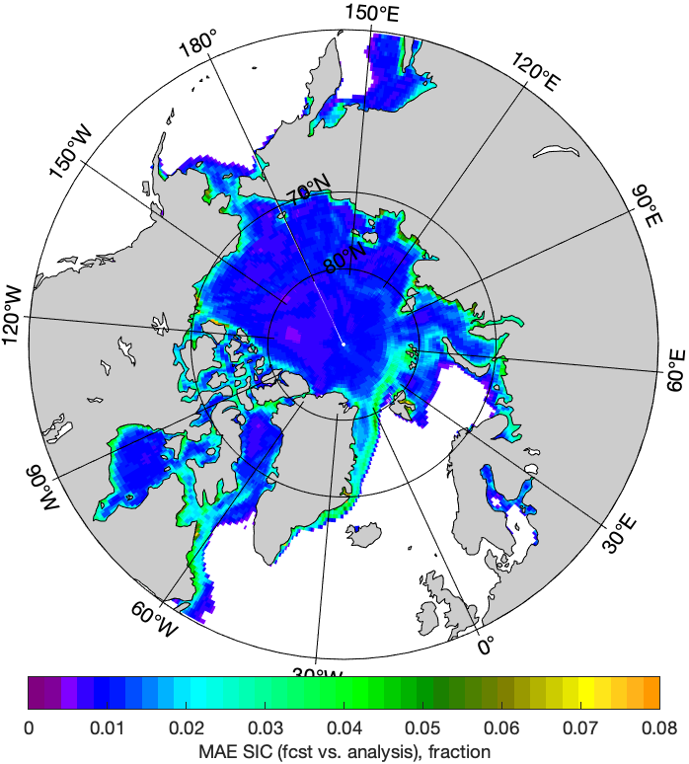
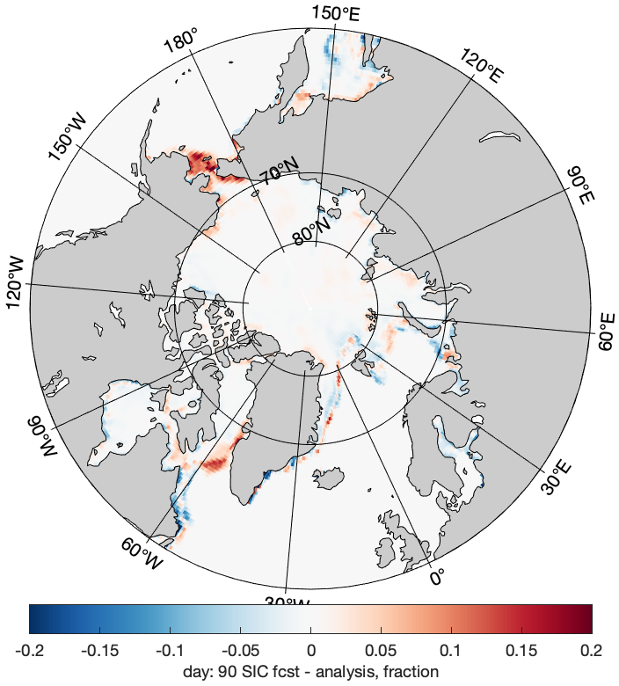
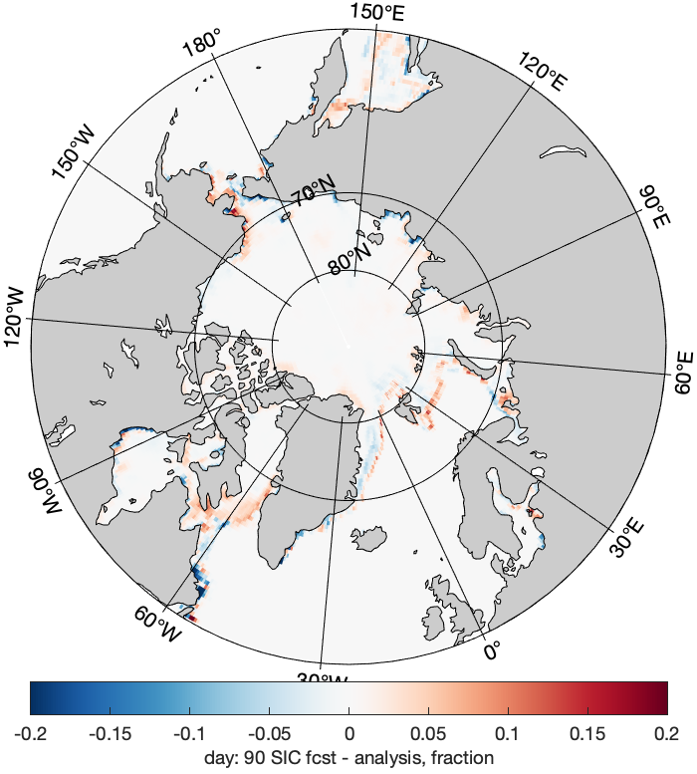
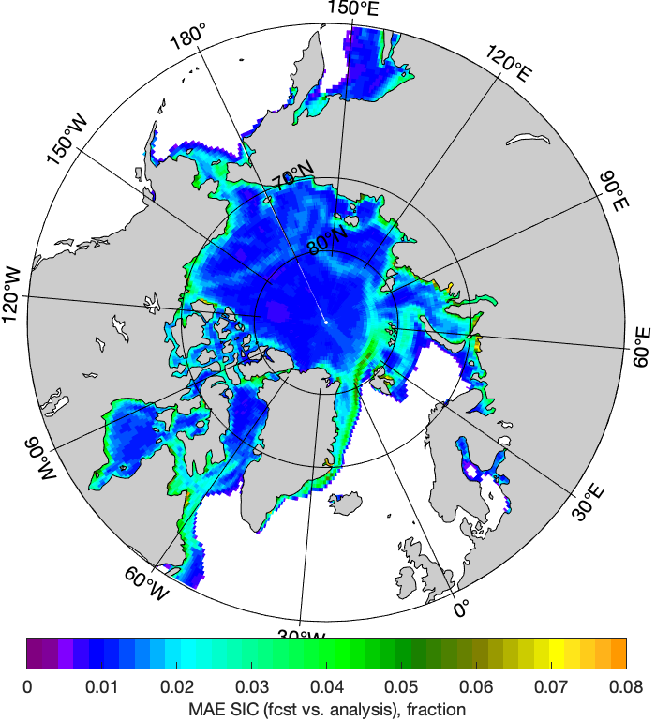
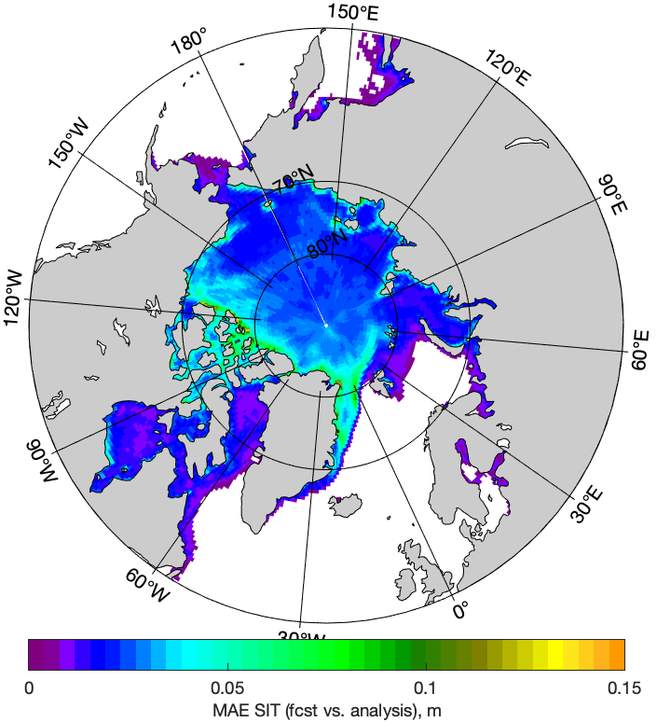
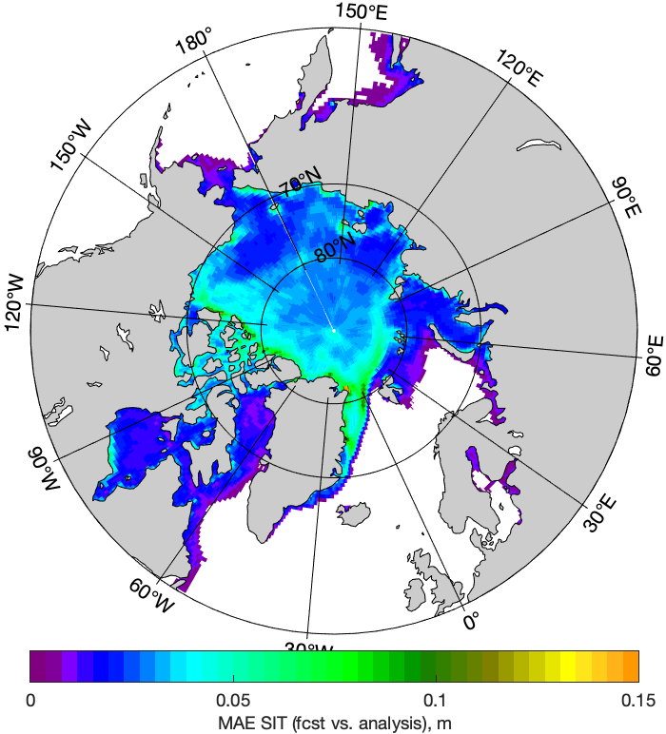
DA: AWI-CPS2.1 2018 test example – SIC and SIT
SIC DA increament
Annual Mean absolute
estimates
31 March
SIT DA increament
decreased in case of nudging the winds
with nudging
without nudging
11
Notes:
Slide 11 exemplifies the data assimilatioon analysis increments with (left) and withoout (right) nudging for the sea ice concentration (SIC, upper panels) and sea ice thickness (SIT, low panels).
The shown are an example of SIC spatial distribution for 31 March 2018 (as a background) and mean (over the year 2018) absolute estimates of the increments for SIC and SIT.

Slide 12
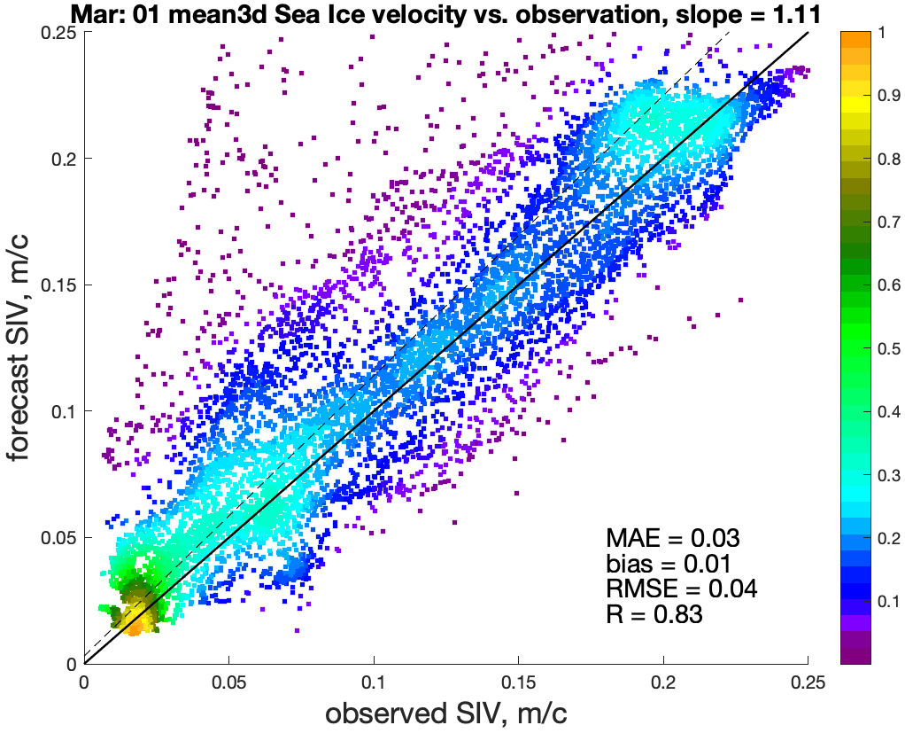
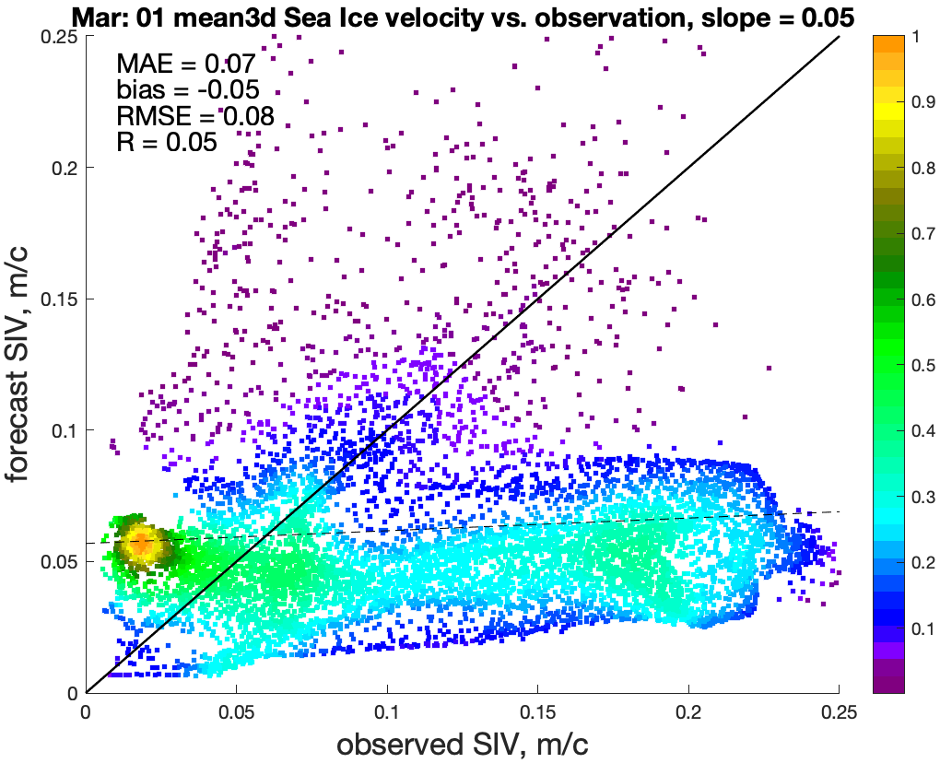
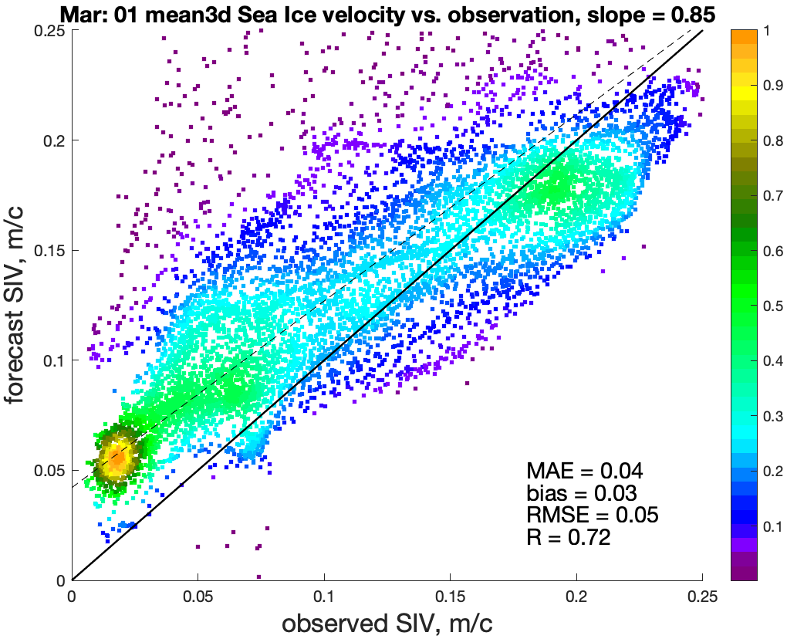
DA: AWI-CPS2.1 2018 test example – SIDrift velocity
3Day mean 24h forecast skills with nudging
3Day mean 24h forecast skills without nudging
ms⁻¹
forecast SID velocity, ms⁻¹
forecast SID velocity, ms⁻¹
ms⁻¹
ms⁻¹
observed SID velocity, ms⁻¹
observed SID velocity, ms⁻¹
3Day mean prediction skills (1-2-3 days) after DA&nudging
In perspective for several day forecast
ms⁻¹
forecast SID velocity, ms⁻¹
12
ms⁻¹
observed SID velocity, ms⁻¹
Notes:
Slide 12: scatter plots of the predicted SIDrift mean velocity (m/s) against observations presented for three-day-mean (3Day meen) for the data assimilation (DA) experimets with (upper left) and without (upper right) nudging atmosphere. Low panel also show a 3Day mean forecast for the case when after re-initialisation given DA with nudging, the system is further integrated without any DA and nudging.

Slide 13
AWI-CPS: Summary and Outlook
Svetlana.Losa@awi.de
Augmenting AWI-CPS (including sea-ice and ocean observational DA) with nudging atmosphere large scale circulation
Expectations met:
accurate representation of large scale atmospheric circulation
-> improved simulated variability of ocean and sea ice
decreased DA analysis increment
improved prediction skills
  more obviously for sea ice drift on synoptic time scales
  on longer time scales:
  evaluate over the time period 2002 – present
TODO:
AWN: address the atmospheric “cold bias”
ODA: multivariate covariances under non-linearity and non-Gaussianity of sea ice properties/error statistics
More on spectral nudging: Posters on site Thu, 27 Apr, 10:45–12:30 | Hall X5
X5.234 | EGU23-5164 | “Projected amplification of summer marine heatwave intensity in the Northeast Pacific Ocean in a warming world” by Marylou Athanase et al.
X5.238 | EGU23-9368 | “Storyline simulations suggest dampening of 2020 Siberian heatwave analogues in warmer climates” by Antonio Sánchez Benítez et al.
X5.240 | EGU23-15532 | “Weather-dependent climate change“ by Helge Goessling
Thank you!
EGU GA Vienna (Austria) 26.04.2023
13

Slide 14
Optional slides

Slide 15
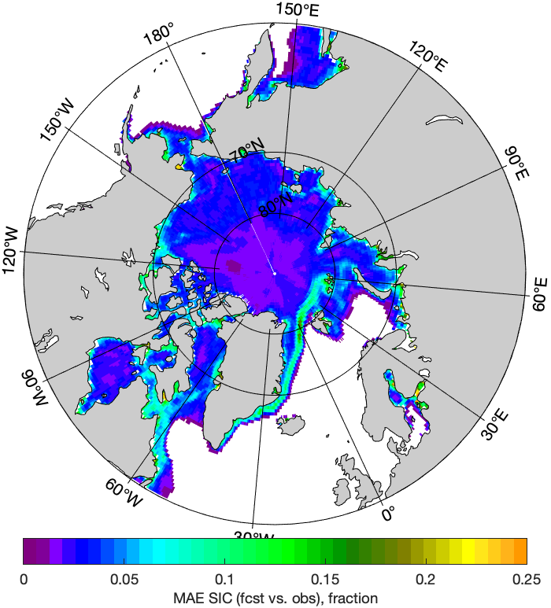

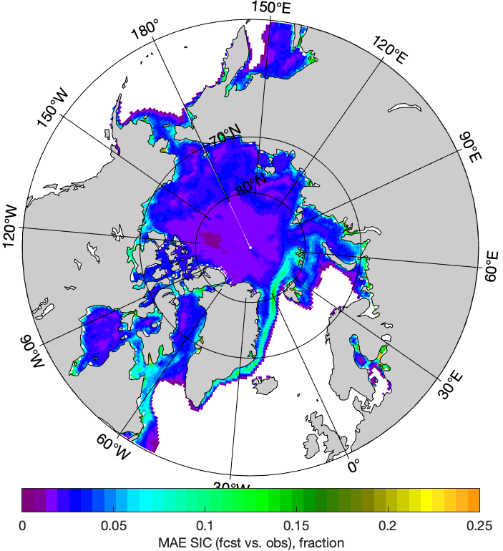
DA: AWI-CPS2.1 2018 test example – SIC
SIC 24h forecast: annual mean absolute deviation from observations (OSI SAF)
with nudging
without nudging
EGU GA Vienna (Austria) 26.04.2023
15

Slide 16
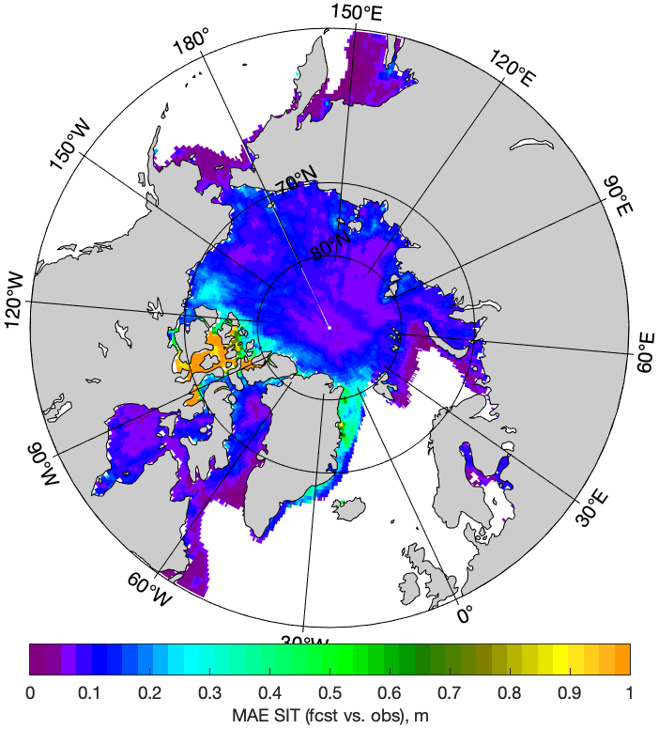

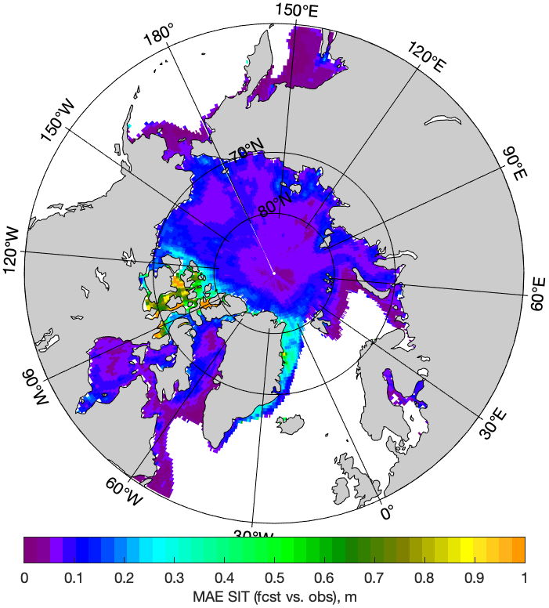
DA: AWI-CPS2.1 2018 test example – SIT
SIT 24h forecast: annual mean absolute deviation from observations (CS2SMOS)
relates to atmosphere “cold bias”
with nudging
without nudging
EGU GA Vienna (Austria) 26.04.2023
16

Slide 17
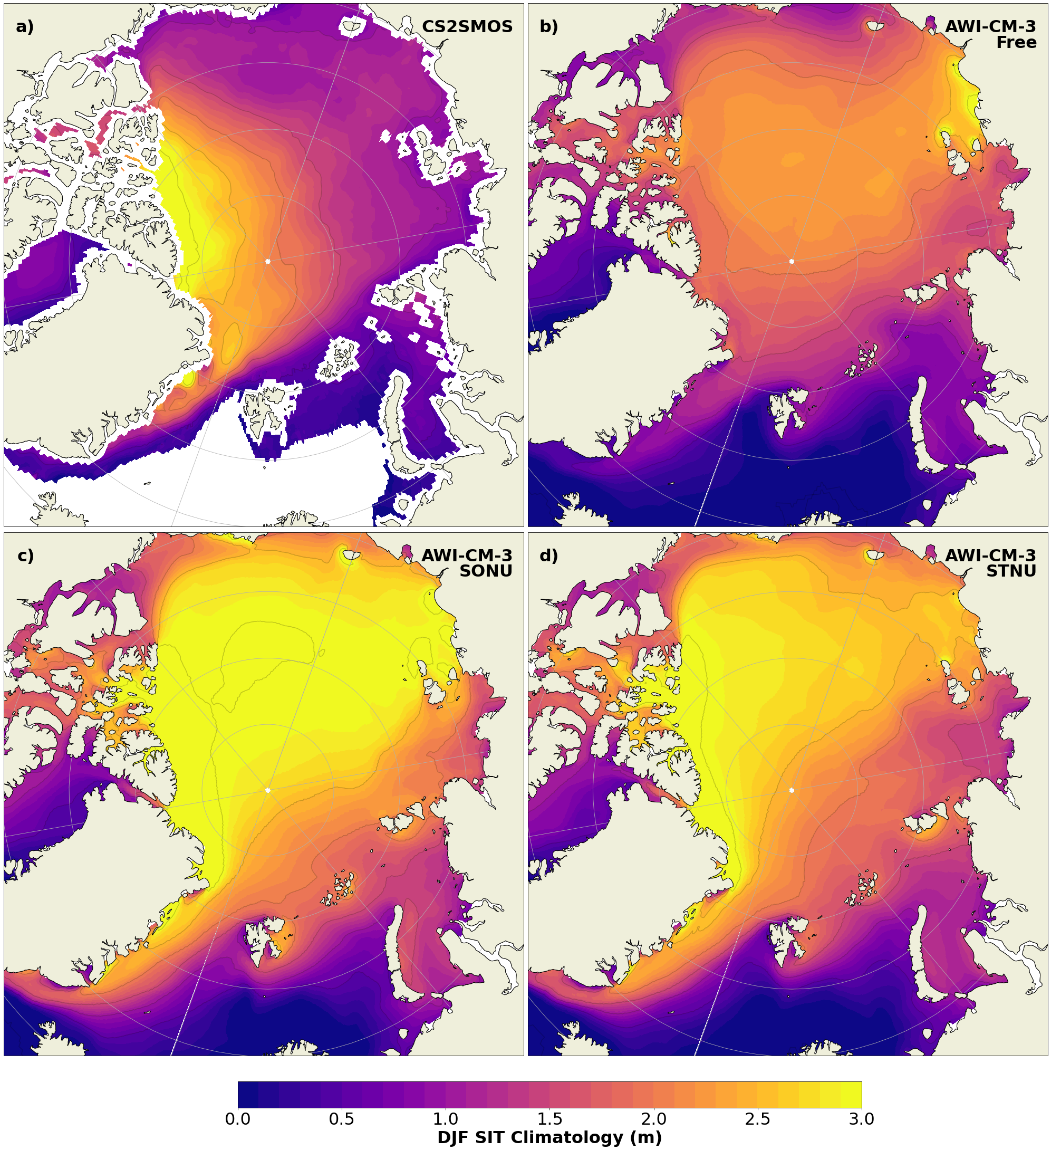

AWI-CPS: with atmosphere constrained
Credit to ESM-Tools team
Main AWN (w/o ODA) results:
improved sea ice variability
(vs. CS2-SMOS: 0.4<r< 0.9)
2m temperature cold bias
overestimated SIT & SIE
Credit to Marylou Athanase
$τ =$ 24h, trunc. T20
covariance inflation
Sea-ice Thickness (SIT)
2010-2016
a)
NO NUDGING
b)
OBS
c)
NUDGED
Canada
Basin
Eurasian
Basin
EGU GA Vienna (Austria) 26.04.2023
17
Notes:
Marylou: Despite this cold bias, we see some clear improvements in the sea-ice thickness and drift.
Originally, our free runs had too thick ice in Canadian Arctic and too think close to Greenland, possibly related to the inaccurate Transpolar Drift and Beaufort Gyre.
With the nudging, the drift patterns are much more realistic, and
the ice thickness distribution displays accurate Greenland-to-Siberia gradients despite a tendency to overestimate the mean thickness

Slide 18
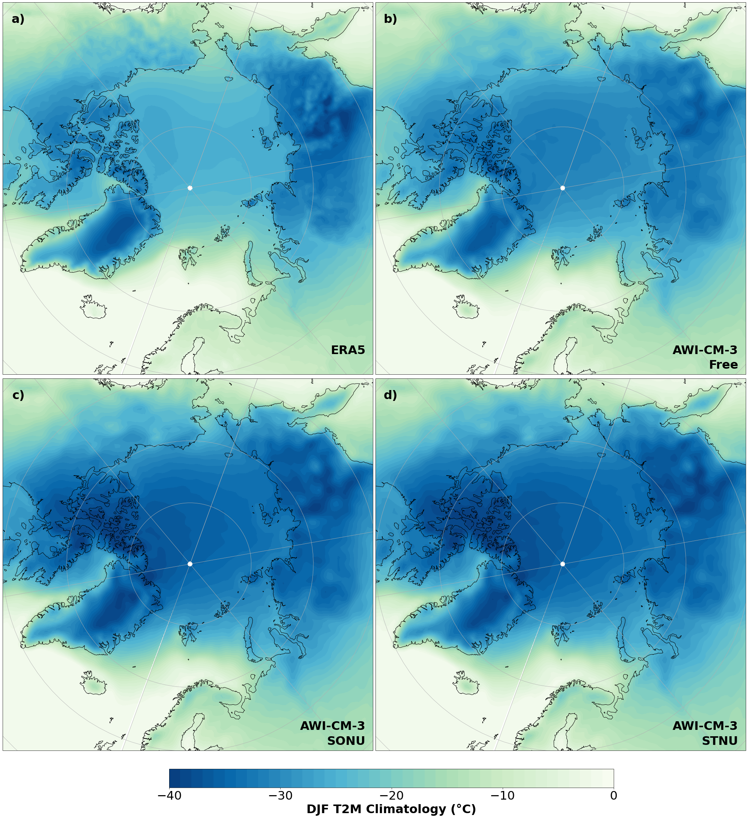
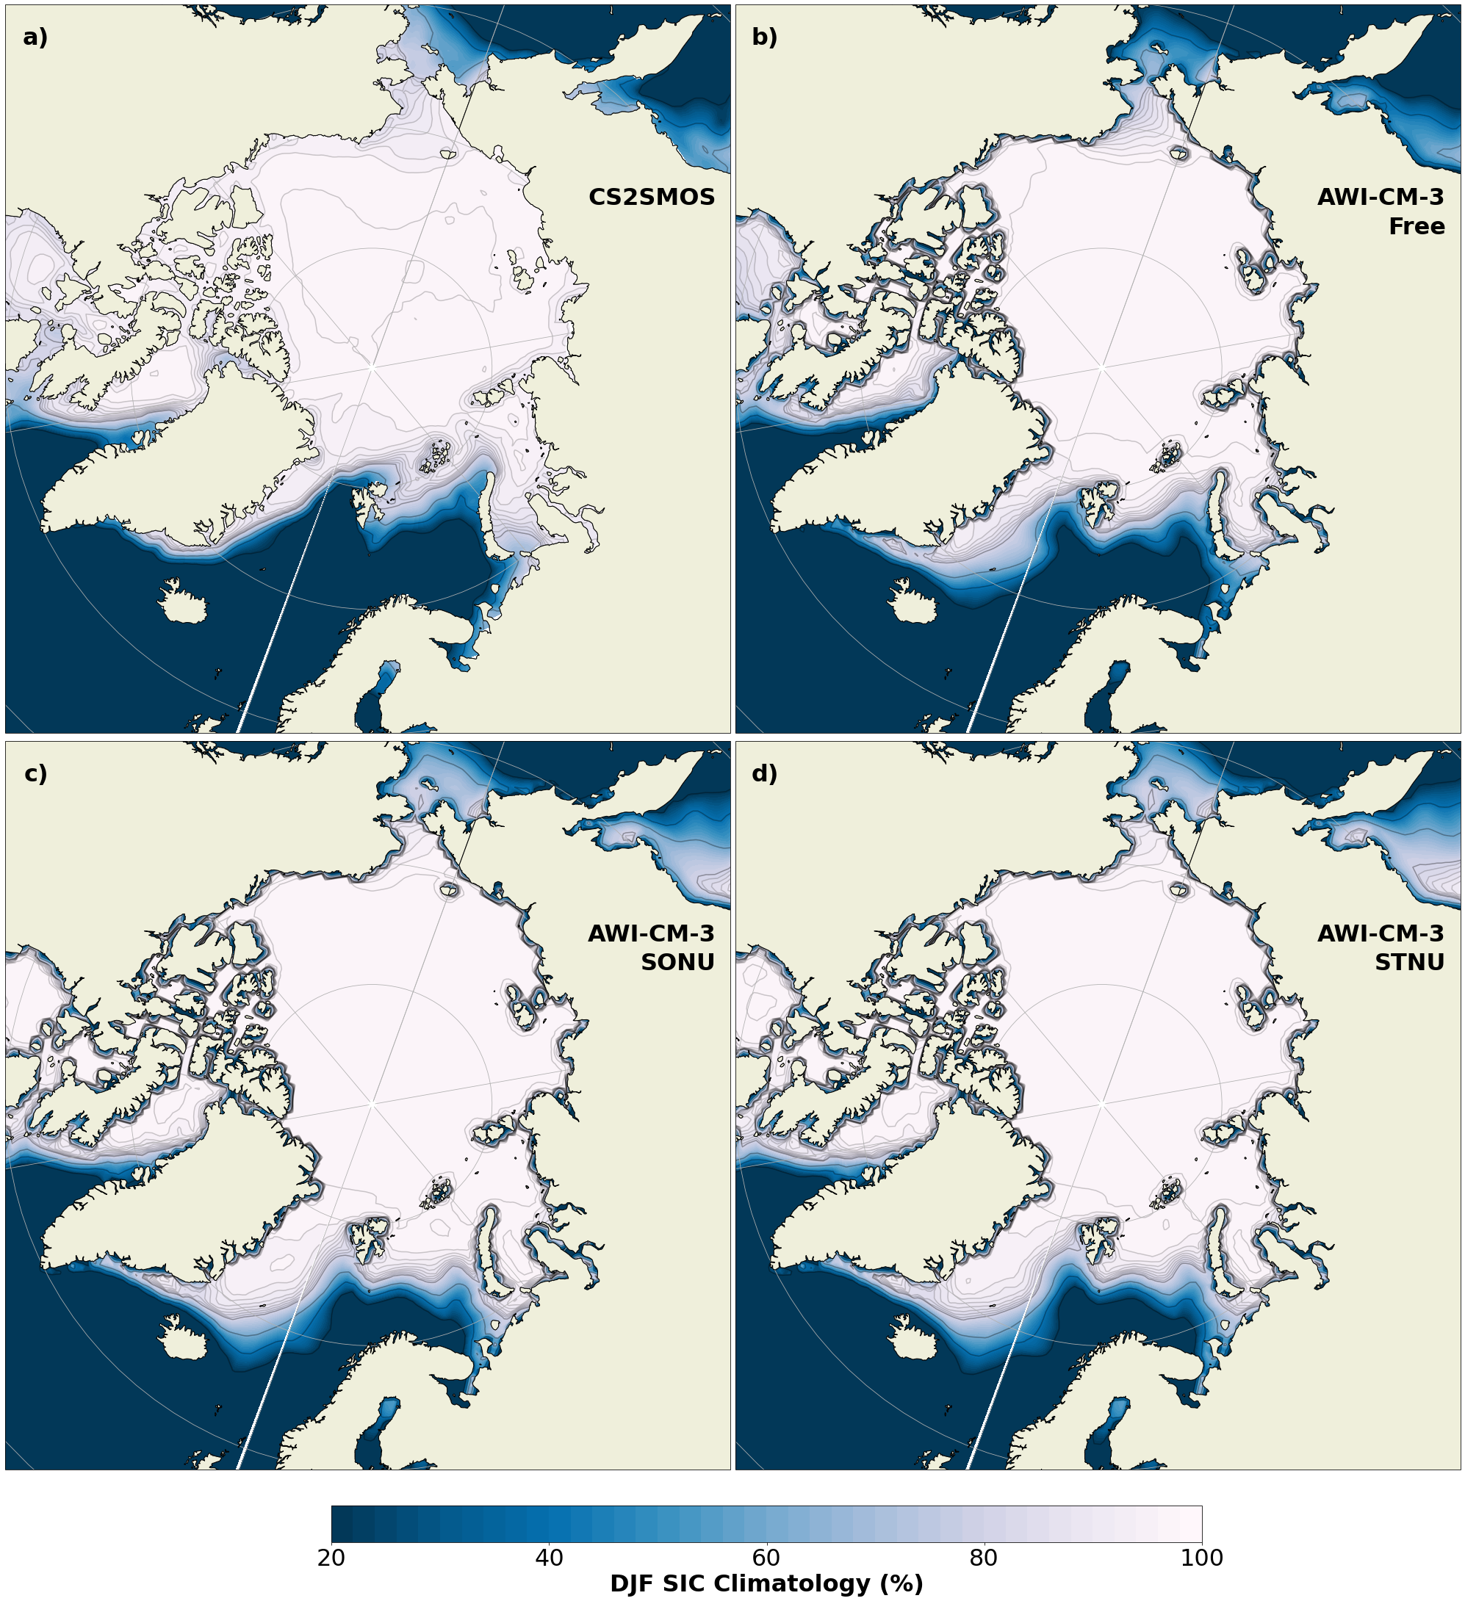
2M Air Temperature (T2M)
NO NUDGING
OBS
NUDGED
Canada
Basin
Eurasian
Basin
Sea-ice Concentration (SIC)
NO NUDGING
OBS
NUDGED
Canada
Basin
Eurasian
Basin

Slide 19
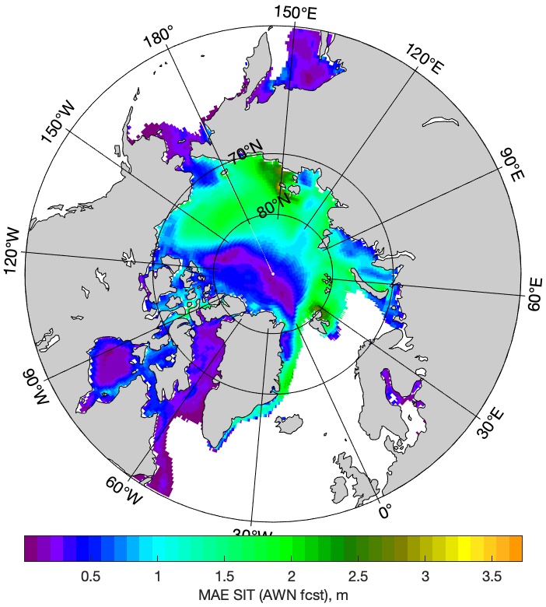
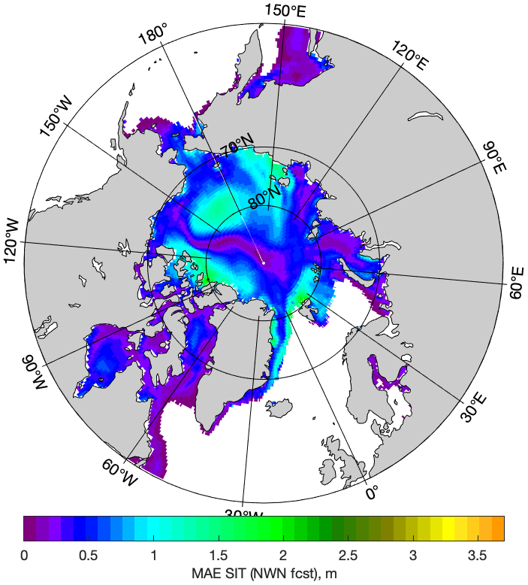

Slide 20
