Slide 1
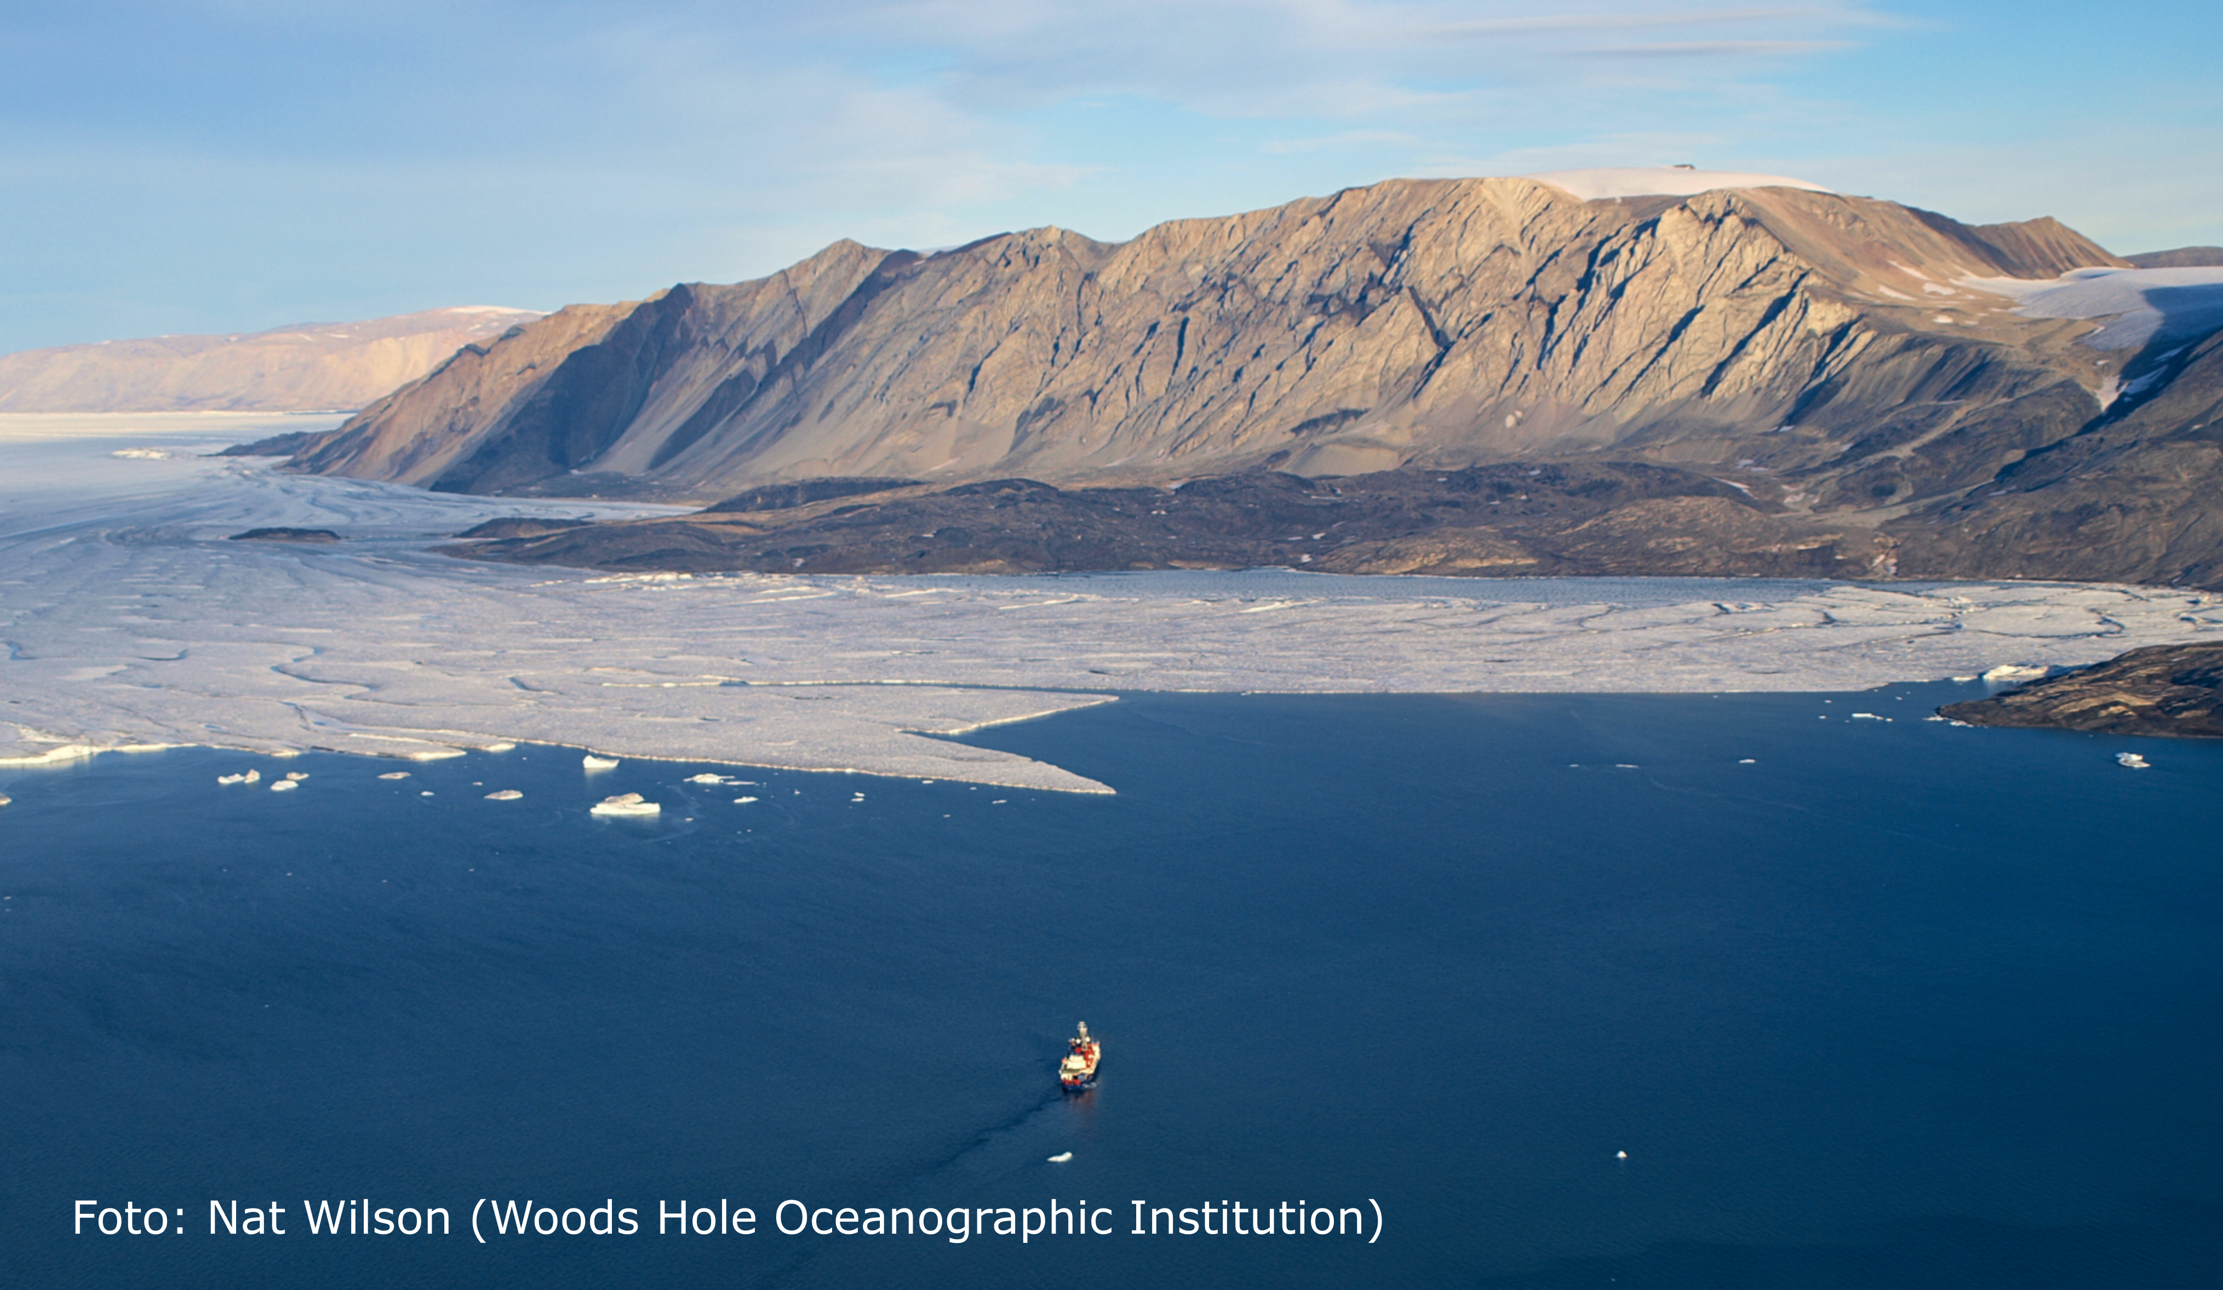

Photo: Nat Wilson
EGU 2024
April 19, 2024
Atlantic Water warming increases melt below Northeast Greenland's last floating ice tongue
Claudia Wekerle¹, Rebecca McPherson¹, Wilken-Jon von Appen¹, Qiang Wang¹,
Ralph Timmermann¹, Patrick Scholz¹, Sergey Danilov^{1,2}, Qi Shu³, and Torsten Kanzow^{1,4}
¹Alfred Wegener Institute, ²Constructor University, ³First Institute of Oceanography, Qingdao, ⁴University Bremen

