Slide 1
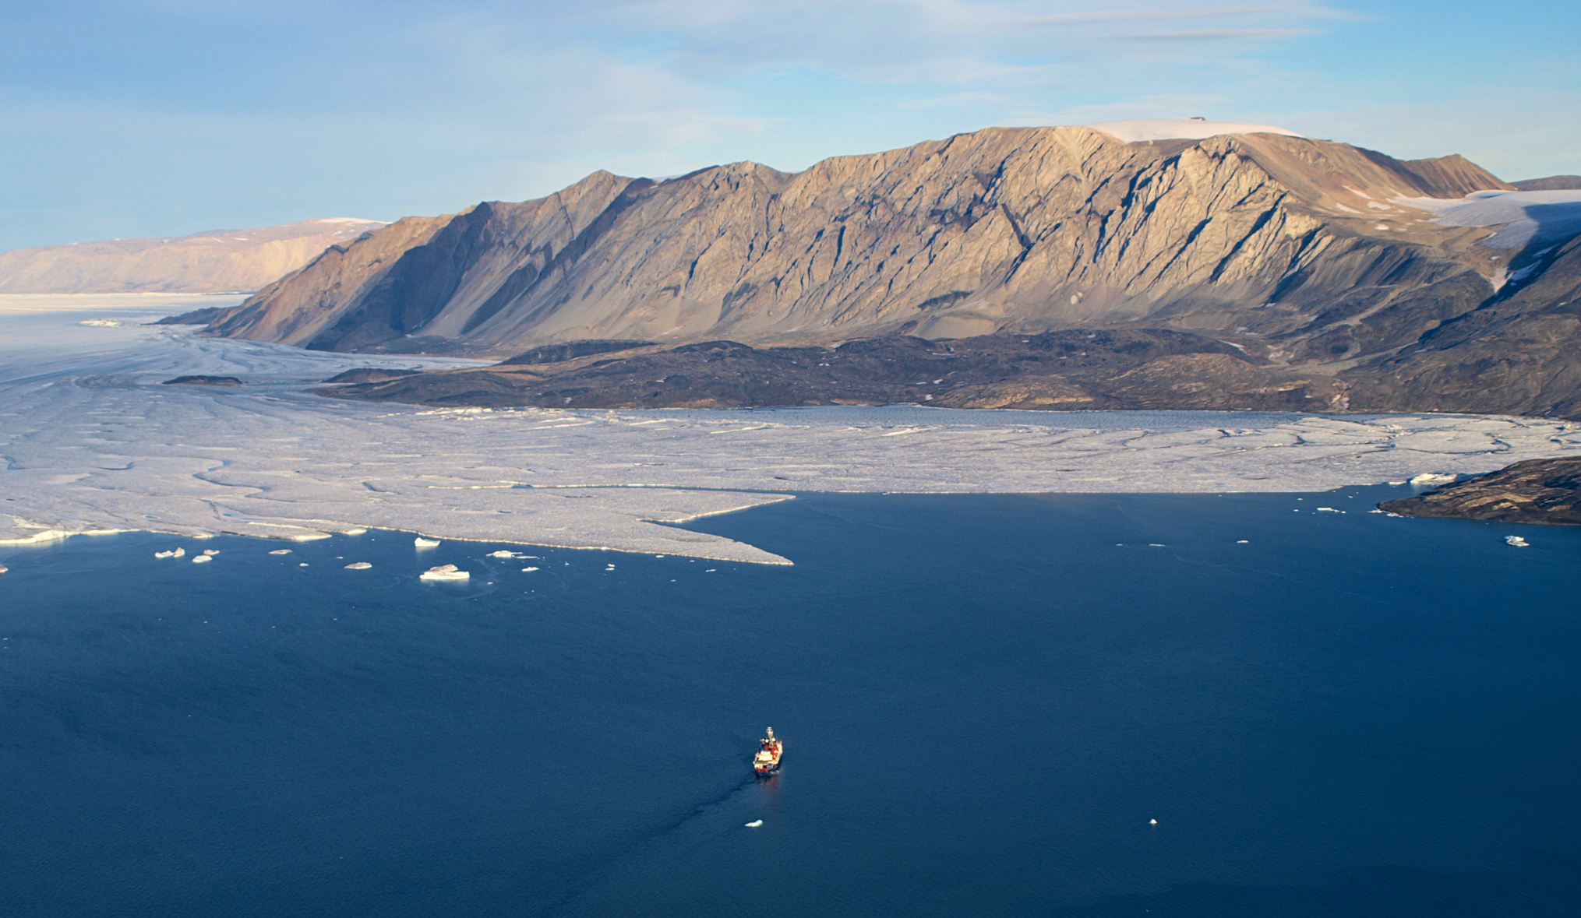

Claudia Wekerle¹, Rebecca McPherson¹, Wilken-Jon von Appen¹, Qiang Wang¹, Ralph Timmermann¹, Patrick Scholz¹, Sergey Danilov^{1,2}, Qi Shu³, Monica Ionita¹, and Torsten Kanzow^{1,4}
¹Alfred Wegener Institute, ²Constructor University, ³First Institute of Oceanography, Qingdao, ⁴University Bremen
Photo: Nat Wilson
Basal melt rate of the 79 North Glacier, Northeast Greenland, and its
connection to the Atlantic Water circulation in the Nordic Seas
FRISP 2024
June 20, 2024

