Slide 1
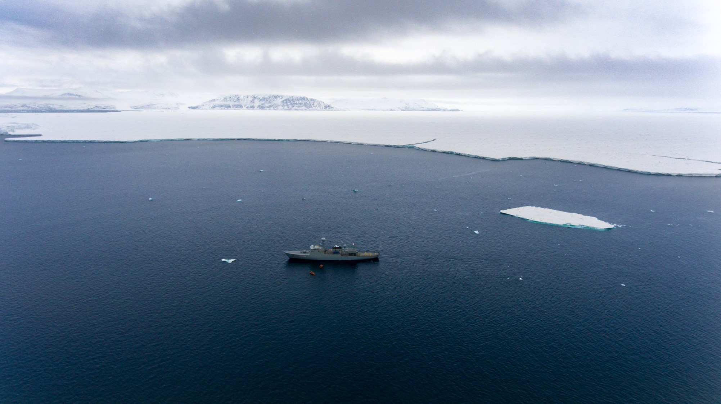
FRISP workshop
June 22, 2023
Atmosphere or ocean - What drives basal melt at Greenland's largest floating ice tongue, the 79°North Glacier?
Claudia Wekerle, Sergey Danilov, Torsten Kanzow, Rebecca McPherson, Patrick Scholz, Ralph Timmermann and Qiang Wang

