Slide 1



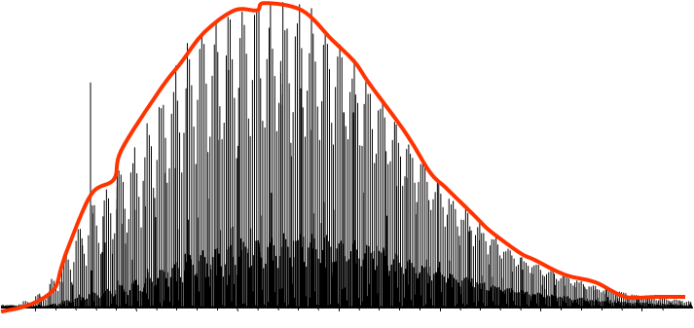
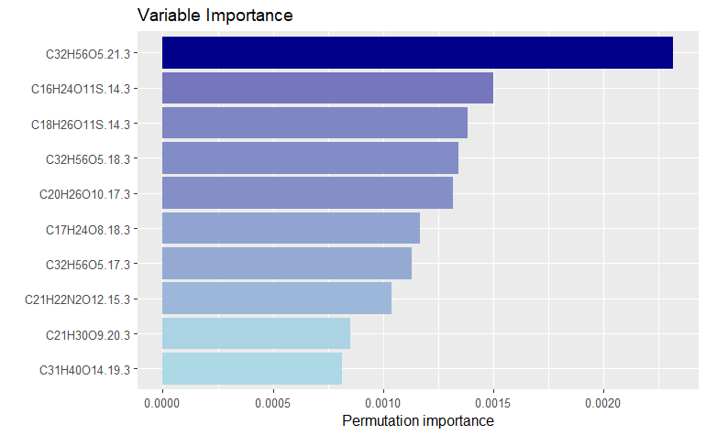

Analysis of key features in LC-FT-MS measurements of Dissolved Organic Matter
Marlo Bareth
Supervisors:
Prof. Dr. Boris P. Koch
Prof. Dr. Gabriel Zachmann
Introduction
Marine Dissolved Organic Matter (DOM) is one of the most complex mixtures on the planet. It consists of the organic compounds which are left in solution after filtering the seawater. The part of DOM in the global carbon cycle is still only partially known. Investigating the included compounds is only possible by chemical analysis. Liquid Chroma-tography Fourier-Transform Mass Spectrometry (LC-FT-MS) is very promising for this. It charges the particles and then measures the weight per charge so precise that one can determine the molecular sum formula of the molecule. The large amount of data points per sample form a barrier to the evaluation of the LCMS data. Thus, the community requires more tools for analysis and visualization.
Data set
From the MOSAiC Expedition
LC-FT-MS peak list with intensities
Preprocessed with UME package
  Molecular formulas assigned
Dimensions
  120 samples
  10 Scans per sample
  ~ 2500 molecular formulas per scan
Abundance
Timepoint
Molecular mass
= Molecular formula
1. tDOM key features
2. fDOM prediction
3. Visualization
Thesis
Problem: Some samples include terrigenous DOM from the trans-arctic drift current (originating in north Siberia), which are only broadly known. Additionally, the UltraMassExplorer (UME) package, which is used for the processing, does currently not support LCMS data.
Method: For this task, a Random Forest is well suited. As a classifier, it will be used to assign the samples to either lying inside the transpolar drift or outside (already labelled). Other, non-binary parameters will also be estimated, using an RF Regression.
As RFs support different methods of determining the Variable Importance (VI), they can be used to study the influence features have on the classification process. To support the LC-FT-MS analysis, updates will be developed for the UME package and the VI analysis will be an example application for these functions.
Problem: Even though correlations between the molecular formulas and EEMS are known, a prediction of them with LCMS data has not performed. This would allow a previously unknown precision when determining the fluorescent components.
Method: Using ML to determine which formulas contribute to the fluorescent data is a logical conclusion for the overlap of the data sets. With the LCMS data adding the retention time as a dimension, a further reduction of the responsible molecular formulas is possible. Therefore, a neural net will be constructed and trained to predict the fluorescence parameters. To reduce the number of predicted variables, the components of a PARAFAC model are being used. From this, fluorescent candidate formulas can be determined by backtracking what influenced the prediction.
If possible: Under the use of a calibration curve of substances with a known polarity, the logP value could be mapped to the retention time, limiting the candidate substances to a sum formula and a range of polarity values. Making an automated selection from a compound database (e.g. PubChem) possible.
1.
First Paper: Key features of terrestrially derived DOM coupled with the enhancement of the UME package
2.
Second Paper: Prediction of fluorescence in DOM from LCMS data
LC-FTMS data
tDOM indicator
Variable Importance
Problem: Visualization of LCMS is a difficult task. Current approaches usually reduce the dimensionality to remain manageable in real-time exploration. The available data points and the previous results face slow reaction time and overdrawing.
Method: With the previous updates to the UME package, the existing visualization will be optimized for a faster runtime. Those implemented during the previous work will also be updated and included into the UME package. Additionally, specific Visualization for LCMS will be implemented.
3.
Third Paper: Interactive visualization of the processed LCMS data and the previous results
Test run with preliminary data
New visualization for the VI results
Updates for LC-FT-MS data handling
Random Forest
Variable importance
Neural Network
Languages R and Python
Possibly Virtual Reality (Unity)
Overdrawing and efficient rendering?
Enough samples for a Neural Net?
Handling missing values?
Tools
Challenges

Slide 2
Graphics
3 Method: To avoid overdrawing, adding another dimension to the user’s interaction is a logical step. Therefore, the task will include the construction of an immersive visualization to view the LCMS raw data and the results from the previous two milestones. Special emphasis will be put on the rendering time of the built plots.
The VI analysis of the data set will be used as an example application of the planned UME update for LCMS.
Abundance
Molecular mass
= Molecular formula
LCMS data
tDOM indicator

