Slide 1


Polar SWIFT
Fast polar ozone chemistry for climate models
Ingo Wohltmann¹, Daniel Kreyling¹, Wolfgang Dorn¹, Markus Rex¹
Janice Scheffler², Ulrike Langematz²
^{1 AWI 2 FU}

Slide 2

FAST-O3: Motivation
Fast ozone chemistry for climate models
Ozone usually prescribed in climate models, since detailed calculation computationally very expensive
  e.g. in IPCC CMIP5 models
  (IPCC, 2013, section 9.1.3.2.6)
Desirable to include interactive ozone in climate models due to important ozone-climate interactions on decadal scale
  e.g. Effect of changes in polar stratospheric vortex and ozone on surface temperature trends in Antarctica
  (Thompson and Solomon, Science, 296, 895-899, 2002)
  e.g. Changes in tropospheric wave driving of the stratospheric Brewer-Dobson
  (Rex et al., GRL, 33, doi:10.1029/2006GL026731, 2006)

Slide 3
FAST-O3: Status
Development of a fast scheme for calculating stratospheric ozone chemistry and transport
  AWI SWIFT model for fast calculation of polar ozone chemistry: Development finished and validated
  Extrapolar extension of SWIFT in development (Daniel Kreyling)
  Coupling to CCM EMAC (and ocean version EMAC-O) at FU Berlin successful
  Coupling to ECHAM6 ongoing (Wolfgang Dorn)

Slide 4
FAST-O3: Status
Three choices for transport
  No transport and dynamical correction term (finished)
  Transport by the ECHAM6 GCM (Wolfgang Dorn, in development)
  Addition of the Lagrangian transport and mixing module from the ATLAS Chemistry and Transport Model in development

Slide 5
Polar SWIFT: Technical Overview
A fast model for vortex averaged polar ozone loss. Only 4 prognostic equations per altitude (vortex average). Large time step possible (1 day).
Solves system of coupled differential equations for key species:
  HNO₃ (total)
  HNO₃ (gas phase)
  HCl
  ClONO₂
  ClO_{x}
  O₃
Includes terms for the overall net effect of chemical mechanisms rather than one term for each reaction. Equations are physically justified (no Taylor expansions etc.)
Proportionality constants of the individual terms are empirical parameters trained on chemical reaction rates from a Chemistry Transport Model (ATLAS CTM) for two Arctic and two Antarctic winters
Driven by only 2 time series: FAP (fraction of vortex exposed to PSC conditions) and
FAS (fraction of vortex exposed to sunlight)

Slide 6
Polar SWIFT: Equations
Species concentrations: Vortex averages. a…z and α: Empirical parameters trained on ATLAS data.
Prognostic
d[O₃]/dt=-d[ClO_{x}]FAS Ozone depletion by ClO+ClO and ClO+BrO cycle
d[ClONO₂]/dt=b[ClO_{x}][HNO₃gas]FAS Net effect of ClONO₂ photolysis / ClO+NO₂
-a{[HCl]}[ClONO₂][HNO₃total]^{2/3}FAP Chlorine activation by HCl+ClONO₂ (heterogeneous)
-h[ClONO₂][HNO₃total]^{2/3}FAP Chlorine activation by ClONO₂+H₂O (heterogeneous)
d[HCl]/dt=c₁[ClO_{x}]FAS²/[O₃]+c₂[ClONO₂]FAS³/[O₃] Chlorine deactivation by Cl+CH₄ into HCl (SH)
+f[ClO_{x}][OH_{day}]FAS HCl formation by ClO+OH
-a{[HCl]}[ClONO₂][HNO₃total]^{2/3}FAP Chlorine activation by HCl+ClONO₂ (heterogeneous)
-l[ClO_{x}][H₂O]FAS[HCl][HNO₃total]^{2/3}FAP Chlorine activation by HOCl+HCl (heterogeneous)
-k[HCl][OH_{day}]FAS Activation by HCl+OH (gas phase)
d[HNO₃total]/dt=-e[HNO₃total]FAP_{s} Effect of denitrification
Diagnostic
[ClO_{x}]=[Cl_{y}]-[HCl]-[ClONO₂] ClO_{x} is everything not in reservoir gases
[HNO₃gas]=[HNO₃total](1-FAP_{s})+z[HNO₃total]FAP_{s} Partitioning HNO₃ (gas / clouds)
[OH_{day}]=sqrt([H₂O][NO_{day}]FAS) OH in sunlit part
[NO_{day}]=[HNO₃gas]FAS⁴/([O₃]+αFAS) NO in sunlit part

Slide 7
Polar SWIFT: Training method
Change from training on satellite data (Rex et al., 2014, mixing ratios)
to training on ATLAS Chemistry Transport Model
(reaction rates + mixing ratios, both vortex average)
Advantages:
Old approach included transport effect, new approach only chemical changes New approach allows to run model in combination with existing transport scheme
Old approach required satellite data to be available. Availability for species like ClONO₂ is limited
Very detailed look into processes possible
Disadvantage:
Fit is not based on observational data, but on model results…
…but ATLAS is validated with observations, agreement is good

Slide 8
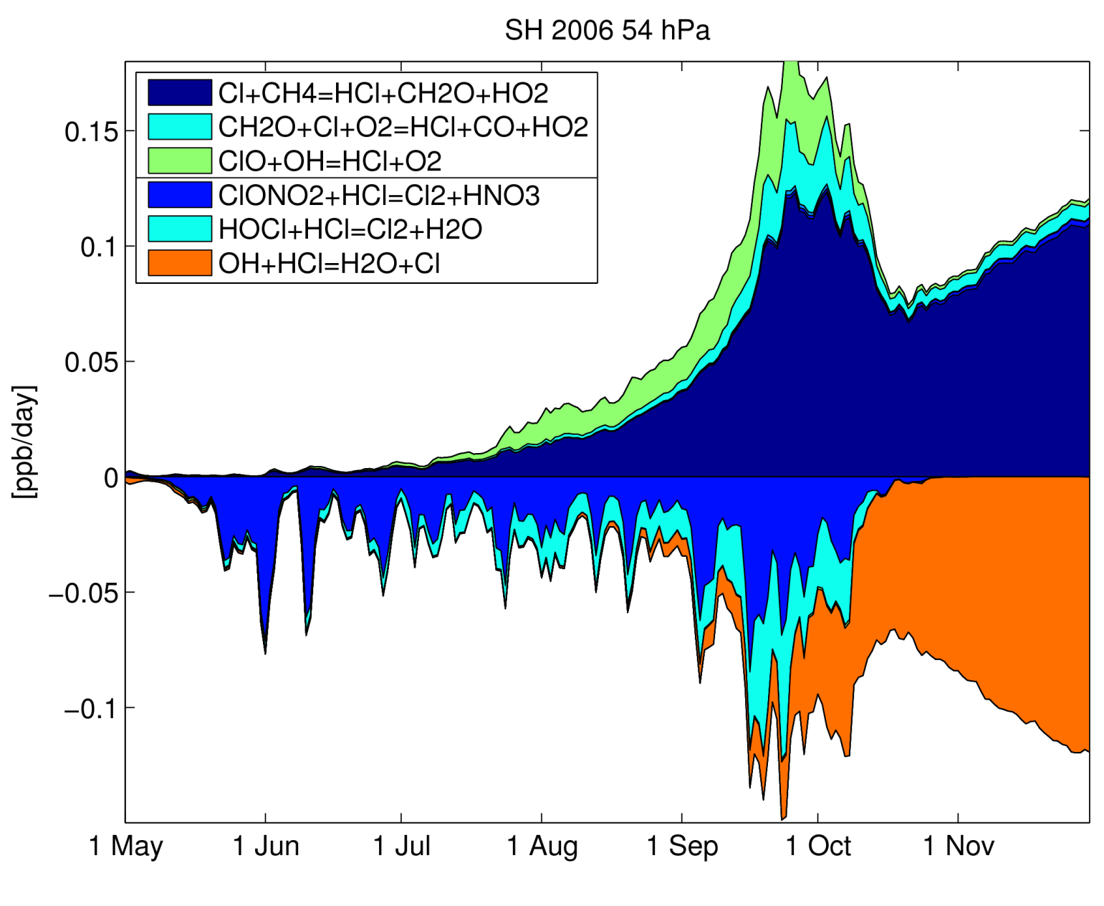
Polar SWIFT trained on ATLAS CTM:
Example: Rates of HCl reactions
Vortex averages

Slide 9
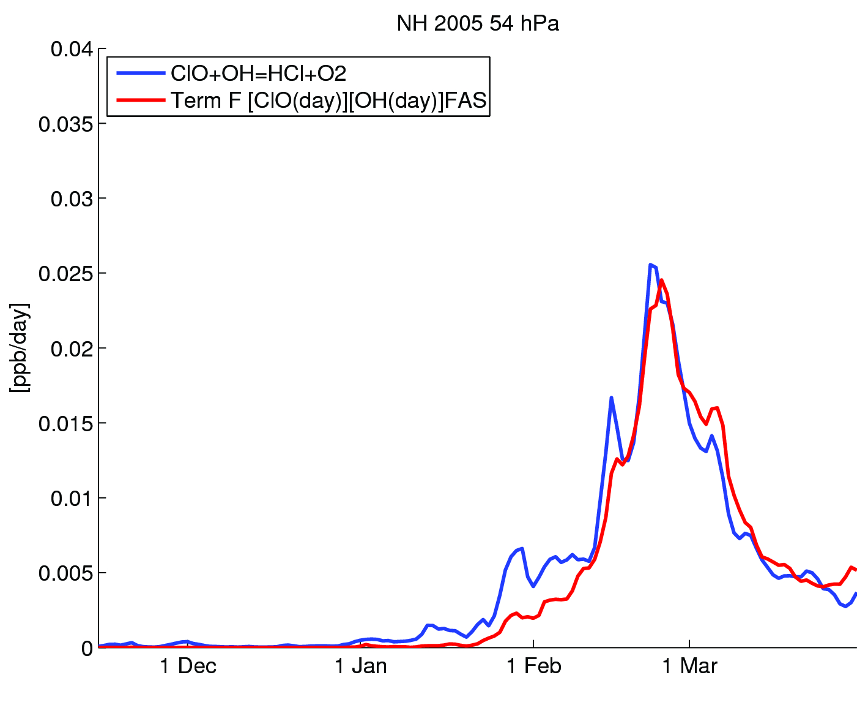
Polar SWIFT trained on ATLAS CTM:
Example training: HCl term F

Slide 10
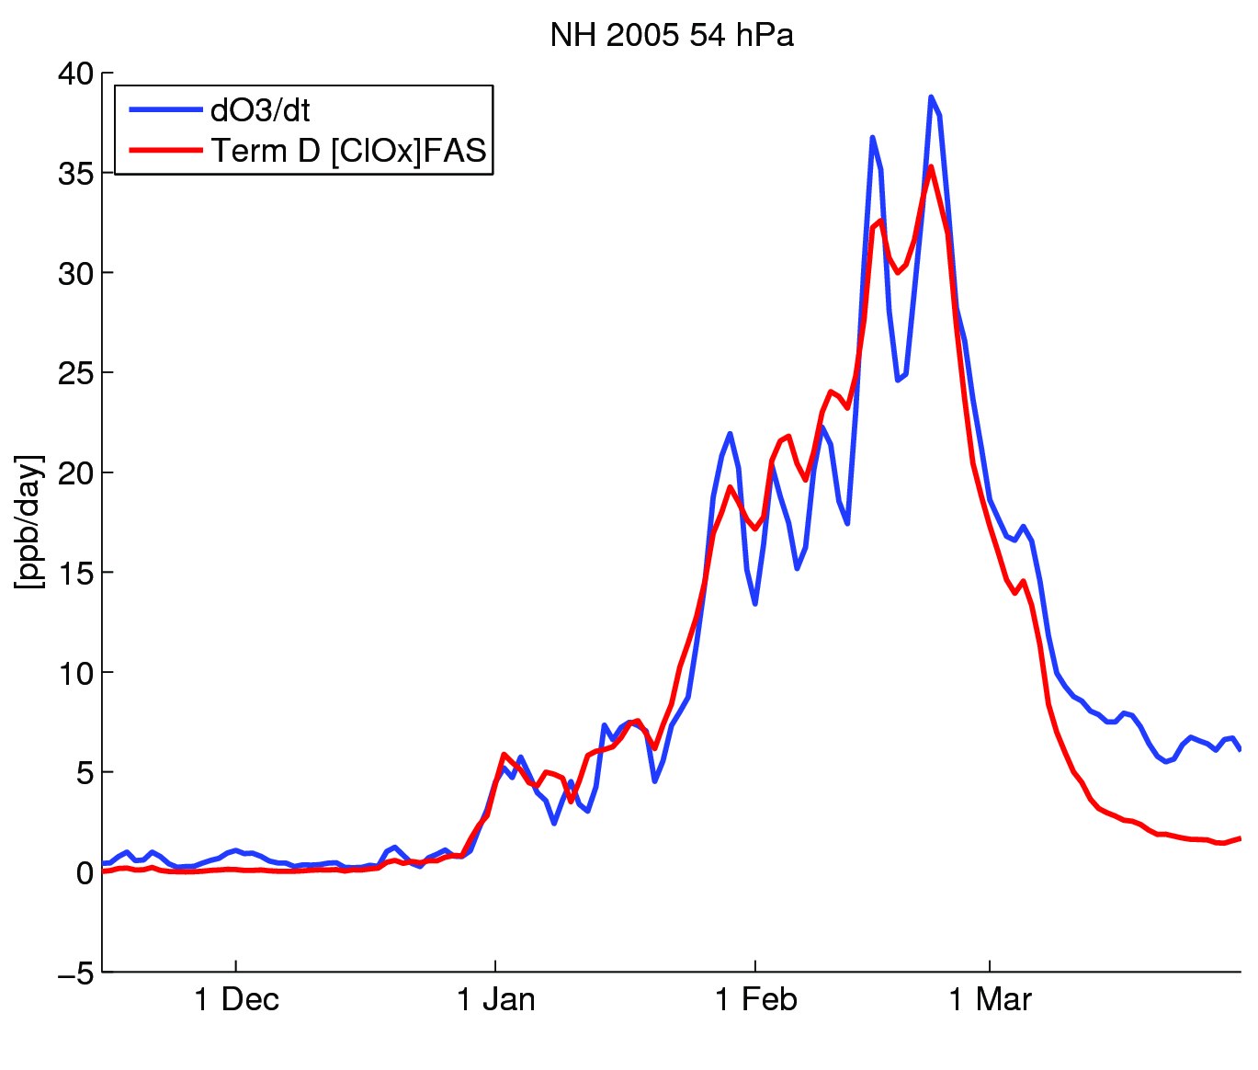
SWIFT-Polar trained on ATLAS CTM:
Example training: Ozone term

Slide 11
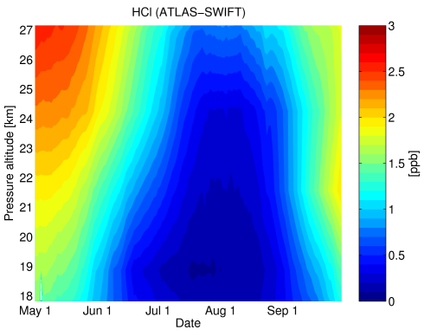
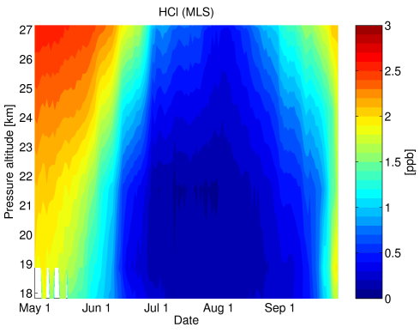
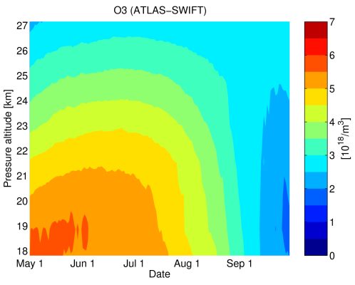
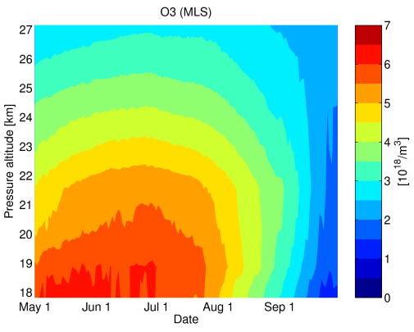
Test SWIFT as chemistry module in ATLAS CTM
Driven by ECMWF ERA Interim
Winter SH 2006 vortex means
27 km
3 ppb
HCl
Numerical Effort
Full chemistry model ATLAS-SWIFT polar
2 weeks/model year seconds/model year
48 processors 1 processor
18 km
27 km
7e18 molec/m3
Ozone
18 km
May
Oct
May
Oct
ATLAS with SWIFT
MLS satellite
Original version: Rex et al. (2014), Atmos. Chem. Phys., 14, 6545-6555
Version shown here: Wohltmann et al., in preparation

Slide 12
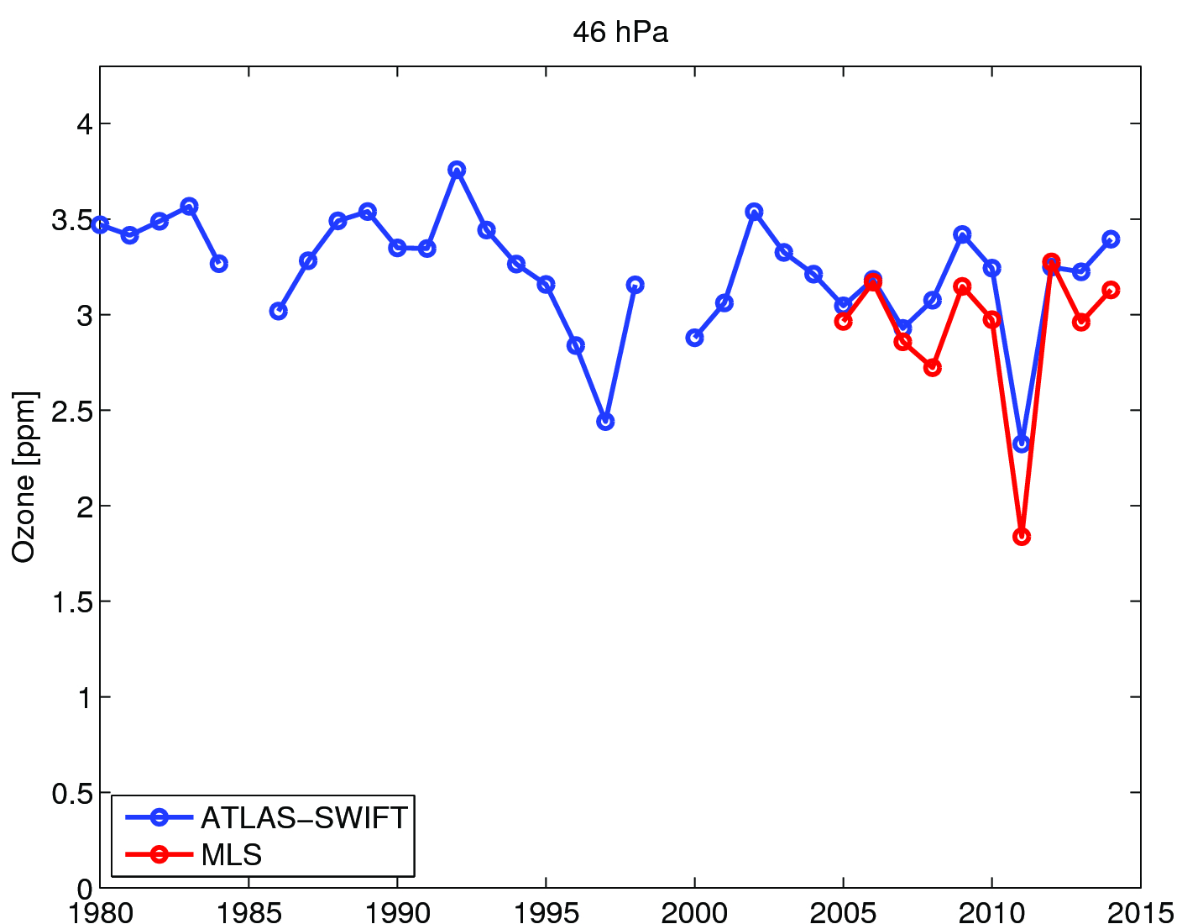
Interannual variability NH
Vortex averaged ozone shortly before vortex breakup at 46 hPa from SWIFT in ATLAS CTM

Slide 13
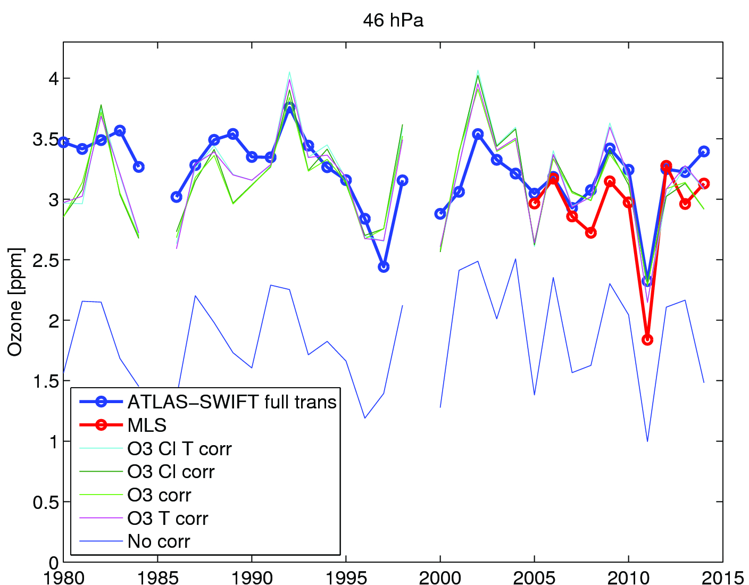
Dynamical correction term NH
Dynamical correction by adding a simple term to ozone at each time step

Slide 14
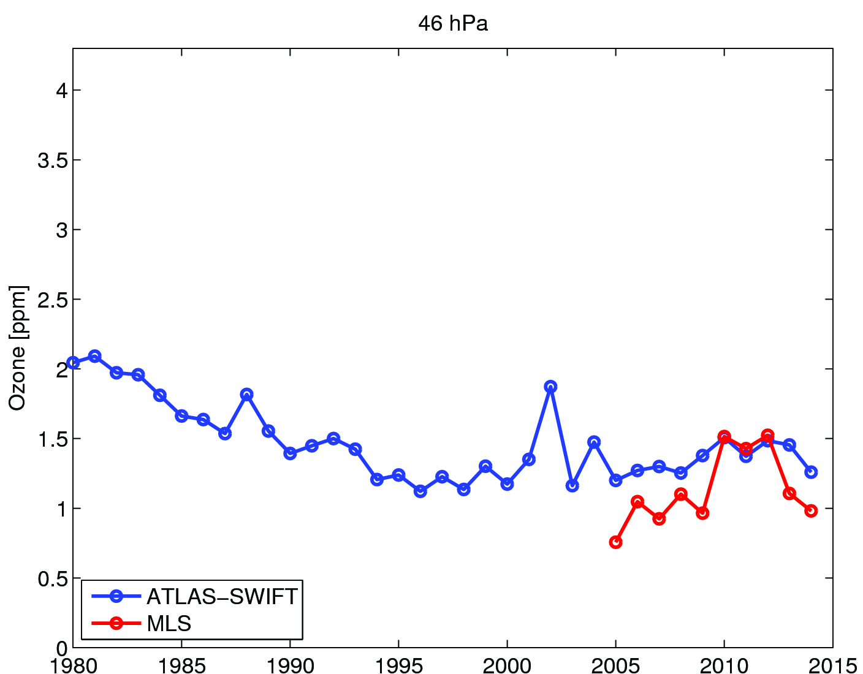
Interannual variability SH
Vortex averaged ozone 1 October at 46 hPa from SWIFT in ATLAS CTM

Slide 15
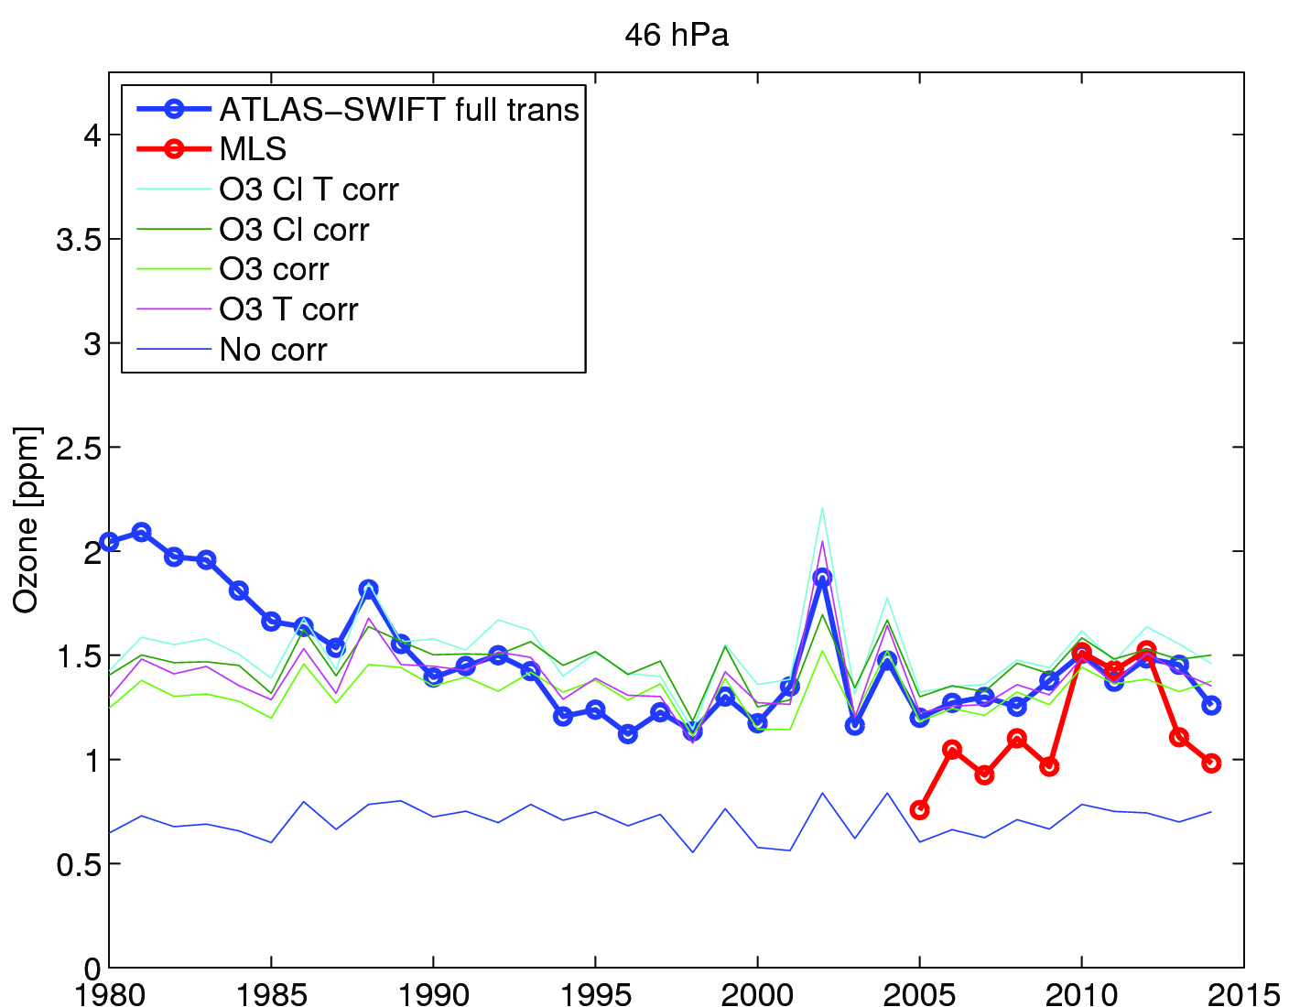
Dynamical correction term SH
(note: full run with changing Cly, other runs without changing Cly)

